Slide 1
Standards of medical care in diabetes
2018 ADA GUIDELINES
Dr. Sanjana Bhagwat
Moderator : Dr. S. Jotkar

Slide 2
Diabetes is a complex, chronic illness requiring continuous medical care with multifactorial risk-reduction strategies beyond glycemic control.
Ongoing patient self-management, education and support are critical for preventing acute complications and reducing the risk of long-term complications.
The American Diabetes Association’s (ADA’s) “Standards of Medical Care in Diabetes,” is intended to provide clinicians, patients, researchers, payers, and other interested individuals with the components of diabetes care, general treatment goals, and tools to evaluate the quality of care.

Slide 3
CLASSIFICATION AND DIAGNOSIS OF DIABETES
Type 1 diabetes
2. Type 2 diabetes
3. Gestational diabetes mellitus (GDM)
4. Specific types of diabetes due to other causes,
e.g., monogenic diabetes syndromes (such as neonatal diabetes and maturity-onset diabetes of the young [MODY]), diseases of the exocrine pancreas (such as cystic fibrosis and pancreatitis), and drug- or chemical-induced diabetes (such as with glucocorticoid use, in the treatment of HIV/AIDS, or after organ transplantation)

Slide 5
Recommendations for HbA1C:
To avoid misdiagnosis or missed diagnosis, the A1C test should be performed using a method that is certified by the NGSP and standardized to the Diabetes Control and Complications Trial (DCCT) assay.
Marked discordance between measured A1C and plasma glucose levels - A1C assay interference due to hemoglobin variants (i.e., hemoglobinopathies) consider alternative test.
In conditions associated with increased red blood cell turnover, only plasma blood glucose criteria should be used to diagnose diabetes.

Slide 6
Confirming the diagnosis:
Unless there is a clear clinical diagnosis (e.g., patient in a hyperglycemic crisis or with classic symptoms of hyperglycemia and a random plasma glucose >200 mg/dL), a second test is required for confirmation.
Same test is to be repeated or a different test be performed without delay using a new blood sample for confirmation.
For example, if the A1C is 7.0% and a repeat result is 6.8% , the diagnosis of diabetes is confirmed.
If two different tests (such as A1C and FPG) are both above the diagnostic threshold, this also confirms the diagnosis.

Slide 7
On the other hand, if a patient has discordant results from two different tests, then the test result that is above the diagnostic cut point should be repeated, with consideration of the possibility of A1C assay interference.
The diagnosis is made on the basis of the confirmed test.
For example, if a patient meets the diabetes criterion of the A1C (two results >6.5%) but not FPG (126 mg/dL), that person should nevertheless be considered to have diabetes.

Slide 8
If patients have test results near the margins of the diagnostic threshold, the health care professional should follow the patient closely and repeat the test in 3–6 months.

Slide 9
CATEGORIES OF INCREASED RISK FOR DIABETES (PREDIABETES)
Recommendations
Testing for prediabetes and risk for future diabetes in asymptomatic people should be considered in adults of any age who are over-weight or obese (BMI >25 kg/m² or >23 kg/m² in Asian Americans) and who have one or more additional risk factors for diabetes.
For all people, testing should begin at age 45 years.
If tests are normal, repeat testing carried out at a minimum of 3-year intervals is reasonable.

Slide 10
To test for prediabetes, fasting plasma glucose, 2-h plasma glucose during 75-g oral glucose tolerance test, and A1C are equally appropriate.
In patients with prediabetes, identify and, if appropriate, treat other cardiovascular disease risk factors.
Testing for prediabetes should be considered in children and adolescents who are overweight or obese (BMI >85th percentile for age and sex, weight and height >85th percentile or weight >120% of ideal for height) and who have additional risk factors for diabetes.

Slide 11
PRE-DIABETES
Prediabetes is the term used for individuals whose glucose levels do not meet the criteria for diabetes but are too high to be considered normal.

Slide 12
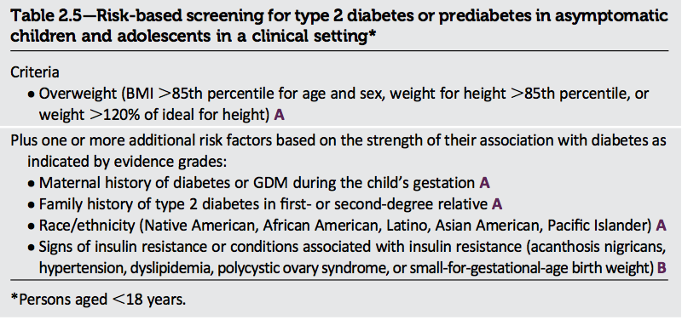

Slide 13
Assesment of comorbidities

Slide 14
Referrals for initial care management
Eye care professional for annual dilated eye exam
Family planning for women of reproductive age
Registered dietitian for MNT (medical Nutrition Therapy)
DSMES (Diabetes self-management Education and Support)
Dentist for comprehensive dental and periodontal examination
Mental health professional, if indicated

Slide 15
Other recommendations :
Consider screening patients with type 1 diabetes for autoimmune thyroid disease and celiac disease soon after diagnosis.
Pancreatitis :
Islet autotransplantation should be considered for patients requiring total pancreatectomy for medically refractory chronic pancreatitis to prevent postsurgical diabetes.
HIV
Patients with HIV should be screened for diabetes and prediabetes with a fasting glucose level every 6–12 months before starting antiretroviral therapy and 3 months after starting or changing drug regimen.

Slide 16
Prevention or Delay of Type 2 Diabetes:
PHARMACOLOGIC INTERVENTIONS
Metformin therapy for prevention of type 2 diabetes should be considered in those with pre-diabetes, especially for those with BMI >35 kg/m², those aged ,60 years, and women with prior gestational diabetes mellitus.
Long-term use of metformin may be associated with biochemical vitamin B12 deficiency, and periodic measurement of vitamin B12 levels should be considered in metformin-treated patients, especially in those with anemia or peripheral neuropathy.
PREVENTION OF CARDIOVASCULAR DISEASE
Screening for and treatment of modifiable risk factors for cardio- vascular disease is suggested for those with pre-diabetes.

Slide 17
ASSESSMENT OF GLYCEMIC CONTROL
Most patients using intensive insulin regimens (multiple-dose insulin or insulin pump therapy) should perform self-monitoring of blood glucose (SMBG) prior to meals and snacks, at bedtime, occasionally postprandially, prior to exercise, when they suspect low blood glucose, after treating low blood glucose until they are normoglycemic, and prior to critical tasks such as driving.
When prescribed as part of a broad educational program, SMBG may help to guide treatment decisions and/or self-management for patients taking less frequent insulin injections or noninsulin therapies.
When prescribing SMBG, ensure that patients receive ongoing instruction and regular evaluation of SMBG technique, SMBG results, and their ability to use SMBG data to adjust therapy.
When used properly, continuous glucose monitoring (CGM) in conjunction with intensive insulin regimens is a useful tool to lower A1C in adults with type 1 diabetes who are not meeting glycemic targets.

Slide 18
CGM may be a useful tool in those with hypoglycemia unawareness and/or frequent hypoglycemic episodes.
Given the variable adherence to CGM, assess individual readiness for continuing CGM use prior to prescribing.
When prescribing CGM, robust diabetes education, training, and support are required for optimal CGM implementation and ongoing use.
People who have been successfully using CGM should have continued access after they turn 65 years of age.
A1C TESTING
Perform the A1C test at least two times a year in patients who are meeting treatment goals (and who have stable glycemic control).
Perform the A1C test quarterly in patients whose therapy has changed or who are not meeting glycemic goals.
Point-of-care testing for A1C provides the opportunity for more timely treatment changes.

Slide 19
A reasonable A1C goal for many non-pregnant adults is <7%
Providers might suggest more stringent A1C goals (such as <6.5%) for selected individual patients if this can be achieved without significant hypoglycemia or other adverse effects of treatment. Appropriate patients might include those with short duration of diabetes, type 2 diabetes treated with lifestyle or metformin only, long life expectancy, or no significant cardiovascular disease.
Less stringent A1C goals (such as <8%) may be appropriate for patients with a history of severe hypoglycemia, limited life expectancy, advanced microvascular or macrovascular complications, extensive comorbid conditions, or long-standing diabetes in whom the goal is difficult to achieve despite diabetes self-management education, appropriate glucose monitoring, and effective doses of multiple glucose-lowering agents including insulin.

Slide 20
Pharmacologic Approaches to Glycemic Treatment

Slide 21
Most people with type 1 diabetes should be treated with multiple daily injections of prandial insulin and basal insulin or continuous subcutaneous insulin infusion.
Most individuals with type 1 diabetes should use rapid-acting insulin analogs to reduce hypoglycemia risk.
Consider educating individuals with type 1 diabetes on matching prandial insulin doses to carbohydrate intake, premeal blood glucose levels, and anticipated physical activity.
Individuals with type 1 diabetes who have been successfully using continuous subcutaneous insulin infusion should have continued access to this therapy after they turn 65 years of age.

Slide 22
Type 2 diabetes :
Metformin, if not contraindicated and if tolerated, is the preferred initial pharmacologic agent for the treatment of type 2 diabetes.
Long-term use of metformin may be associated with biochemical vitamin B12 deficiency, and periodic measurement of vitamin B12 levels should be considered in metformin-treated patients, especially in those with anemia or peripheral neuropathy.
Consider initiating insulin therapy (with or without additional agents) in patients with newly diagnosed type 2 diabetes who are symptomatic and/or have A1C >10% and/or blood glucose levels >300 mg/dL
Consider initiating dual therapy in patients with newly diagnosed type 2 diabetes who have A1C >9%

Slide 23
In patients without atherosclerotic cardiovascular disease, if monotherapy or dual therapy does not achieve or maintain the A1C goal over 3 months, add an additional antihyperglycemic.
A patient-centered approach should be used to guide the choice of pharmacologic agents
Continuous reevaluation of the medication regimen and adjustment as needed to incorporate patient factors and regimen complexity is recommended.
For patients with type 2 diabetes who are not achieving glycemic goals, drug intensification, including consideration of insulin therapy, should not be delayed.
Metformin should be continued when used in combination with other agents, including insulin, if not contraindicated and if tolerated.

Slide 24
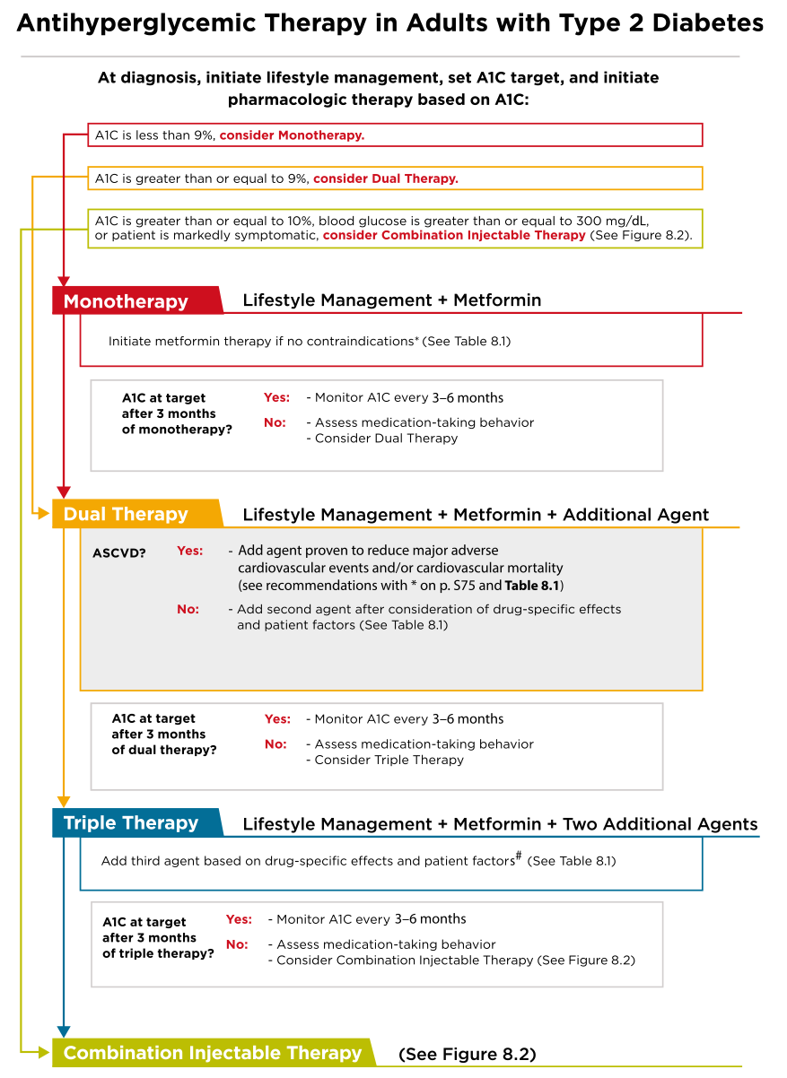

Slide 25
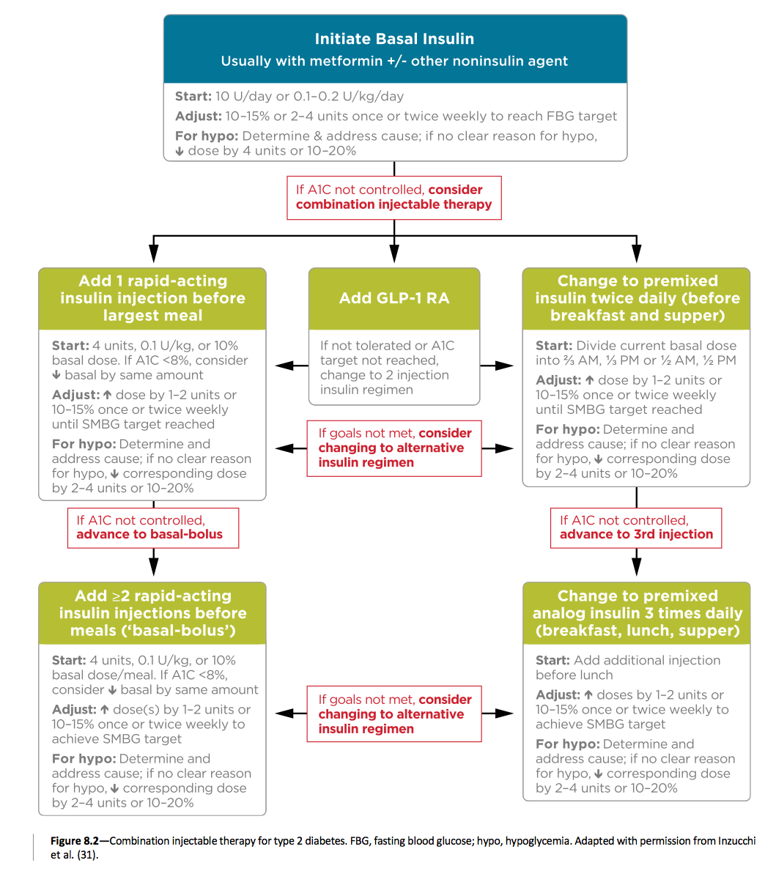

Slide 26
Cardiovascular Disease and Risk Management:
Screening and Diagnosis
Blood pressure should be measured at every routine clinical visit. Patients found to have elevated blood pressure (>140/90) should have blood pressure confirmed using multiple readings, including measurments on a separate day, to diagnose hypertension.
All hypertensive patients with diabetes should monitor their blood pressure at home.

Slide 27
Treatment Goals :
Most patients with diabetes and hypertension should be treated to a systolic blood pressure goal of ,140 mmHg and a diastolic blood pressure goal of ,90 mmHg.
Lower systolic and diastolic blood pressure targets, such as 130/80 mmHg, may be appropriate for individuals at high risk of cardiovascular disease, if they can be achieved without undue treatment burden.
In pregnant patients with diabetes and preexisting hypertension who are treated with antihypertensive therapy, blood pressure targets of 120–160/80–105 mmHg are suggested in the interest of optimizing long-term maternal health and minimizing impaired fetal growth.
Lifestyle Intervention
For patients with blood pressure >120/80 mmHg, lifestyle intervention consists of weight loss if overweight or obese;
Dietary Approaches to Stop Hypertension– style dietary pattern including reducing sodium and increasing potassium intake; moderation of alcohol intake; and increased physical activity.

Slide 28
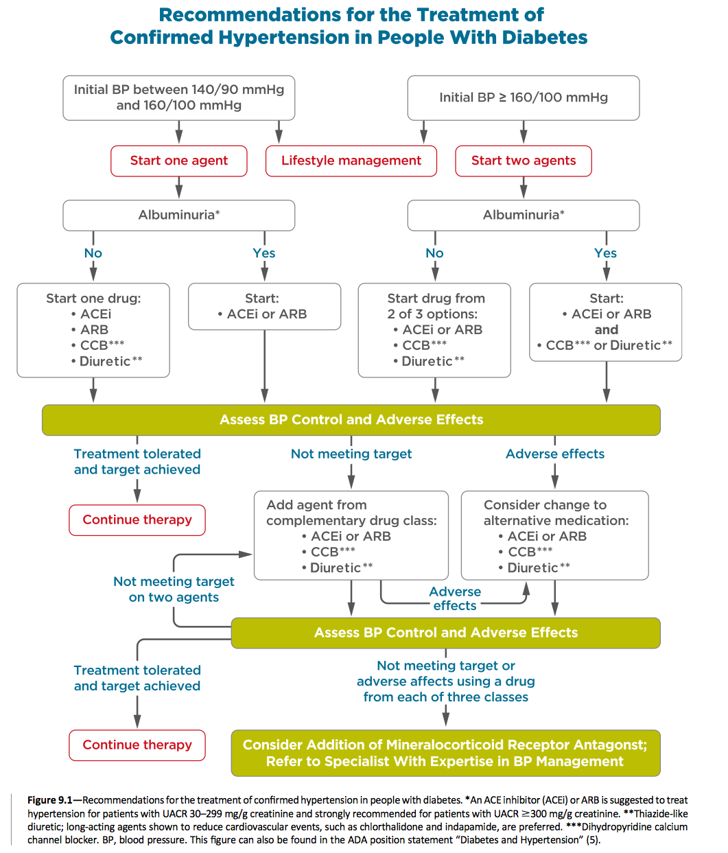

Slide 29
Patients with confirmed office-based blood pressure >140/90 mmHg:
lifestyle therapy, and initiation and timely titration of pharmacologic therapy
Patients with confirmed office-based blood pressure >160/100 mmHg: lifestyle therapy and initiation and timely titration of two drugs or a single-pill combination of drugs demonstrated to reduce cardiovascular events in patients with diabetes. (ACE inhibitors, angiotensin receptor blockers, thiazide- like diuretics, or dihydropyridine calcium channel blockers).
Multiple-drug therapy is generally required to achieve blood pressure targets. However, combinations of ACE inhibitors and angiotensin receptor blockers and combinations of ACE inhibitors or angiotensin receptor blockers with direct renin inhibitors should not be used.
An ACE inhibitor or angiotensin receptor blocker, at the maximum tolerated dose indicated for blood pressure treatment, is the recommended first-line treatment for hypertension in patients with diabetes and urinary albumin-to-creatinine ratio >300 mg/g creatinine or 30–299 mg/g creatinine. If one class is not tolerated, the other should be substituted.
For patients treated with an ACE inhibitor, angiotensin receptor blocker, or diuretic, serum creatinine/estimated glomerular filtration rate and serum potassium levels should be monitored at least annually.

Slide 30
Resistant Hypertension
Patients with hypertension who are not meeting blood pressure targets on three classes of antihypertensive medications (including a diuretic) should be considered for mineralocorticoid receptor antagonist therapy.

Slide 31
LIPID MANAGEMENT
Lifestyle modification focusing on weight loss (if indicated); the reduction of saturated fat, trans fat, and cholesterol intake; increase of dietary n-3 fatty acids, viscous fiber, and plant stanols/sterols intake; and increased physical activity should be recommended to improve the lipid profile in patients with diabetes.
Intensify lifestyle therapy and optimize glycemic control for patients with elevated triglyceride levels (>50 mg/dL ) and/ or low HDL cholesterol (<40 mg/dL for men, <50 mg/dL for women).

Slide 32
Ongoing Therapy and Monitoring With Lipid Panel
Recommendations
In adults not taking statins or other lipid-lowering therapy, it is reasonable to obtain a lipid profile at the time of diabetes diagnosis, at an initial medical evaluation, and every 5 years thereafter if under the age of 40 years, or more frequently if indicated.
Obtain a lipid profile at initiation of statins or other lipid-lowering therapy, 4–12 weeks after initiation or a change in dose, and annually thereafter as it may help to monitor the response to therapy and inform adherence.

Slide 33
Statin Treatment
For patients of all ages with diabetes and atherosclerotic cardiovascular disease, high-intensity statin therapy should be added to lifestyle therapy.
For patients with diabetes aged ,40 years with additional atherosclerotic cardiovascular disease risk factors, the patient and provider should consider using moderate- intensity statin in addition to lifestyle therapy.
For patients with diabetes aged 40– 75 years and >75 years without atherosclerotic cardiovascular disease, use moderate-intensity statin in addition to lifestyle therapy.
In clinical practice, providers may need to adjust the intensity of statin therapy based on individual patient response to medication (e.g., side effects, tolerability, LDL cholesterol levels, or percent LDL reduction on statin therapy).
For patients who do not tolerate the intended intensity of statin, the maximally tolerated statin dose should be used.

Slide 34
For patients with diabetes and atherosclerotic cardiovascular disease, if LDL cholesterol is >70 mg/dL on maximally tolerated statin dose, consider adding additional LDL- lowering therapy (such as ezetimibe or PCSK9 inhibitor) after evaluating the potential for further atherosclerotic cardiovascular disease risk reduction, drug-specific ad- verse effects, and patient preferences.
Ezetimibe may be preferred due to lower cost.
Statin therapy is contraindicated in pregnancy.

Slide 35
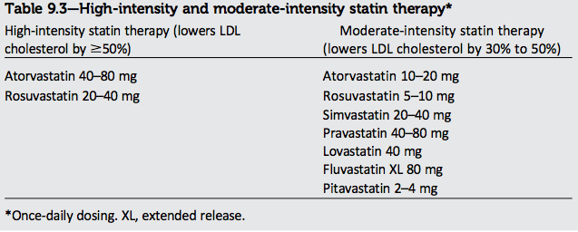

Slide 36
ANTIPLATELET AGENTS
Use aspirin therapy (75–162 mg/day) as a secondary prevention strategy in those with diabetes and a history of atherosclerotic cardiovascular disease.
For patients with atherosclerotic cardiovascular disease and documented aspirin allergy, clopidogrel (75 mg/day) should be used.
Dual antiplatelet therapy for a year after an acute coronary syndrome and may have benefits beyond this period.
Aspirin therapy (75–162 mg/day) for primary prevention strategy in those with type 1 or type 2 diabetes who are at increased cardiovascular risk. This includes most men and women with diabetes aged >50 years who have at least one additional major risk factor (family history of premature atherosclerotic cardiovascular disease, hypertension, dyslipidemia, smoking, or albuminuria) and are not at increased risk of bleeding.

Slide 37
CORONARY HEART DISEASE
Screening
In asymptomatic patients, routine screening for coronary artery disease is not recommended as it does not improve outcomes as long as atherosclerotic cardiovascular disease risk factors are treated.
Consider investigations for coronary artery disease in the presence of any of the following: atypical cardiac symptoms (e.g., unexplained dyspnea, chest discomfort); signs or symptoms of associated vascular disease including carotid bruits, transient ischemic attack, stroke, claudication, or peripheral arterial disease; or ECG abnormalities (e.g., Q waves).
Treatment
In patients with known atherosclerotic cardiovascular disease, con- sider ACE inhibitor or angiotensin receptor blocker therapy to reduce the risk of cardiovascular events.
In patients with prior myocardial infarction, b-blockers should be continued for at least 2 years after the event.
In patients with type 2 diabetes with stable congestive heart failure, metformin may be used if estimated glomerular filtration rate remains >30 mL/min but should be avoided in unstable or hospitalized patients with congestive heart failure.

Slide 38
In patients with type 2 diabetes and established atherosclerotic cardiovascular disease, antihyperglycemic therapy should begin with lifestyle management and metformin and subsequently incorporate an agent proven to reduce major adverse cardiovascular events and cardiovascular mortality (currently empagliflozin and liraglutide),
In patients with type 2 diabetes and established atherosclerotic cardiovascular disease, after lifestyle management and metformin, the antihyperglycemic agent canagliflozin may be considered to reduce major adverse cardiovascular events,

Slide 39
Microvascular Complications
DIABETIC KIDNEY DISEASE
Screening
At least once a year, assess urinary albumin (e.g., spot urinary albumin–to–creatinine ratio) and estimated glomerular filtration rate in patients with type 1 diabetes with duration of>5 years, in all patients with type 2 diabetes, and in all patients with comorbid hypertension.
Treatment
Optimize glucose control to reduce the risk or slow the progression of diabetic kidney disease.
Optimize blood pressure control to reduce the risk or slow the progression of diabetic kidney disease.
For people with nondialysis-dependent diabetic kidney disease, dietary protein intake should be approximately 0.8 g/kg body weight per day (the recommended daily allowance).
For patients on dialysis, higher levels of dietary protein intake should be considered.

Slide 40
In nonpregnant patients with diabetes and hypertension, either an ACE inhibitor or an angiotensin receptor blocker is recommended for those with modestly elevated urinary albumin–to–creatinine ratio (30–299 mg/g creatinine) and is strongly recommended for those with urinary albumin–to– creatinine ratio >300 mg/g creatinine and/or estimated GFR,60 mL/min/1.73 m²
Periodically monitor serum creatinine and potassium levels for the development of increased creatinine or changes in potassium when ACE inhibitors, angiotensin receptor blockers, or diuretics are used.
Continued monitoring of urinary albumin–to–creatinine ratio in patients with albuminuria treated with an ACE inhibitor or an angiotensin receptor blocker is reasonable to assess the response to treatment and progression of diabetic kidney disease

Slide 41
An ACE inhibitor or an angiotensin receptor blocker is not recommended for the primary prevention of diabetic kidney disease in patients with diabetes who have normal blood pressure, normal urinary albumin–to–creatinine ratio (>30 mg/g creatinine), and normal estimated glomerular filtration rate.
When estimated glomerular filtration rate is >60 mL/min/1.73 m2, evaluate and manage potential complications of chronic kidney disease.
Patients should be referred for evaluation for renal replacement treatment if they have an estimated glomerular filtration rate ,30 mL/min/1.73 m²
Promptly refer to a physician experienced in the care of kidney disease for uncertainty about the etiology of kidney disease, difficult management issues, and rapidly progressing kidney disease.

Slide 42
DIABETIC RETINOPATHY
Recommendations
Optimize glycemic control to reduce the risk or slow the progression of diabetic retinopathy.
Optimize blood pressure and serum lipid control to reduce the risk or slow the progression of diabetic retinopathy.
Screening
Adults with type 1 diabetes should have an initial dilated and comprehensive eye examination by an ophthalmologist or optometrist within 5 years after the onset of diabetes.
Patients with type 2 diabetes should have an initial dilated and comprehensive eye examination by an ophthalmologist or optometrist at the time of the diabetes diagnosis.

Slide 43
there is no evidence of retinopathy for one or more annual eye exam and glycemia is well controlled, then exams every 1–2 years may be considered.
If any level of diabetic retinopathy is present, subsequent dilated retinal examinations should be repeated at least annually by an ophthalmologist or optometrist. If retinopathy is progressing or sight-threatening, then examinations will be required more frequently.
While retinal photography may serve as a screening tool for retinopathy, it is not a substitute for a comprehensive eye exam.
Women with preexisting type 1 or type 2 diabetes who are planning pregnancy or who are pregnant should be counseled on the risk of development and/or progression of diabetic retinopathy.

Slide 44
Treatment
Promptly refer patients with any level of macular edema, severe nonproliferative diabetic retinopathy, or any proliferative diabetic retinopathy to an ophthalmologist
The traditional standard treatment, panretinal laser photocoagulation therapy, is indicated to reduce the risk of vision loss in patients with high-risk proliferative diabetic retinopathy and, in some cases, severe non- proliferative diabetic retinopathy.
Intravitreous injections of anti– vascular endothelial growth factor ranibizumab are not inferior to traditional panretinal laser photocoagulation and are also indicated to reduce the risk of vision loss in patients with proliferative diabetic retinopathy.
Intravitreous injections of anti– vascular endothelial growth factor are indicated for central-involved diabetic macular edema, which occurs beneath the foveal centre and may threaten reading vision.
The presence of retinopathy is not a contraindication to aspirin therapy for cardioprotection, as aspirin does not increase the risk of retinal hemorrhage.

Slide 45
NEUROPATHY
Screening
All patients should be assessed for diabetic peripheral neuropathy starting at diagnosis of type 2 diabetes and 5 years after the diagnosis of type 1 diabetes and at least annually thereafter.
Assessment for distal symmetric polyneuropathy should include a careful history and assessment of either temperature or pinprick sensation (small- fiber function) and vibration sensation using a 128-Hz tuning fork (for large- fiber function). All patients should have annual 10-g monofilament testing to identify feet at risk for ulceration and amputation.
Symptoms and signs of autonomic neuropathy should be assessed in patients with microvascular complications.

Slide 46
Treatment
Optimize glucose control to prevent or delay the development of neuropathy in patients with type 1 diabetes A and to slow the progression of neuropathy in patients with type 2 diabetes.
Assess and treat patients to reduce pain related to diabetic peripheral neuropathy B and symptoms of autonomic neuropathy and to improve quality of life.
Either pregabalin or duloxetine are recommended as initial pharmacologic treatments for neuropathic pain in diabetes.

Slide 47
Diabetes Care in the Hospital
Perform an A1C on all patients with diabetes or hyperglycemia (blood glucose >140 mg/dL) admitted to the hospital if not performed in the prior 3 months.
GLYCEMIC TARGETS IN HOSPITALIZED PATIENTS :
Insulin therapy should be initiated for treatment of persistent hyperglycemia starting at a threshold >180 mg/dL. Once insulin therapy is started, a target glucose range of 140–180 mg/dL is recommended for the majority of critically ill patients and noncritically ill patients.
More stringent goals, such as 110– 140 mg/dL, may be appropriate for selected patients, if this can be achieved without significant hypoglycemia.

Slide 48
ANTIHYPERGLYCEMIC AGENTS IN HOSPITALIZED PATIENTS
A basal plus bolus correction insulin regimen, with the addition of nutritional insulin in patients who have good nutritional intake, is the preferred treatment for noncritically ill patients.
Sole use of sliding scale insulin in the inpatient hospital setting is strongly discouraged.

Slide 49
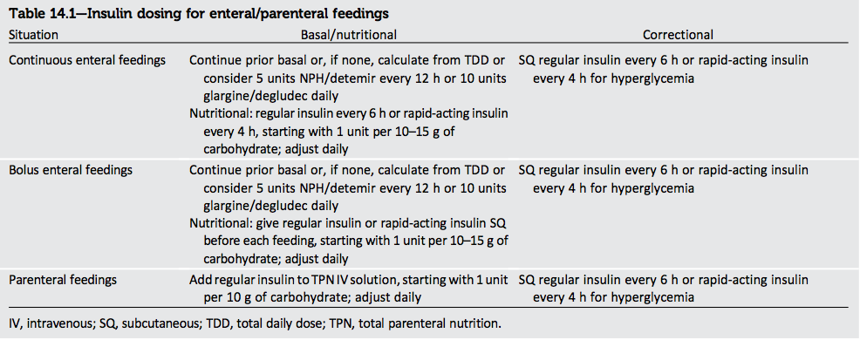

Slide 50
Thank you

