Slide 1
Arrythmias
- Dr. Isha Bansal
Moderator: Dr. Shaliendra Mane Sir

Slide 2
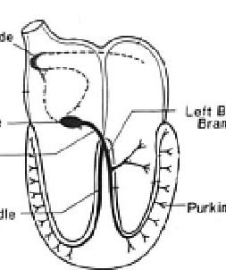
Normal Impulse Conduction
Sinoatrial node
AV node
Bundle of His
Bundle Branches
Purkinje fibers

Slide 3
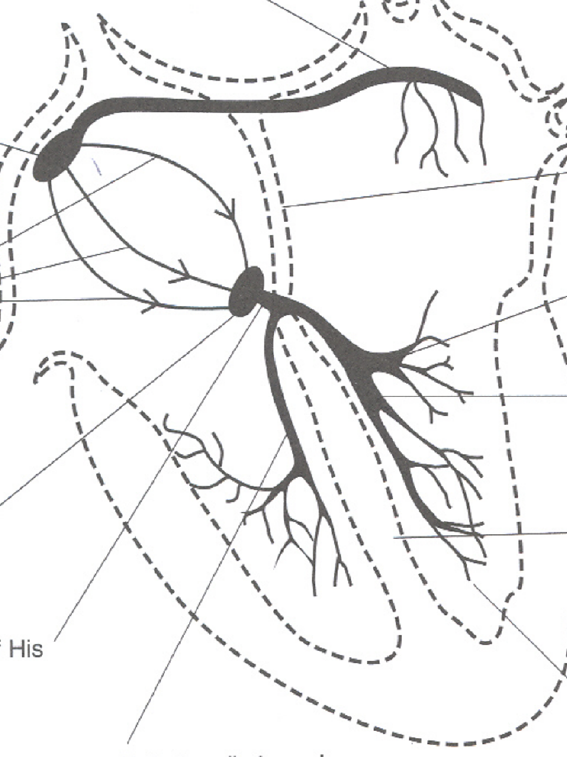
Brady-arrythmias
Heart rate <60

Slide 4
Classification
SA Block/Exit Block
1st Degree AV Bock
2nd Degree AV Block
3rd Degree AV Block
Bifasicular/Trifasicular block

Slide 5
EXIT BLOCK
Transient block of impulses from the SA node
No P wave, QRS Complex,
It is usually irregular, if regular then often confused
with Sinus Bradycardia.

Slide 6
Types of SA BLOCK
First-degree SA Block: It is always concealed. Can be seen in EPS
Second-degree SA Block:

Slide 7
Sick Sinus Syndrome
Conduction problem with no junctional escape during sinus pause
Diagnose with ECG or Holter. If inconclusive, need electrophysiologic testing.
If asymptomatic, leave alone. If symptomatic, needs pacemaker.

Slide 8
First Degree AV Block
Delay at the AV node results in prolonged PR interval
PR interval>0.2 sec.
Leave it alone

Slide 9
Second Degree AV Block Type 1 (Wenckebach)
Increasing delay at AV node until a p wave is not conducted.
Often comes post inferior MI with AV node ischemia
Gradual prolongation of the PR interval before a skipped QRS. QRS are normal!
No pacing as long as no bradycardia.

Slide 10
Second Degree AV Block Type 2
Diseased bundle of HIS with BBB.
Sudden loss of a QRS wave because p wave was not transmitted beyond AV node. QRS are abnormal!
May be precursor to complete heart block and needs pacing.

Slide 11
Third Degree AV Block
Complete heart block where atria and ventricles beat independently AND atria beat faster than ventricles.
Must treat with pacemaker.

Slide 13
RBBB
Criterias:
1, QRS>= 120ms
2, An rsr’ , rsR’, rSR’ pattern in lead V1 or V2 and ocassionally a wide and notched R wave
3, Reciprocal changes in V5, V6 , I and AVL (slurred S wave)

Slide 14
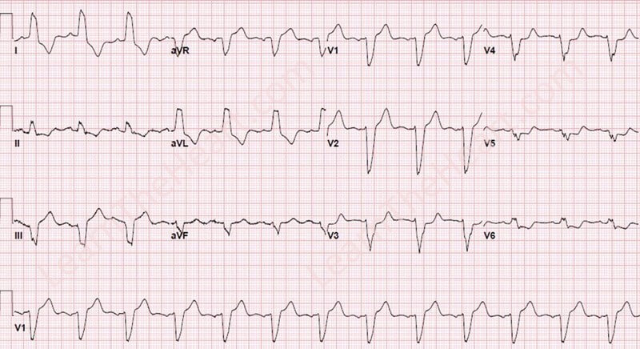

Slide 15
LBBB
QRS>= 120ms
Broad R wave in I ,aVL, V5 and V6
Prominent QS wave in V1 and V2
Absence of q wave

Slide 16
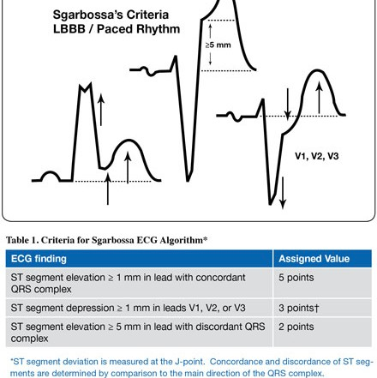

Slide 17
LAFB
Slightly prolonged QRS duration (Not quite 120 msec or < 3 small boxes)
Left axis deviation
qR complex in leads I and aVL (Depolarization going towards these leads)
rS complex in leads II, III, and aVF (Depolarization going away from these leads)

Slide 18
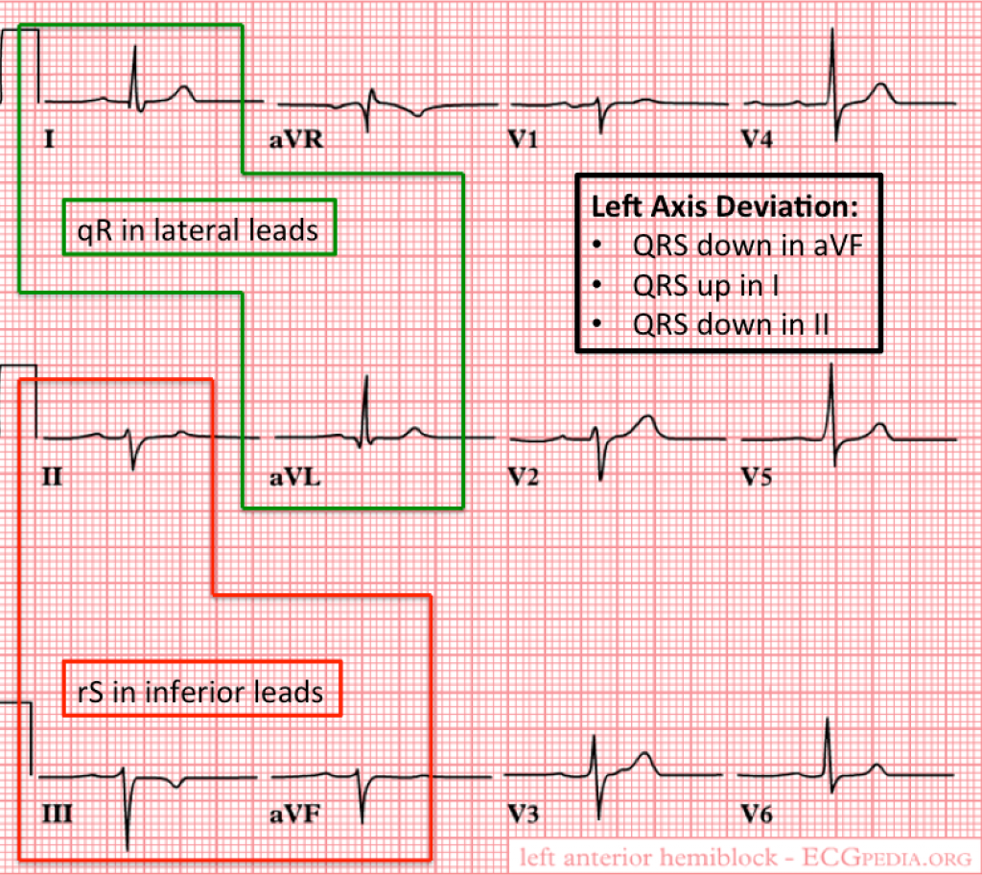

Slide 19
LPFB
Slightly prolonged QRS duration (Not quite 120 msec or < 3 small boxes)
Right axis deviation
qR complex in leads II, III, and aVF (Depolarization going towards these leads)
rS complex in leads I and aVL (Depolarization going away from these leads)
Absence of right ventricular hypertrophy or prior lateral myocardial infarction

Slide 20
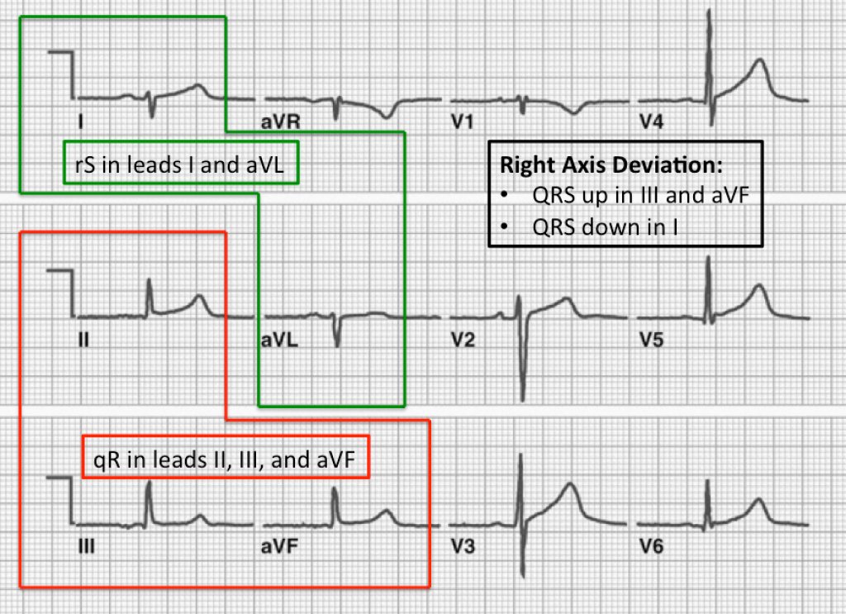

Slide 21
Bifascicular Block
RBBB plus LABB OR RBBB plus LPBB
QRS is widened (at least 3 boxes)
V5 and V6 have RR’ (rabbit ears)
V1 and V2 have rSR’
Pacemaker if syncope occurs

Slide 22
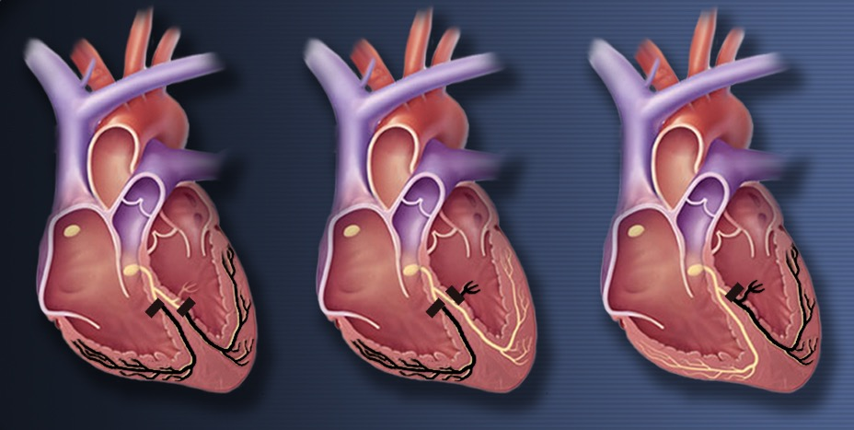
Right bundle branch block and left posterior hemiblock
Right bundle branch block and left anterior hemiblock
Complete left bundle branch block

Slide 25
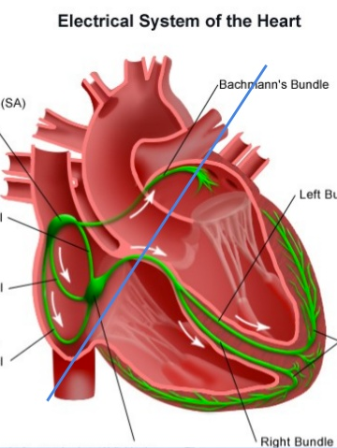
Tachy-arrythmias
Heart rate of more than 100

Slide 26
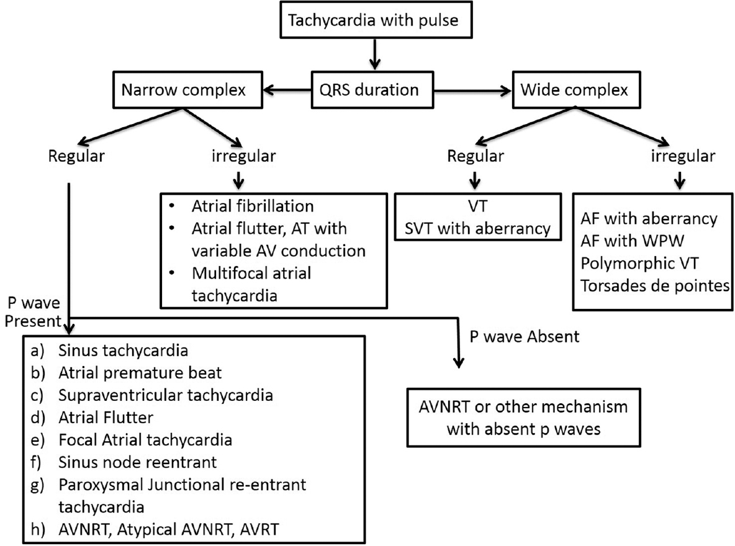

Slide 27
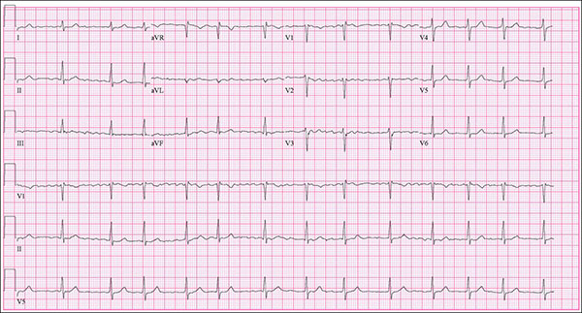

Slide 28
Atrial Fibrillation
Irregularly Irregular rythm
No P waves
Absence of anisoelectric baseline
Variable Ventricular rate
ORS complelexes < 120ms unless pre-existing bundle branch block, accessory pathway or rate related aberrant conduction

Slide 29
Ashman’s Phenomenon- presence abberantly conducted beats, usually of RBBB morpholo, due to long refractory period as determined by the preceding R-R interval
Af is described as having “rapid ventricualr response” once the rate is more than 100
Slow AF when the rate is <60 bpm

