Slide 1
Empagliflozin and Progression of Kidney Disease in Type 2 Diabetes
Dr. Sanjana Bhagwat
Moderator : Dr. A. Korane

Slide 2
Published in The New England Journal of Medicine
Published in June 14, 2016
Impact Factor : 79.258
EMPA-REG OUTCOME trial : This was an analysis that was a prespecified component of the secondary microvascular outcome of that trial.

Slide 3
Clinical Question
Among patients with T2DM at high risk for CV events, does daily empagliflozin 10 or 25 mg have any long-term adverse renal-effects when compared to placebo?

Slide 4
INTRODUCTION
Type 2 diabetes is a major risk factor for macrovascular and microvascular disease.
Kidney disease develops in approximately 35% of patients with type 2 diabetes and is associated with increased mortality.
Intensive glucose-lowering strategies have been shown to reduce renal complications.
Despite optimized glucose control and the use of single-agent blockade of the renin–angiotensin–aldosterone system (RAAS), patients with type 2 diabetes remain at increased risk for death and complications from cardiorenal causes.

Slide 5
Empagliflozin, a selective sodium–glucose cotransporter 2 inhibitor, reduces hyperglycemia in patients with type 2 diabetes by reducing the renal reabsorption of glucose, thereby increasing urinary glucose excretion.
The use of empagliflozin has been associated with a lowering of glycated hemoglobin levels in patients with type 2 diabetes, including those with stage 2 or 3a chronic kidney disease, and with reductions in weight and blood pressure, without increases in heart rate.

Slide 6
Empagliflozin has been shown to reduce intraglomerular pressure and improve hyperfiltration in patients with type 1 diabetes and it has been suggested that these effects may translate into improved renal outcomes.
However, concern has been raised that sodium–glucose cotransporter 2 inhibitors may be associated with long-term adverse renal effects.

Slide 7
In the recent EMPA-REG OUTCOME trial, the primary goal was to assess cardiovascular outcomes.
This study report the results of a prespecified secondary objective of that trial, which was to examine the effects of empagliflozin on microvascular outcomes and, in particular, progression of kidney disease in patients with type 2 diabetes at high risk for cardiovascular events.

Slide 8
MATERIAL AND METHODS
Multicenter, randomized, double-blind, placebo-controlled trial
N=7,020
Empagliflozin 10mg po daily (n=2,345)
Empagliflozin 25mg po daily (n=2,342)
Placebo (n=2,333)
Setting: 590 sites in 42 countries
Enrollment: 2010-2013
Median follow-up: 3.1 years
Analysis: Intention-to-treat
Primary outcome: CV mortality, nonfatal MI, or nonfatal stroke

Slide 9
INCLUSION CRITERIA
T2DM
Age ≥18 years
BMI ≤45 kg/m2
eGFR ≥30 mL/min/1.73 m2 by MDRD
CVD, defined by ≥1 of the following:
MI >2 months prior
Multivessel CAD

Slide 10
Single vessel CAD with positive stress test or UA hospitalization in prior year
UA >2 months prior and evidence of CAD
Stroke >2 months prior
Occlusive PAD
Either of:
No glucose-lowering agents in prior 12 weeks and A1c 7-9%
Stable glucose-lowering therapy in prior 12 weeks and A1c 7-10%

Slide 11
EXCLUSION CRITERIA
Uncontrolled hyperglycemia with fasting glucose >240 mg/dL
Liver disease with ALT, AST or ALP x3 ULN
Planned CV surgery or angioplasty in 3 mo
GFR <30 mL/min/1.73 m² by MDRD
Prior surgery with chronic malabsorption (eg, bariatric) in prior 2 years
RBC disorders

Slide 12
Cancer
Anti-obesity drug treatment in prior 3 months
Systemic steroids
Change in thyroid hormone dosage in prior 6 weeks
Nursing, pregnant, or child-bearing age women not using acceptable method of birth control or refusing pregnancy testing
Alcohol or drug abuse

Slide 13
Randomization in a 1:1:1 ratio to a group with stratification by A1c, BMI, renal function, and geographic region:
Empagliflozin 10 mg
Empagliflozin 25 mg
Placebo
Modifications to non-study glucose-modifying medications were permitted after week 12 to reach local therapeutic guidelines
Other cardiovascular risk factors, including dyslipidemia and hypertension, were treated at the discretion of investigators to local guidelines

Slide 14
MICROVASCULAR OUTCOMES
Included the first occurrence of any of the following:
the initiation of retinal photocoagulation
vitreous hemorrhage
diabetes-related blindness
or incident or worsening nephropathy

Slide 15
RENAL OUTCOMES
The first renal microvascular outcome was incident or worsening nephropathy, defined as :
progression to macroalbuminuria
A doubling of the serum creatinine level, accompanied by an eGFR of ≤45 ml per minute per 1.73 m².
the initiation of renal-replacement therapy
death from renal disease.

Slide 16
Other prespecified renal microvascular outcomes were a composite of incident or worsening nephropathy or death from cardiovascular causes.
the individual components of incident or worsening nephropathy
and incident albuminuria in patients with a normal albumin level at baseline.

Slide 17
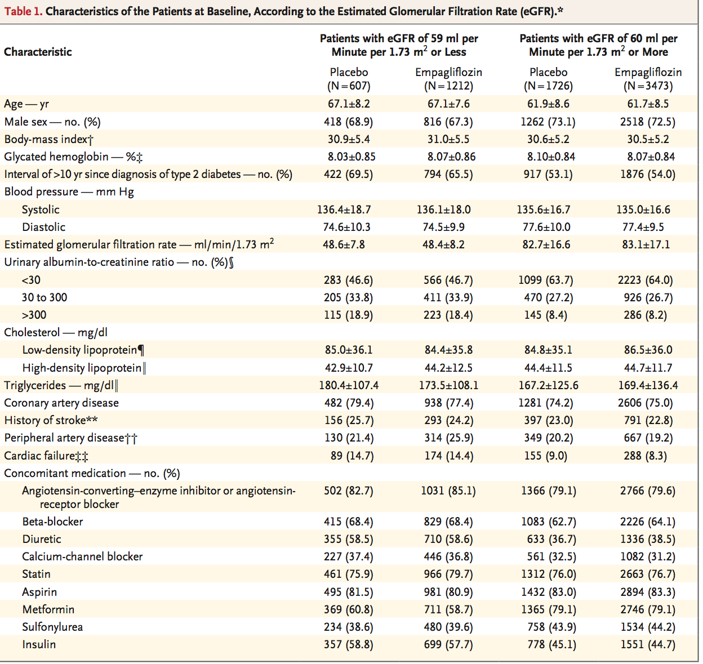

Slide 18
STATISTICAL ANALYSIS
A modified intention-to-treat approach to perform analyses in patients who had received at least one dose of a study drug was performed.
The trial protocol specified that the outcomes of incident or worsening nephropathy would be analyzed in treated patients who did not have macroalbuminuria at baseline, who had available measurements of serum creatinine at baseline and after baseline, and who had postbaseline measurements of the urinary albumin-to-creatinine ratio

Slide 19
A Cox proportional-hazards model to assess between-group differences in the risk of an outcome was used.
Prespecified analyses included comparisons of the pooled empagliflozin doses (10 mg and 25 mg) and the individual doses versus placebo.

Slide 20
RESULTS
A total of 7020 patients at 590 sites in 42 countries received at least one dose of a study drug.
According to the trial design, more than 99% of the patients had established cardiovascular disease.

Slide 21
eGfr:
45-59 ml/min/1.73 m² : 17.8%
30-44 : 7.7%
Albuminuria :
Micro – 28.7%
Macro – 11%
80.7% of the patients were taking ACE inhibitors or ARBs at baseline.
The median duration of treatment was 2.6 years, and the median observation time was 3.1 years.

Slide 22
Cardiovascular outcomes : significantly lower risk of 3- point MACE in the pooled empagliflozin group than in the placebo group.
Microvascular outcomes : significant relative risk reduction of 38%.

Slide 23
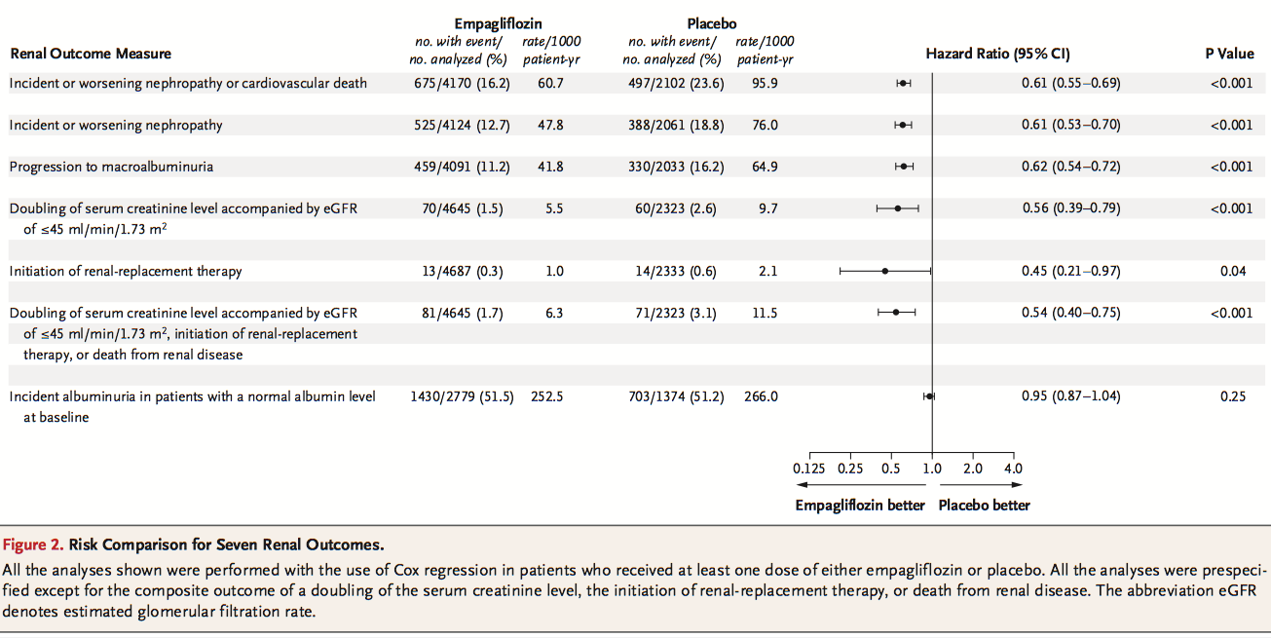

Slide 24
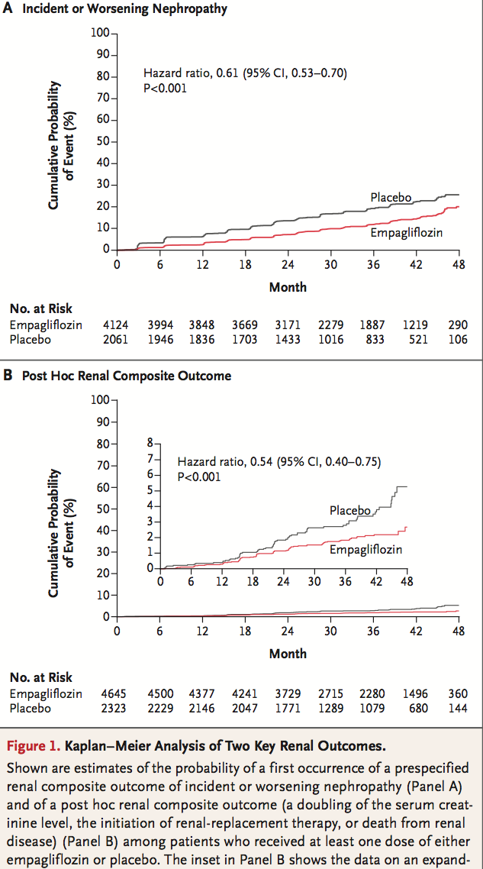

Slide 25
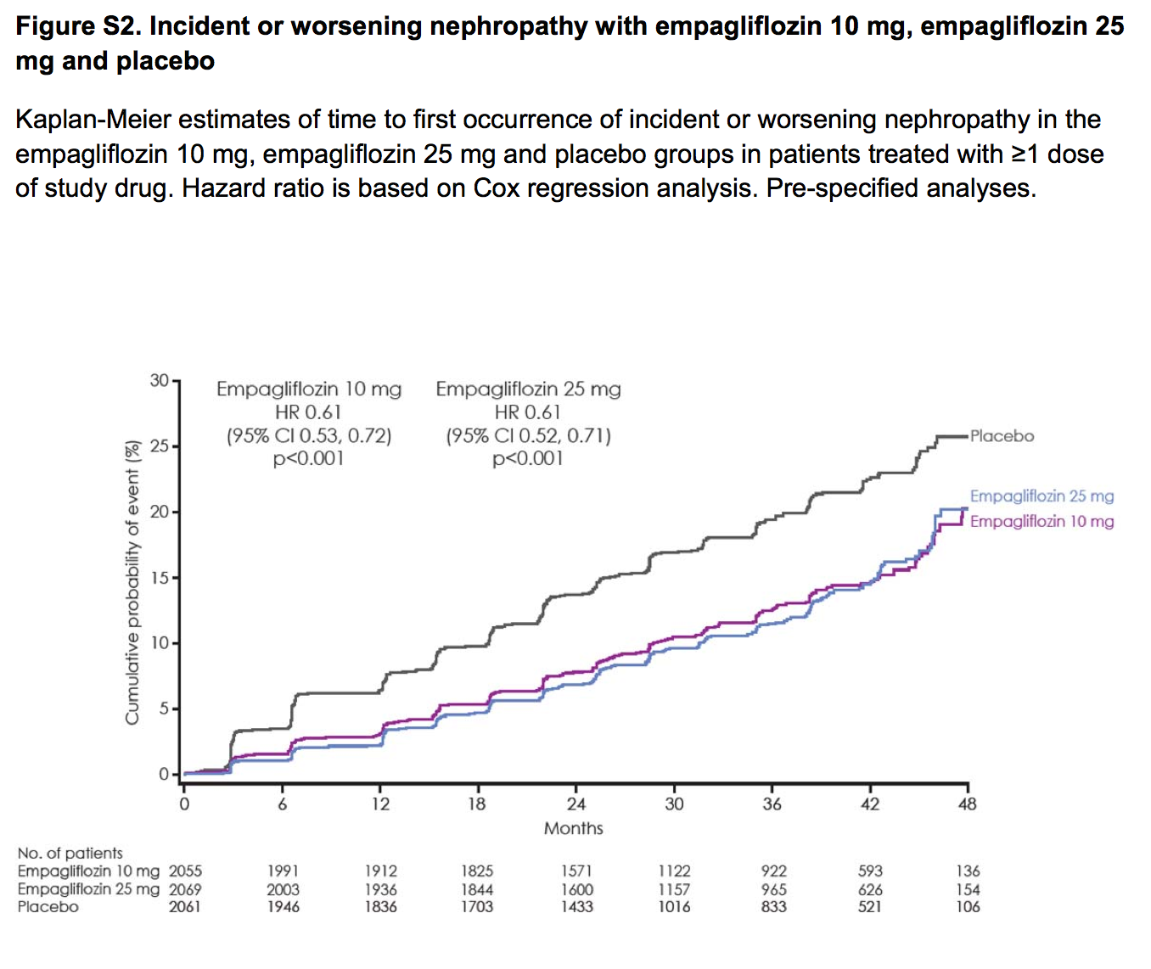

Slide 26
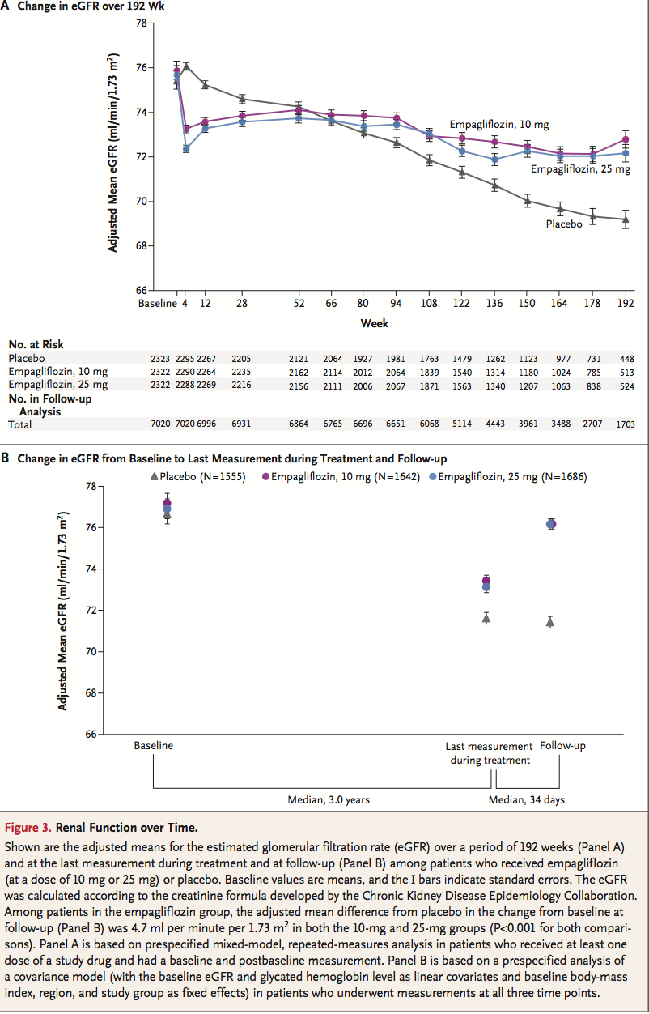

Slide 27
The initial decrease in the eGFR in the empagliflozin group was completely reversed after the cessation of the study drug
Quantification of the difference between the study groups in the average rate of change in the eGFR for three prespecified time periods, using the CKD-EPI creatinine equation was done.

Slide 28
From baseline to week 4 (period 1), there was a short-term decrease in the eGFR in the empagliflozin groups as compared with a small increase in the placebo group

Slide 29
Thereafter, during long-term administration (period 2; from week 4 to the last week of treatment), the eGFR remained stable in the empagliflozin groups and declined steadily in the placebo group

Slide 30
After the cessation of the study drug (period 3; last week of treatment to follow-up), the eGFR increased with both doses of empagliflozin as compared with a small decrease in the placebo group

Slide 31
DISCUSSION
Patients of Type 2 DM who received empagliflozin in addition to standard care had a significant :
lower risk of microvascular outcome events.
significantly lower risk of progression to macroalbuminuria or clinically relevant renal outcomes, such as a doubling of the serum creatinine level and initiation of renal-replacement therapy,
lower rates of hyperglycemia and lower values for weight and blood pressure

Slide 32
The mechanisms behind the renal effects of empagliflozin are probably multifactorial, but direct renovascular effects may play an important role.
Empagliflozin reduces proximal tubular sodium reabsorption, thereby increasing distal sodium delivery to the macula densa, which has been shown to activate tubuloglomerular feedback, leading to afferent vasomodulation and a decrease in hyperfiltration.

Slide 33
Type 1 diabetes and hyperfiltration, empagliflozin reduces the intraglomerular pressure.
Despite the low-pressure environment of renal glomeruli, a reduction in glomerular hypertension of approximately 6 to 8 mm Hg was observed with empagliflozin.
arterial stiffness, vascular resistance, serum uric acid levels, and the systemic and renal neurohormonal systems, may also contribute to the improvements in the progression of renal disease observed with empagliflozin

Slide 34
Previous trials have focused on the role of RAAS blockade for improving renal outcomes in type 2 diabetes. Such blockade causes vasodilation of the efferent arteriolar system of the glomerulus and a reduction in intraglomerular pressure.

Slide 35
This vasomodulatory mechanism is known to cause a short-term decrease in the eGFR, which is accompanied by a smaller decline in renal function during continued treatment.
In this trial, Empagliflozin showed a similar pattern of change in renal function.
Renal function significantly improved after the discontinuation of empagliflozin, thus indicating that the hemodynamic changes were reversed even after long-term use.

Slide 36
Most patients were receiving background RAAS, so the renal effects of empagliflozin glomerular hemodynamic changes were reversed were still apparent even with the use of these agents
However, empagliflozin did not prevent incident albuminuria despite previous evidence that the drug lowers the intra- glomerular pressure.

Slide 37
Adverse effects of empagliflozin
Greater incidence of genital infection
AKI and hyperkalemia were similar or lesser than placebo

Slide 38
LIMITATIONS
These results were observed in a population of patients whose blood pressure was well managed, with extensive use of RAAS blockers
the renal effects of empagliflozin cannot necessarily be generalized to patients with type 2 diabetes at lower cardiovascular risk.
findings to black patients also has limitations because of the small sample size that we studied
The magnitude of the observed effect on these risk factors over a median follow-up period of 3.1 years is unlikely to fully account for the ob- served difference in renal function among pa- tients receiving empagliflozin.

Slide 39
CONCLUSION
Among patients with type 2 diabetes who were at high risk for cardiovascular events, the use of Empagliflozin was associated with slower progression of kidney disease than was placebo when added to standard care. Empagliflozin was also associated with a significantly lower risk of clinically relevant renal events.

Slide 40
THANK YOU

