Slide 1
HEPATORENAL SYNDROME
Development of renal failure in patients with severe liver disease in the absence of any identifiable renal pathology.
Functional disturbance
The 5-year probability of developing HRS from first presentation with ascites is 11%

Slide 2
Diagnostic criteria

Slide 3
Classification
Type 1
Type 2
Rapidly progressive (less than 2 weeks) reduction of renal function with doubling of initial serum creatinine to greater than 2.5 mg/dL
Should be considered whenever there are criteria for acute kidney injury
Satisfy the dignostic criteria but do not progress rapidly.
Relatively preserved renal function with refractory ascites.

Slide 4
Mechanism

Slide 5
Clinical features
Marked sodium and water retention
Low mean arterial blood pressure
Marked elevation of RAAS
Low cardiac output
Death is due to liver failure

Slide 6
Prevention
Monitor diuretic therapy
Avoid nephrotoxic drugs
Risk of renal failure in patients with SBP revented by iv albumin and antibiotics.

Slide 7
Differential diagnosis
Prerenal azotemia – over-diuresis and severe diarrhoea, bacterial infection, NSAIDS
Intrinsic renal failure
ATN – shockm increased urinary sodium and granular casts

Slide 8
Treatment
General measures :
Stop diuretics and CVP should be measured to rule out hypovolemia
Intravascular volume is expanded by intravenous albumin at a dose of 1g/kh body weight (max 100g)
Repeated in 12 hours if serum creatinine does not normalize.
Potential nephrotoxic drugs, diuretics and vasodilators are stopped.
Diagnostic tap
Renal replacement therapy if there is severe volume overload, acidosis or hyperkalemia. However it does lead to recovery unless liver transplant is done.

Slide 9
Liver transplantation :
Only definitve therapy but it is important to lower pretrasplantation serum creatinine as it leads to better outcomes.
Pharmacological treatment :
Vasodilators – dopamine at renal support dose causes renal vasodilatory effect but no effect in HRS.
Vasoconstrictors – ornipressin, terlipressin, octreotide with midodrine, noradrenaline
Best evidence is for use of terlipressin.
Significant higher HRS-1 reversal rates, decreased rate of death. 0.5-1 mg iv every 4-6 hours.
No early response after 2 days of therapy the dose can be doubled every 2 days upto a maximum of 12 mg/day. In patients who respond, treatment should be extended until reversal of HRS or a maximum of 14 days.

Slide 10
Transjugular intrahepatic portosystemic shunt (TIPS)
Can ne consideres if HRS recurs after discontinuation of successful vasoconstrictor therapy with creatinine returning to near normal values and particularly if transplantation is not likely in the near future.
Extracorporeal albumin dialysis :
Some benefit in type 1 HRS. this method uses an albumin-containing dialysate.

Slide 11
HEPATOPULMONARY SYNDROME
Clinical disorder associated with advanced liver disease, pulmonary vascular dilatation and a defect in oxygenation in the absence of detectable primary cardiopulmonary disease.
Po₂ is <80 mmHg anf the alveolar-arterial oxygen gradient exceeds 15 mmHg breathing room air.
Platypnoea and orthodeoxia are usual.
HPS is not related to type or severity of liver disease or portal hypertension.
Patients with HPS have poorer quality of life and twice the mortality.

Slide 12
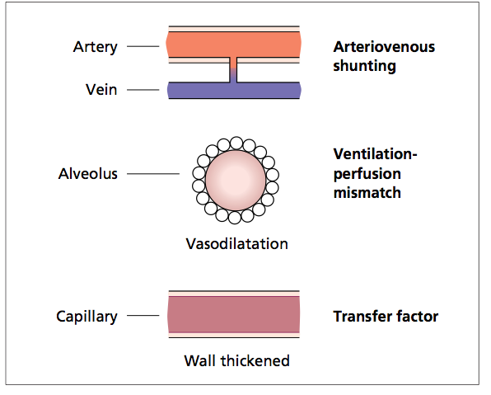
The intrapulmonary shunting is due to marked dilatation of precapillary and capillary vessels.
This results in diffusion limitation of capillary oxygenation and V/Q mismatch.
The vasoactive substances suspected in HPS are nitric oxide, endothelin -1 and tumour necrosis factor alpha.

Slide 13
Diagnosis
Contrast enhanced echocardiography can demonstrate abnormal passage of microbubbles through the pulmonary circulation into the left side of the lung.
Tc-99 m macroaggregated albumin lung scanning.
Pulmonaryangiography – may show large pulmonary AV shunts
Transesophageal echo may show intracardiac shunts.

Slide 14
Treatment
No pharmacological therapy is effective.
Progressive and severe hypoxemia are an indication for liver transplantation. Currently the only effective treatment.
Hypoxaemia may take weeks to resolve even after transplantation.
Coil embolotherapy may be indicated along with the transplant when the pulmonary shunts are large.
Transjugular intrahepatic portosystemic shunt (TIPS) has improved srterial saturation but results are unpredictable.

Slide 15
Thank You

