Slide 1
IRON-RESISTANT IRON DEFICIENCY ANAEMIA
DR. SANJANA BHAGWAT
MODERATOR : DR. A. GANAPULE

Slide 2
Normal iron metabolism

Slide 3
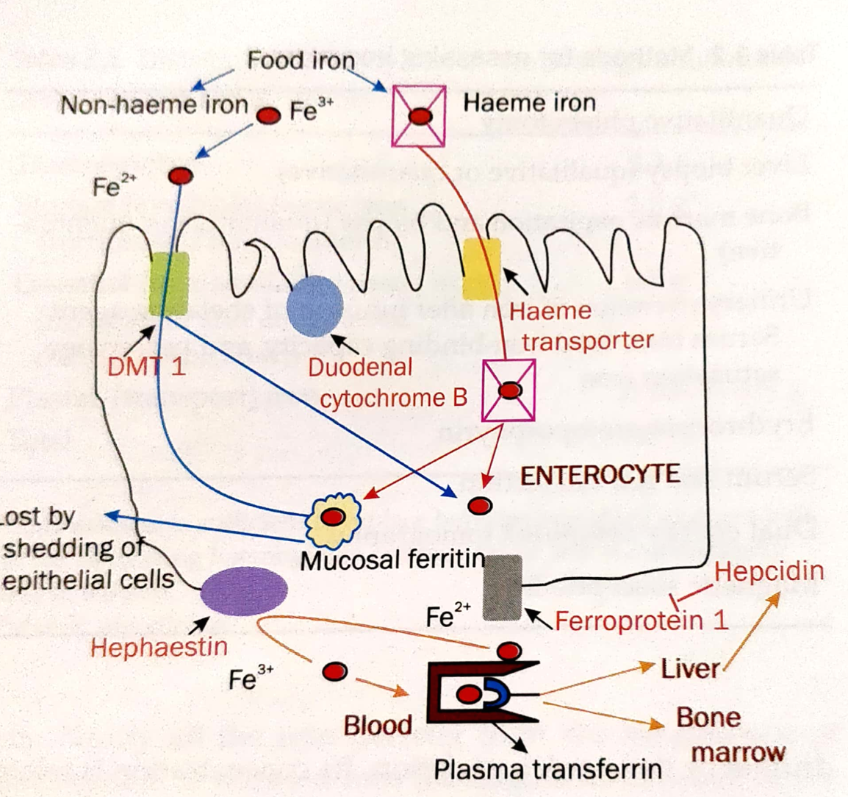
IRON METABOLISM

Slide 4
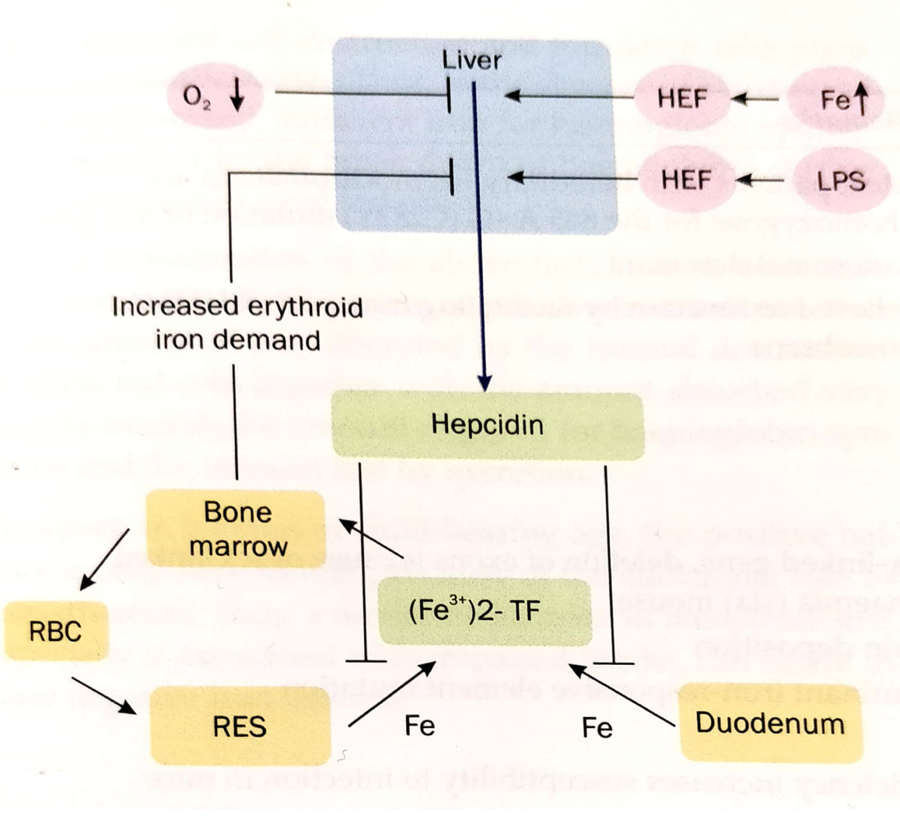

Slide 5
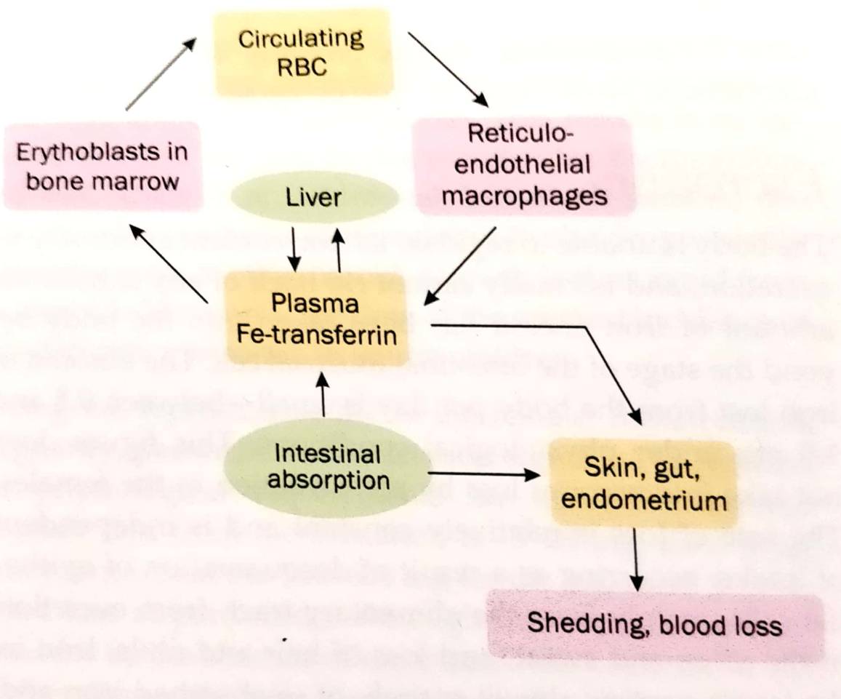

Slide 6
Genetic forms of iron deficiency anaemia

Slide 7
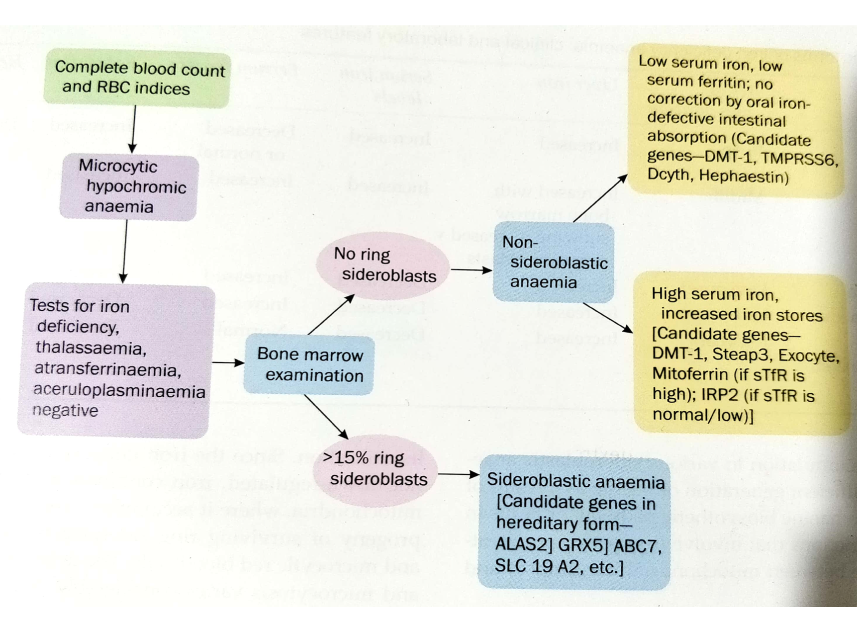

Slide 8
Mutations in genes encoding :
DMT-1
Glutaredoxin 5
Transferrin
Ceruloplasmin
Matripase-2 (TMPRSS6)

Slide 10
Dmt 1 mutation primarily affects iron utilisation and not absorption
GLRX5- iron overload and presence of ringed sideroblasts in the bone marrow. This is due to defective heme synthesis secondary to to iron regulatory proteins deregulation linked to the decreased production of iron-sulphur by the mutated gene.
Atransferrinaemia and aceruloplasminaemia are associated with iron overload outside the erythron.
Moderate microcytic hypochromic anaemia (late onset in aceruloplasminaemia) with low serum iron, liver iron overload and high ferritin.
Deficiency of serum trasferrin interrupts iron delivery to erythroid precursors triggering a massive but futile increase in intestinal iron absorption and consequent tissue iron deposition
Ceruloplasmin is a ferroxidase. In deficiency ferroportin cannot release iron to plasma transferrin. Leading to anaemia and concomittant deposition of iron in different organs
Both are rare but can be confused with haemochromatosis.

Slide 11
IRIDA syndrome

Slide 12
pathogenesis

Slide 14
The TMPRSS6 gene is located on chromosome 22 and encodes for a transmembrane type II serine protease that suppresses hepcidin secretion by cleaving hemojuvilin, a surface co-receptor in BMP-6-SMAD signaling pathway.
Mutations in both the maternal and paternal genes leads to a severe form of iron-deficiency anaemia that is refractory to iron treatment.
It is a recessive disorder.
Mechanism is unknown.
But, deficiency of the protein causes the body to produce too much hepcidin a hormone that prevents iron absorption from the intestine. Normally hepcidin protects the body from iron overload.

Slide 15
Severe congenital hypochromic microcytic anaemia with low serum iron and low transferrin saturation is seen.
Pathognomic finding – high hepcidin levels in serum and urine despite severe iron deficiency.
Plus patients with this gene deficiency cannot produce new red blood cells efficiently as the required iron is derived from macrophages and hepcidin causes more macrophages to hold on to iron.
Patients show poor response to parenteral iron, the iron is trapped in macrophages and cannot be used for red blood cell production.

Slide 16
features

Slide 17
DEFINITION:
Anemia with variable degree of microcytic hypochromic indices
Low-normal to normal serum ferritin
Very low serum iron and transferrin saturation (TSAT)
Inappropriately high serum hepcidin levels compared to degree of anemia
Oral iron refractoriness as per standard criteria for evaluation of response to oral iron
Presence of homozygous of compound heterozygous mutations in TMPRSS6 gene

Slide 18
Suspicion of IRIDA usually occurs during a pediatric routine evaluation.
However, in some patients, the condition is recognized only in adulthood, either because the anemia is mild or because it has been misclassified.
Overall, it is likely that up till now this condition has been under-diagnosed.
However, there are subtle clinical points in history and initial evaluation which should arouse a differential of IRIDA during initial work up and these include-

Slide 19
Onset of anemia which is mild-moderate degree in infancy or early childhood
Presence of history of anemia in other siblings or an elder sibling being chronically treated for iron deficiency without much improvement
Microcytosis and hypochromia extreme compared to degree of anemia (Very low MCV and MCH)
Absence of organomegaly and absence/minimally evident stigmata of classical iron deficiency like hair changes, dry skin, koilonychia and angular cheilitis.
High RBC count and low reticulocyte count (A high RBC count may also be seen in thalassemia trait, but same would have higher retic count whereas in iron deficiency though retic count is low, RBC count too would be low proportionately to degree of anemia)

Slide 20
diagnosis

Slide 21
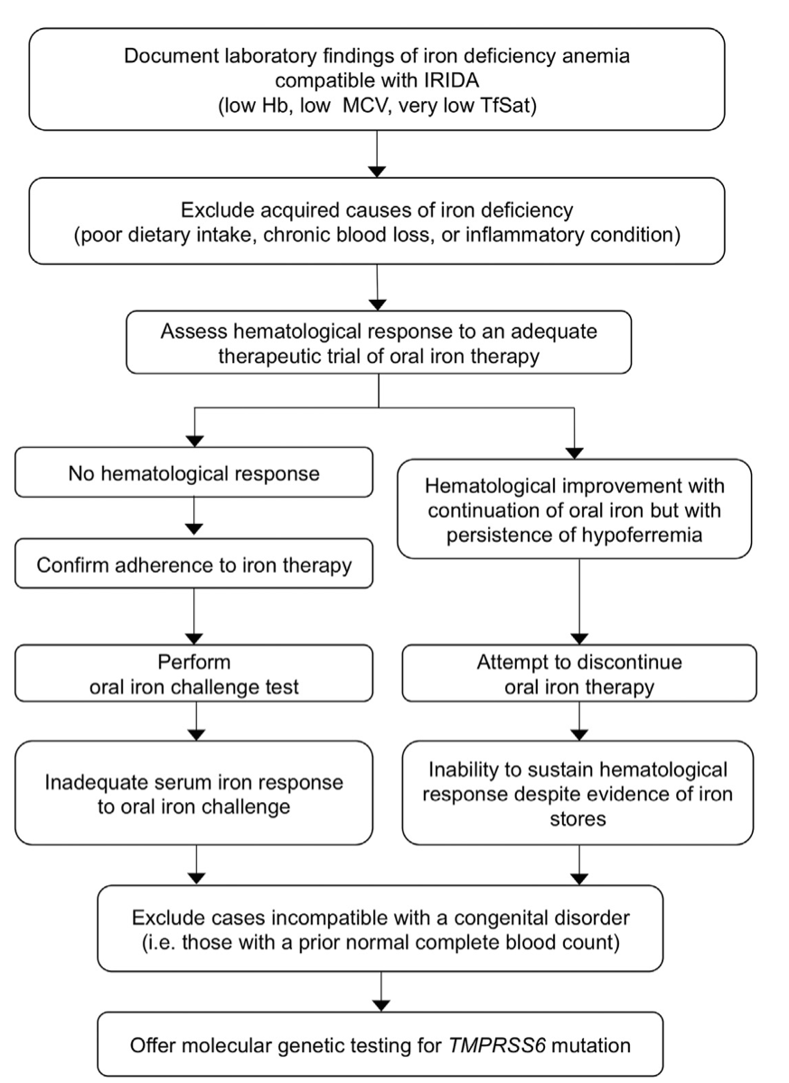

Slide 22
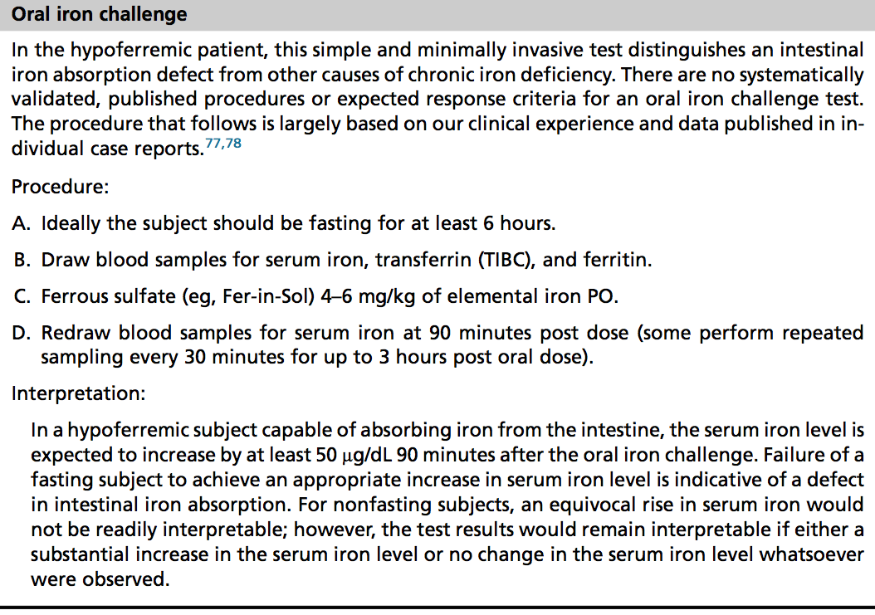

Slide 24
TREATMENT

Slide 25
Since the hallmark of IRIDA is oral iron refractoriness, treatment has largely been dependent upon using IV iron for sustained response though in many cases the response to IV iron too is partial.
However, the current recommendations and guidelines as published by Donker et al. suggest an initial trial of iron (FeSo4 form) along with Vitamin C for 6–8 weeks before going ahead with IV iron treatment.
his recommendation is based on the fact that the pathogenic nature of the TMPRSS6 gene variation determines the response to oral iron, with severe mutations leading to near complete refractoriness. Hence a trial of oral iron is essential.
Some infants with this disorder have been found to show a response when oral iron is administered along with Vitamin C.

Slide 26
In fact few of the cases in these studies have shown that high dose (6–10 mg/kg/day) of elemental iron for 17 months or so resulted in acceptable hemoglobin levels, though microcytosis and low transferrin saturation persisted.
Treatment with oral iron and vitamin C needs to be followed up stringently and further requirement of IV therapy needs to be determined on basis of response being absent or minimal even after 8–10 weeks of trial.
In most cases it is likely that even partial correction of a moderate to mild anemia will help achieve an acceptable hemoglobin level for benefit of the growth and development of the child and it has been well documented that cases of IRIDA improve upon their degree of anemia as they grow into adulthood.

Slide 27
Another important aspect of treatment involves screening of other siblings of a case of IRIDA. The siblings should be initially screened for presence of anemia and if present, offered genetic diagnosis for the targeted mutation present in the other sibling.

Slide 28
Future treatments

Slide 29
In the future, other treatments aimed at lowering plasma hepcidin levels might become available.
These innovative therapies are currently being developed with the aim of correcting the anemia of chronic diseases but they could represent an interesting alternative to intravenous iron treatment in other conditions of iron-restricted erythropoiesis, especially in IRIDA.
Anti-hepcidin antibodies were shown to correct the anemia of chronic diseases in a mouse model based on injections of heat-killed Brucella abortus.
Another promising approach is the development of Anticalins® (Pieris AG, Germany) which are genetically modified lipocalins that can target almost any desired molecule with a high affinity.

Slide 30
One Anticalin® has been developed that is highly specific for hepcidin and is proposed to antagonize hepcidin for the treatment of anemia of chronic diseases.
An interesting alternative for the sequestration of hepcidin comes from the Spiegelmer® technology (Noxxon Pharma) with a PEGylated anti-hepcidin L-RNA oligonucleotide, now starting in phase I/IIa clinical trials in cancer patients.
Finally, the reduction of HAMP mRNA by siRNA technology (Alnyam, USA) has also proven pre-clinical efficacy79 and the same company also plans to apply this technology to the silencing of other molecules in the hepcidin regulatory pathway.

Slide 31
Thank you

