Slide 1
Reticulocyte Hemoglobin Vis-À-Vis Immature Reticulocyte Fraction, as the earliest Indicator of Response to Therapy in Iron Deficiency Anemia
Dr. Sanjana Bhagwat
Moderator : Dr. A. Ganpule
JAPI ; Vol 65, Oct 2017

Slide 2
INTRODUCTION
The challenge in iron deficiency anemia (IDA) is not only to diagnose it early but also to monitor and evaluate its response to iron therapy at the earliest.
Response to iron therapy is classically assessed by increase in peripheral blood Reticulocyte count which occurs in 3-4 days and rise in hemoglobin within the first week

Slide 3
Immature Reticulocyte Fraction (IRF) is one of the newer parameters of automated haematology analyzers and is a sensitive measure of erythropoiesis.
IRF denotes fraction of developing RBC’s (reticulocytes) which have high content of mRNA with least maturity.

Slide 4
Another newer reticulocyte parameter, Ret-He, is a measure of hemoglobin content of the freshly produced red blood cells and offers real-time information on iron supply for erythropoiesis.
Change in RET-He is seen as early as the 3rd – 4th day after therapy is initiated.

Slide 5
This study was undertaken to evaluate Ret-Hb vis-à-vis IRF as an earliest indicator of response to iron therapy in iron deficiency anemia (IDA), by assessing change in reticulocyte haemoglobin (RET-He) and IRF at 48 hours after initiation of intravenous iron therapy.

Slide 6
Materials and Methods
This study was based in a tertiary hospital in Rajasthan and the period of study was 15 months.
Sanple size : 144 patients

Slide 7
Inclusion criteria :
within the age group of 15-65 years
with newly diagnosed and untreated iron deficiency anemia admitted in medicine wards
not suffering from any inflammatory disorders (excluded by C-reactive protein)
Exclusion criteria :
Patients having other forms of anemia/ hemoglobinopathies/ any malignancy/having MCV >80 fL
pregnant females were excluded from this study.

Slide 8
Patients having microcytic hypochromic anemia, serum ferritin below 20 ng/ml and transferrin saturation < 20% were selected.
Bone marrow aspirates were and sent for Wright – Giemsa staining along with Prussian blue staining for estimation of iron store.
The patients were then started on intravenous iron sucrose ( 300mg dissolved in 250 ml Normal Saline IV infusion over 4 hours on Day 0 and Day 1) along with oral antioxidants.
After 48 hours, CBC, RET-He and IRF were repeated for each patient.

Slide 9
Results
A total of 144 patients were included in the study. Of these, 42 (29.2%) patients were excluded from final statistical analysis as their bone marrow aspirates were aparticulate and therefore, their iron stores could not be assessed
From the bone marrow aspirates of remaining 102 patients, Prussian blue stained films were examined and graded.

Slide 10
Of the 102 patients:
73 (71.6%) had no stainable iron in bone marrow (grade 0),
10 (9.8%) had grade 1 stainable iron,
8 (7.8%) had grade 2 stainable iron
11 (10.8) had grade 3 stainable iron.
Based on the grading of bone marrow iron store, the patients were classified into
Group A (grade 0 and 1- depleted iron stores) and
Group B (grade 2 and 3 -functional iron deficiency).

Slide 11
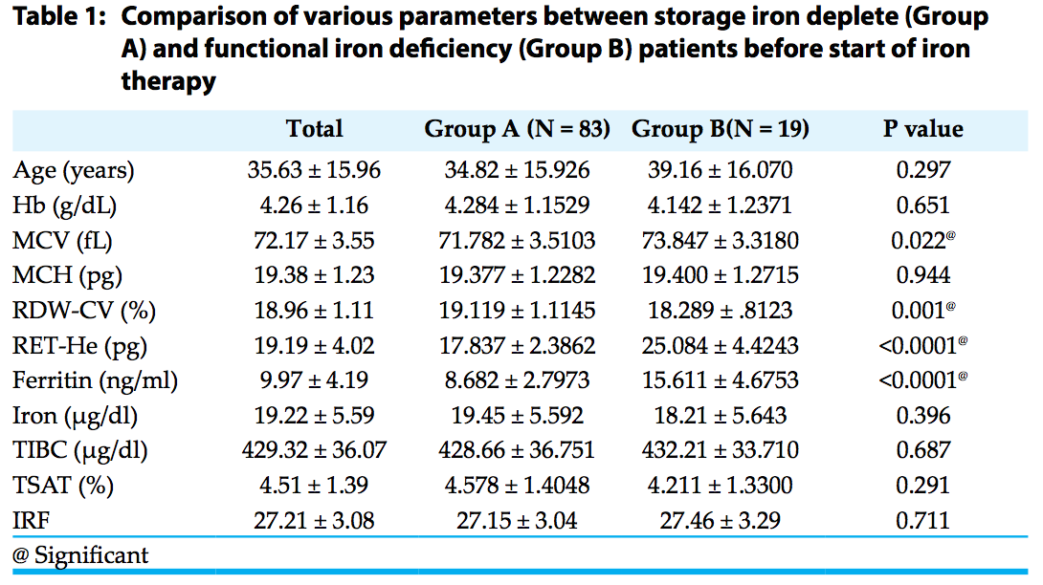

Slide 12
In comparison to Group B, patients of Group A had significantly lower RET-He vs. Group B and lower serum ferritin before start of iron therapy
RET-He and IRF increased significantly at 48 hours after initiation of intravenous iron therapy (post therapy) as compared to baseline (pre therapy) in both the two groups as well when all patients were considered together
Post therapy, the mean increase in RET-He was significantly smaller in magnitude in group B than in group A. The increase in IRF was not significantly different between the two groups

Slide 14
Discussion
All the patients included in our study had microcytic hypochromic anemia with low serum ferritin and low transferrin saturation.
Those with grade 0 and 1 were considered to have depleted iron stores and, therefore, represented absolute iron deficiency (depleted iron store).
Those with grade 2 and 3 in our study had functional iron deficiency.

Slide 15
Reticulocytes are sensitive in detecting erythropoietic activity as they have a more rapid turnover in circulation than mature red cells (1–2 vs. 120 days).
Reticulocyte indices provide a real time evaluation of the bone marrow activity, reflecting the balance between iron and erythropoiesis of the preceding 48 hours.
Response to iron therapy could be detected at an earlier stage, when RBC indicators are still as pretreatment level but the iron stores are sufficient to the point of affecting hematopoiesis and inducing production of a certain percentage of reticulocytes with increased Hb content, resulting in a progressive increase of RET-He.

Slide 16
The current study revealed that RET-He and IRF increase significantly after intravenous iron therapy as early as 48 hours after initiation of treatment irrespective of the status of the iron stores (deplete or functional iron deficiency).
The mean increase in RET-He was of significantly smaller magnitude in group B than in group A.
The increase in IRF was not significantly different between the two groups
Thus those patients who had depleted iron stores showed greater increase in RET-He in response to intravenous iron therapy as compared to those with functional iron deficiency.

Slide 17
Identifying patients who show low RET-He after IV iron therapy makes it possible to identify the patients who are not responding to IV iron.
Thus these patients may be offered additional diagnostic tests and management strategies.

Slide 18
The aim of iron therapy in IDA is to improve iron supply (Hemoglobinization) to the developing RBC’s.
As the traditional parameter of treatment response – reticulocyte count and newer parameter – IRF only reflect erythropoietic activity of bone marrow and they do not reflect the incorporation of iron in maturing RBC’s, which is the primary aim of iron therapy.
RET-Hb is a real time indicator of iron supply to the developing RBC’s and is a useful marker of response to iron therapy.

Slide 19
Limitations
The study included patients only with severe anemia. Whether these findings can be extrapolated to those with mild to moderate degree of anemia or with iron deficiency state is debatable.
This study included the effect of intravenous iron in IDA so the results may not applicable on oral iron therapy.
This study was done at a tertiary care centre, and recruited inpatients only, resulting in a limited sample size, thus the nature of the investigation and the results do not imply a general case, and further studies with a larger sample size are needed.

Slide 20
Conclusion
Both RET-He and IRF increase as early as 48 hours after initiation of intravenous iron therapy.
However, the mean change in IRF was not significant while mean change in RET-Hb had statistical significance.
In essence, RET-Hb, a real time indicator of iron supply (hemoglobinization) to the developing RBC’s, is the earliest marker of response to iron therapy.

