Slide 1
MRI

Slide 2
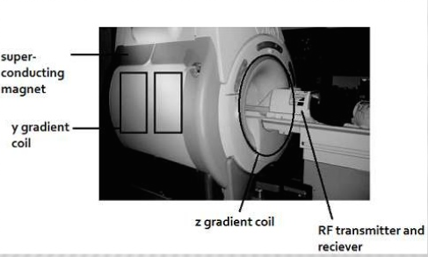
Magnetic resonance imaging is a technique which uses strong magnetic fields and radiofrequency waves to generate images of organs of the body.

Slide 3
The human body contains hydrogen ions which when exposed to a magnetic field are aligned accordingly.
When a radiofrequency pulse (high frequency, low energy electromagnetic wave) is generated the ions are excited and aligned in a different direction
When the RF pulse turned off, they go back to their original position – Relaxation time
This is the basis of MRI
Thus time to excite depends on the RF pulse
Time to relax depends on the tissue (ions)

Slide 4
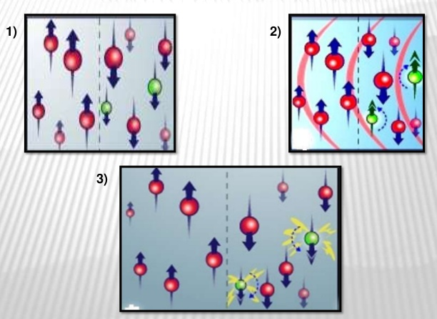

Slide 5
ADVANTAGES
They do not involve exposure to radiation, so they can be safely used in pregnant women and babies,
They are particularly useful for showing soft tissue structures, such as ligaments and cartilage, and organs such as the brain, heart, and eyes
They can provide information about how the blood moves through certain organs and blood vessels, allowing problems with blood circulation, such as blockages, to be identified.
MRI scans can: show swelling and inflammation
Can show both three-dimensional and cross-section images of the body

Slide 6
DISADVANTAGES
Bore is small, hence, some patientscan have claustrophobia and have difficulty in cooperating. Some obese patients cannot be examined.
Acutely ill patients, may not remain still.
slow compared with other imaging modalities.
Patients with pacemakers and certain ferromagnetic appliances cannot be studied.
MRI units require careful siting and shielding.
Greater technological expertise is required
MRI equipment is expensive to purchase, maintain, and operate.
unsuitable for investigating problems such as mouth tumours because coughing, or swallowing, can make the images that are produced less clear.
Bone and calcium do not show up on an MRI scan. Sotissue calcification, a feature of a number of diseases such as osteoporosis, cannot be detected using MRI scanning.

Slide 7
TYPES OF MRI

Slide 8
T1 weighted
T2 weighted
FLAIR
STIR
Proton-density weighted image
Diffusion- weighted
MR Angiography
MR Venography
Functional MRI
MR arthrograms
MR spectroscopy
MRCP
Cardiac MRI
Breast MRI
Foetal MRI
Interventional MRI

Slide 9
On normal MRIs (proton density or PD weighted), the greater the hydrogen content, the brighter the image.
T1 is when the machine is programmed to only look at the longitudinal movement of protons. T1 images are usually used to look at normal anatomical details.
T2 is the transverse movement of protons and is usually used to look at pathology because most tissues involved in disease tend to have a higher water content than normal

Slide 10
T1 and T2 weighted
T1 Is best to look at brain structure as fat appears very bright and bone marrow contains a lot of fat.
T2 is ideal to look for tissue edema as water and fluid appear brighter on T2 images
Grey matter appears grey in both

Slide 11
 | T1 weighted | T2 weighted
CSF | dark | white
fat | white | Less white
Cortical bone (calcium) | dark | Dark
Flowing blood (flow void) | Dark | Dark
Hemosiderin | Dark | Dark
Air | Dark | Dark
Tendon/ligament | Dark | Dark
White matter | Light grey | Dark grey
Grey matter | grey | grey

Slide 12
FLAIR
Fluid attenuated inversion recovery sequence
It is T2 weighted with suppression of the CSF signal.
It is a good technique for visualization of cerebral oedema and periventricular or cortical lesions in conditions such as multiple sclerosis.
 | T! | T2 | FLAIR
CSF | Dark | White | Dark
Oedema | Dark | White | White

Slide 13
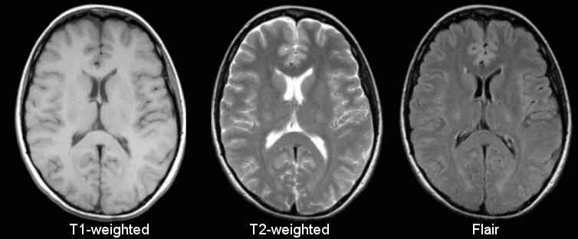

Slide 14
STIR
Short T1 inversion recovery sequence : is a fat suppression technique.
It is particularly useful for suppressing the signal from normal adipose tissue to help reduce artefacts and improve visualisation.
STIR sequencing is also very useful for looking at structures such as the adrenal glands, bone marrow (eg: bone marrow oedema in occult fractures) and fatty tumours.

Slide 15
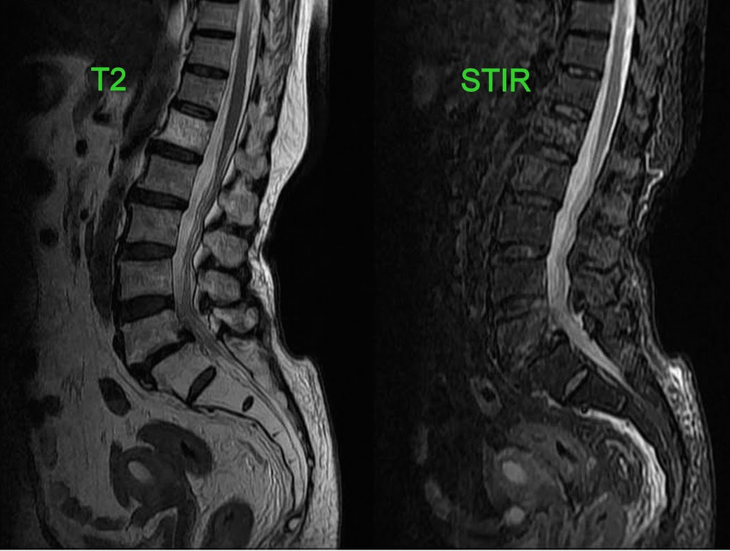

Slide 16
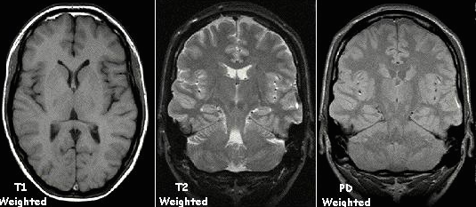
Proton-density weighted image :
Tissue with highest density of protons will appear the brightest
Fluids normally appear as grayish white, almost similar appearance as the fat in the body.
Useful for TMJ imaging, brain imaging

Slide 17
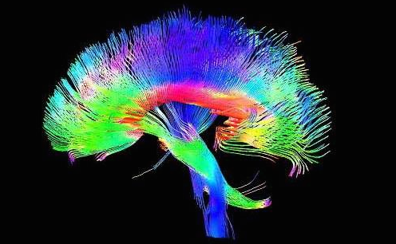
Diffusion Tensor Imaging
Used to view white matter tracts :
Association fibres
Projection fibres
Commisural fibres
Subcortical fibres

Slide 18
Diffusion weighted MRI
Diffusion is movement of molecules from area of high concentration to low concentration.
In human body, water molecules behave in anisotropic fashion , i.e they are direction dependent.
This principle is used to detect direction nerve fibres in brain especially of white matter.
Used as part of diffusion – tensor imaging as different pulse sequences can be used.
Brain infarct can be detected earliest by DWI, within 3-30 min of onset.

Slide 19
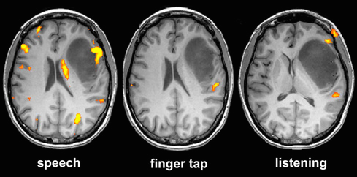
Functional MRI
Used to obtain functional information by visualizing cortical activity.
Detect subtle alterations in blood flow in response to stimuli or actions.
Typically used in pre-surgical patients to map eloquent areas or for research.

Slide 20
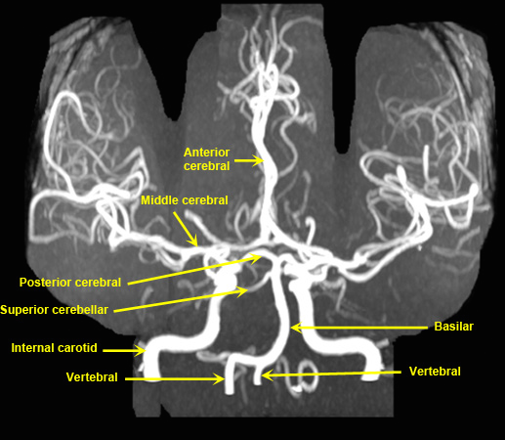
MR Angiography and Venography :
Used for evaluation of arteries and veins respectively.
Gadolinium is used as a paramagnetic contrast agent.

Slide 21
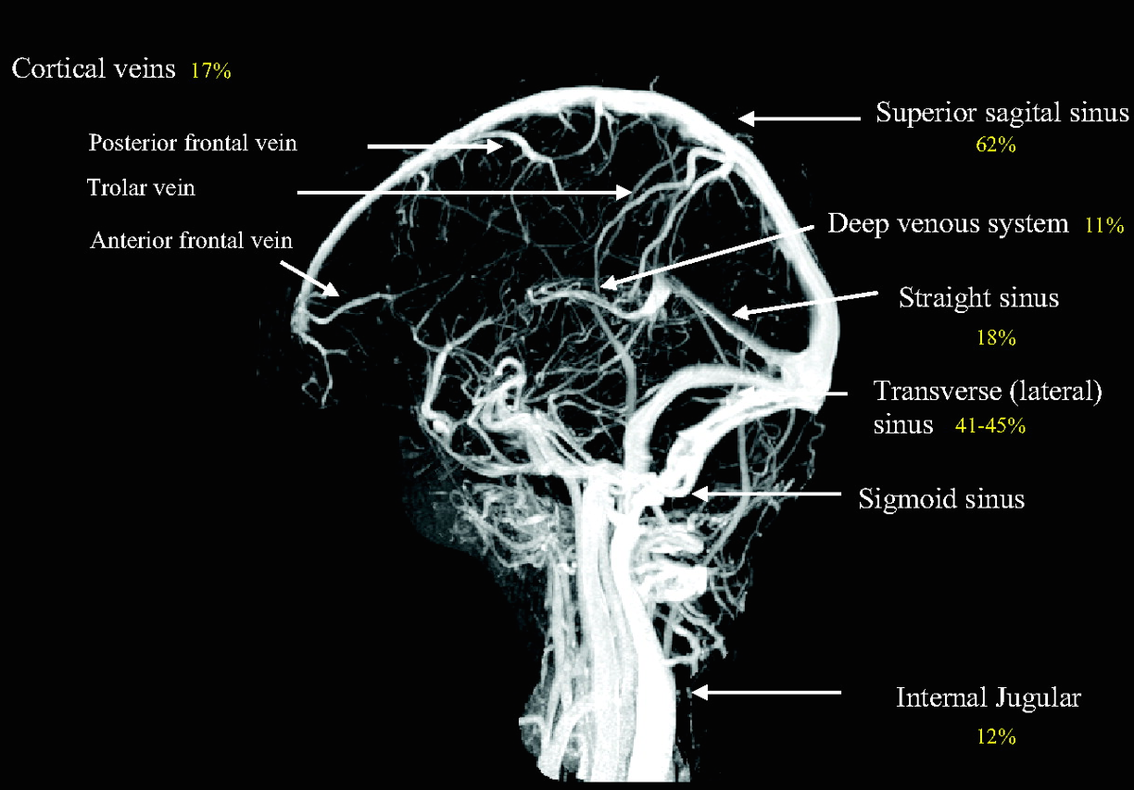

Slide 22
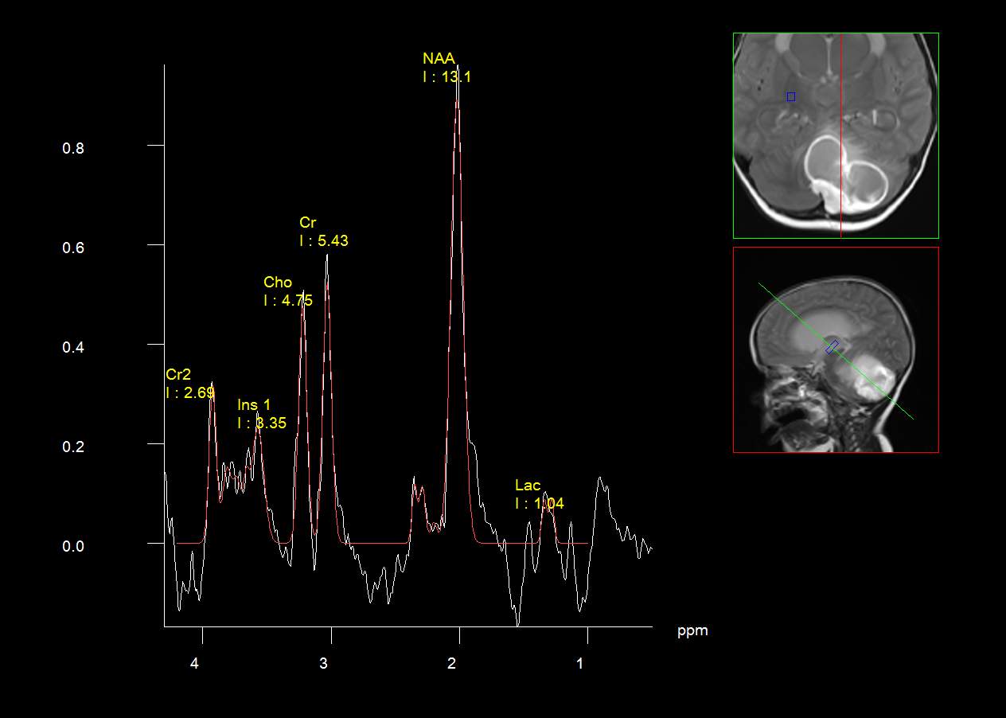
MR Spectroscopy :
It is a series of tests added to the MRI scan to measure the chemical metabolism of a suspected lesions.

Slide 23
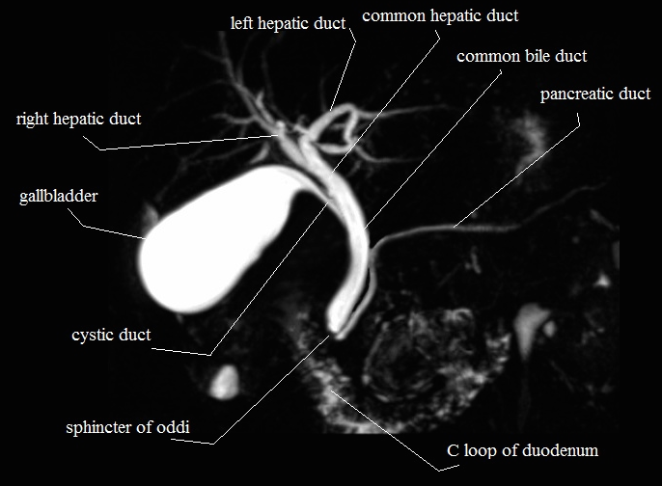
MRCP :
Provides detailed imaging of hepatobiliary and pancreatic system.

Slide 24
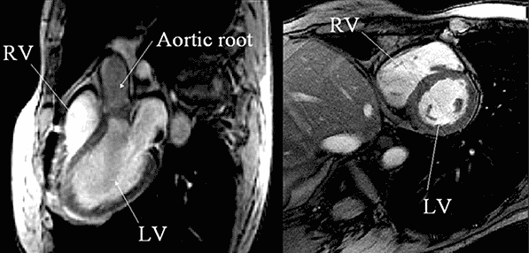
Cardiac MRI :
non-invasive assessment of structure and function of heart and help quantify bloos flow through the valves.
ECG gating and high temporal resolution protocols.

Slide 25
Interventional Radiology :
It finds great use in biopsies of suspected lesions, to remove tissues non-invasively (thermal ablation), various heart procedures.

Slide 26
THANK YOU

