Slide 1
Narrow Complex Tachycardias
Dr. Isha Bansal
MODERATOR: Dr. Shailendra Mane

Slide 3
Re-entry (SVT, WPW)
Two parallel pathways with different rates and refractory periods
Something alters the refractory period and the alternative pathway becomes dominant
This causes a unidirectional conduction block, and a circuitous conduction pathway forms.
PAC

Slide 4
Enhanced or Triggered (PACs, PVCs, Afib, MFAT)
Conduction cells act as Pacemaker cells
Conduction cells can be enhanced and become dominant in the setting of ischemia, sepsis, electrolyte imbalance or toxins.
Some dysrhythmias start with enhanced or triggered activity, but follow a circuitous pathway seen in re-entry. (Atrial flutter, Vtach)

Slide 5
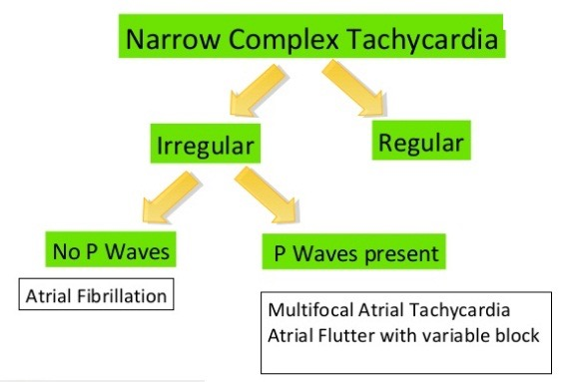

Slide 7
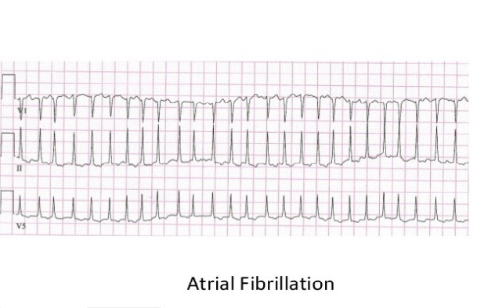

Slide 10
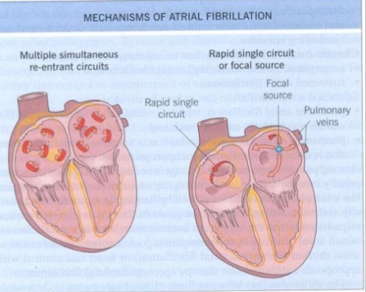

Slide 12
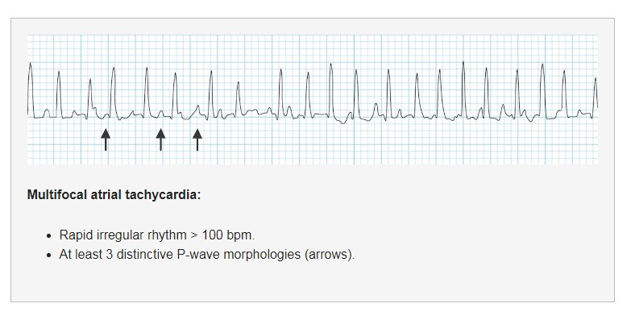

Slide 15
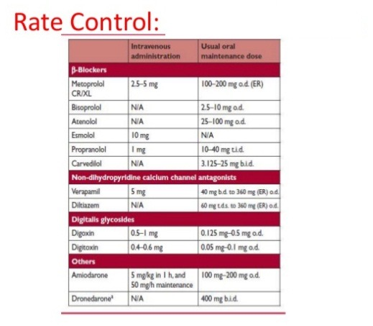

Slide 16
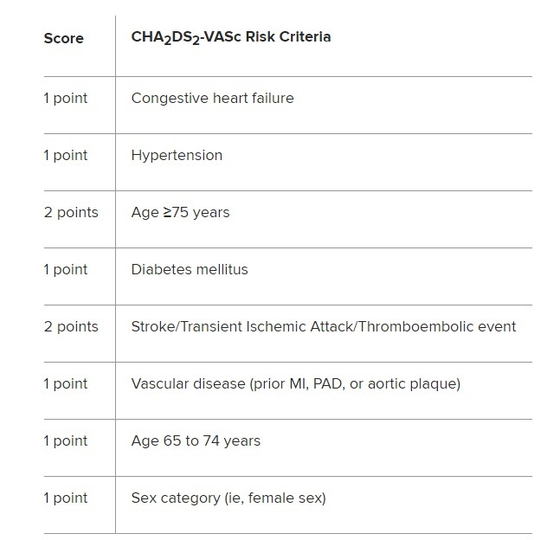

Slide 17
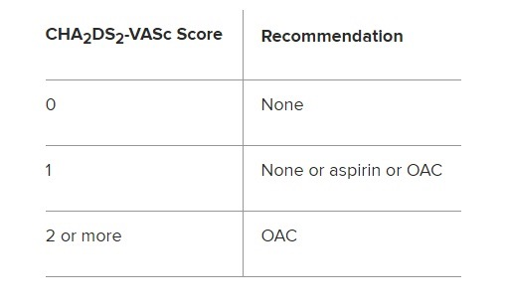

Slide 18
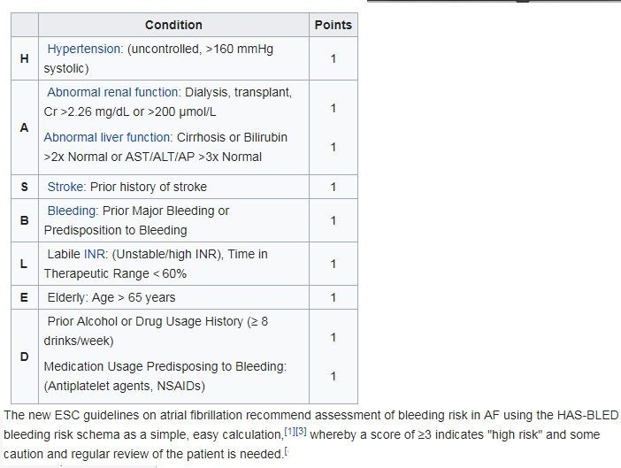

Slide 19
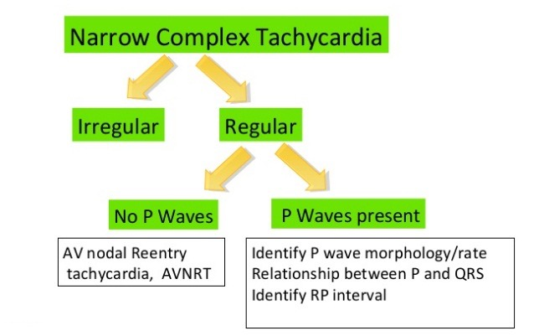

Slide 21
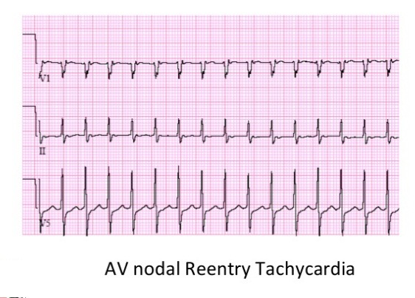

Slide 22
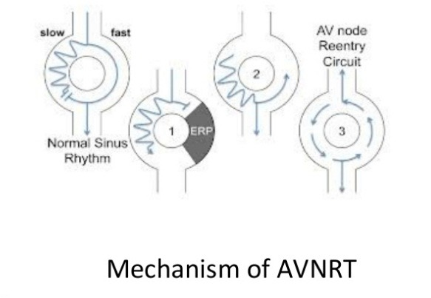

Slide 26
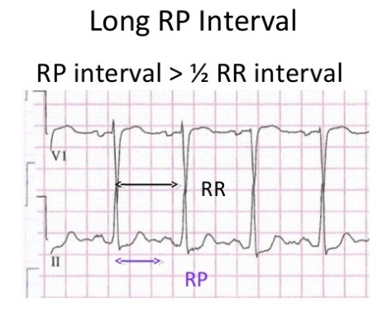

Slide 27
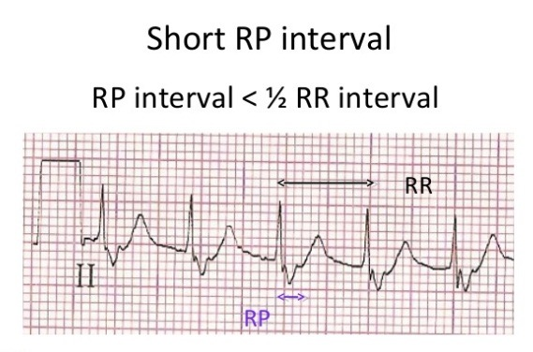

Slide 29
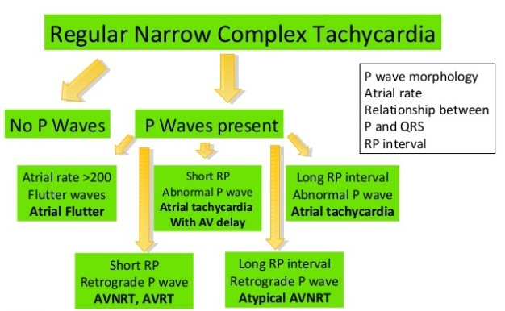

Slide 30
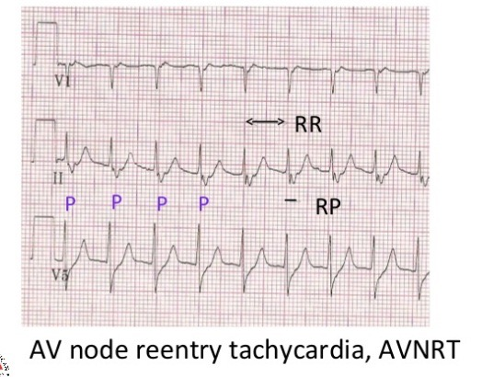

Slide 32
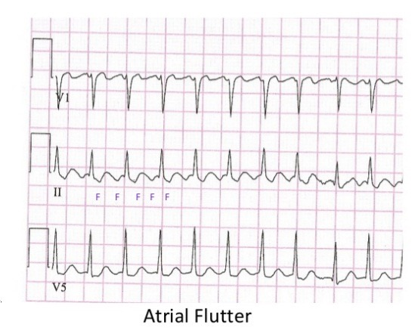

Slide 35
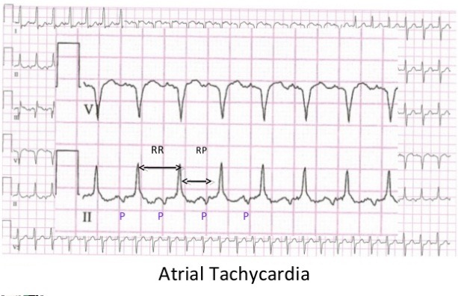

Slide 36
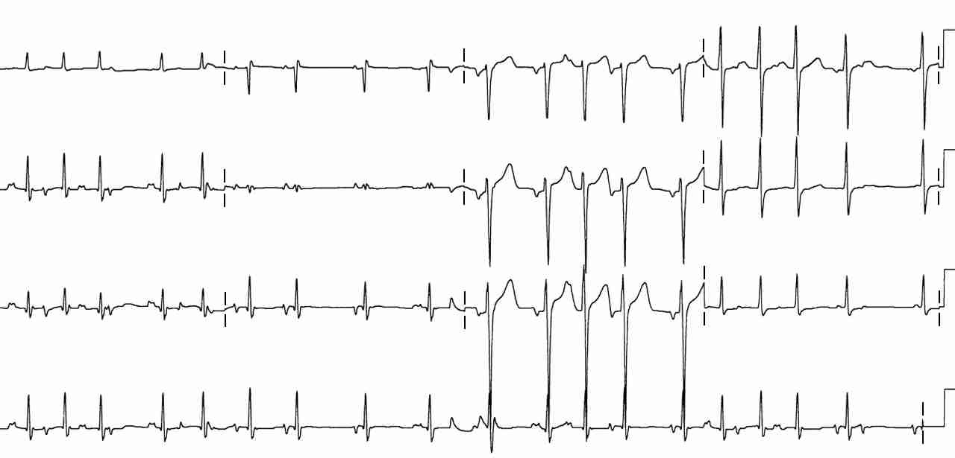
A 60 yo with COPD c/o palpitations & SOB. The EKG shows: a. Atrial Fibrillation
b. Premature Atrial Complexes
c. Multi-Focal Atrial Tachycardia
d. Paroxismal Atrial Tachycardia with block

Slide 37
P waves of at least 3 different shapes
No dominant atrial pacemaker
Rate greater than 100 bpm
Varying PR, RR, and PP intervals
Enhanced or triggered automaticity

Slide 38
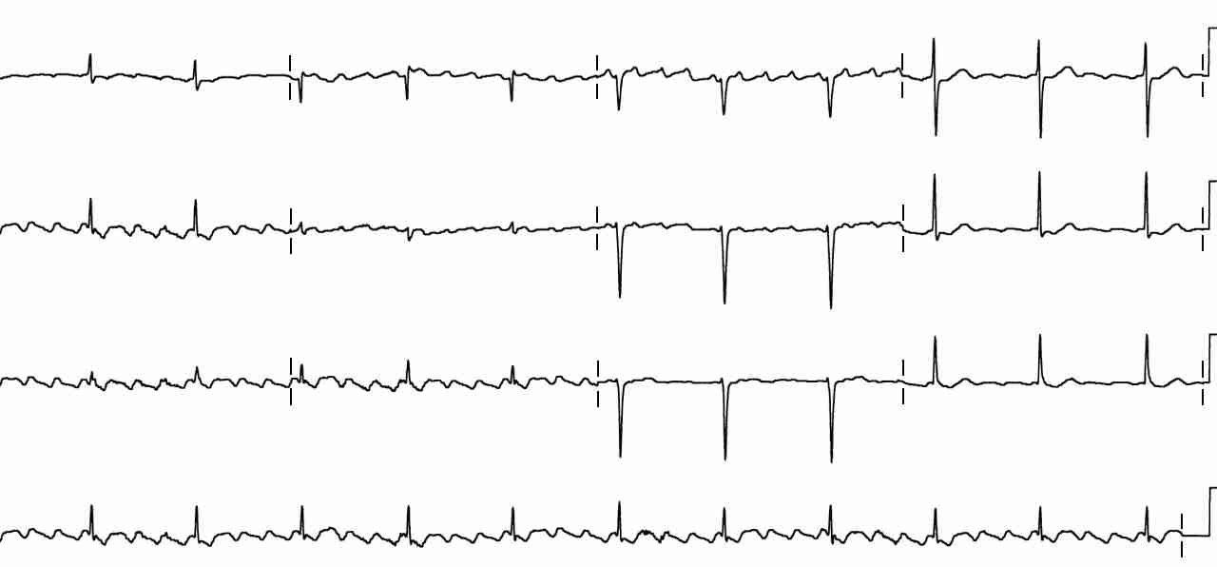
A 56 year old presents with palpitations. EKG shows: a. Atrial fibrillation
b. Atrial flutter
c. Left anterior fasicular block
d. RBBB

Slide 39
B. ATRIAL FLUTTER : Rapid, regular flutter (F) waves at 250-350 per minute (ventricular conduction 1:2, ie ~150bpm)
Sawtooth pattern of F waves in leads 2, 3 and AVF
Little evidence of atrial activity in lead 1
AV conduction variable, QRS typically normal width
Enhanced automaticity leading to circuitous conduction/reentry

Slide 40
A 46 year old presents with palpitations. EKG shows: a. Atrial fibrillation
b. Atrial flutter
c. Left anterior fasicular block
d. RBBB

Slide 41
EKG shows: a. Atrial fibrillation
Prominent fibrillatory waves in V ₁₋₃ & AVF
Irregular ventricular response, greater than 100 / min
Ventricular rate less than 100 implies AV block
Triggered/enhanced automaticity

Slide 42
THANK - YOU

