Slide 1
RITUXIMAB IN B-LINEAGE ADULT ACUTE LYMPHOBLASTIC LEUKAEMIA
Published in nejm in sep 2016

Slide 2
Acute lymphoblastic leukaemia
ALL characterised by proliferation and appearance of lymphoblasts in bone marrow and peripheral blood stream.
Etiology of ALL in adults is uncertain. The incidence increases in the elderly.
The FAB system classifies ALL, into lymphoid malignancies of small uniform blasts(L1), with larger and variable size cells(L2), and uniform cells with basophilic and vacuolated cytoplasm(L3).

Slide 3
Immunologic Subtype | % of cells | FAB classification | Cytogenetic abnormalities
Pre-B ALL | 75 | L1,L2 | t(9,22),t(4,11),t(1;19)
T- cell ALL | 20 | L1,L2 | 14q11 or 7q34
B- cell ALL | 5 | L3 | t(8,14), t(8,22),t(2,8)

Slide 4
Pts usually present with signs of bone marrow failure such as pallor, fatigue, bleeding, fever and infections related to peripheral blood cytopenias.
Extramedullary sites of disease are frequently involved including lymphadenopathy, hepatospleenomegaly,CNS disease,testicular enlargement and / cutaneous infiltration.
Prognosis depends upon genetic characteristics of the tumor, patients age, white cell count and pts overall clinical status and major organ function.

Slide 5
INTRODUCTION
The outcome for adults with acute lymphoblastic leukemia (ALL) has significantly improved over the past decade, with the use of more intensive chemotherapy,
Although tyrosine kinase inhibitors are now used to treat Philadelphia chromosome (Ph)–positive ALL, one of the most promising new approaches relies on the use of monoclonal antibodies targeting the CD19, CD20, CD22, CD33, and CD52 surface antigens expressed by ALL blast cells.
Even though majority of the B cells express CD20 antigen it is only present on 30-50% of the B-cell preceusor ALL blasts.

Slide 6
CD 20 expression in adults with B cell precursor ALL is associated with adverse prognostic significance.
This study conducted a multicenter, randomized trial evaluating the addition of rituximab to chemotherapy in patients with Ph-negative, B-lineage ALL expressing the CD20 antigen.

Slide 7
METHODOLOGY
The Group for Research on Adult Acute Lymphoblastic Leukemia 2005 (GRAALL-2005) trial was conducted between 2006 and 2014 at 56 French and 9 Swiss centers.
Pts of age 18-59 and newly diagnosed ph negative B cell ALL expressing CD20 .
Positivity for CD20 was defined as baseline expression of the CD20 antigen in more than 20% of leukemic cells.
Patients with Burkitt’s mature B-cell lymphoma or leukemia were excluded.

Slide 8
220 patients from 59 centers were randomly assigned to one of the GRAALL-2005/R study groups.
9 patients were not eligible (5 with Ph-positive ALL, 3 with CD20-negative ALL, and 1 with human immunodeficiency virus infection), and 2 patients withdrew consent.
These 11 patients were excluded from the modified intention-to-treat analysis leaving 209 patients (105 in the rituximab group and 104 in the control group).

Slide 9
EXCLUSION CRITERIA
ALL-L3 in the French-American-British classification
Prior myeloproliferative syndrome, including Ph1-positive CML.
ECOG Performance Status Score > 3
Creatinine level > 2x , expect if ALL related.
Total serum bilirubin > 2.5x, ASAT or ALAT (SGPT) > 5x, except if ALL-related.
Positive pregnancy test
Positive serum test for HIV or HTLV-1
NYHA Grade 3/4 cardiac disease
Active severe infection
Psychiatric disease or an history of non-compliance to medical regimens or patients considered potentially unreliable.

Slide 10
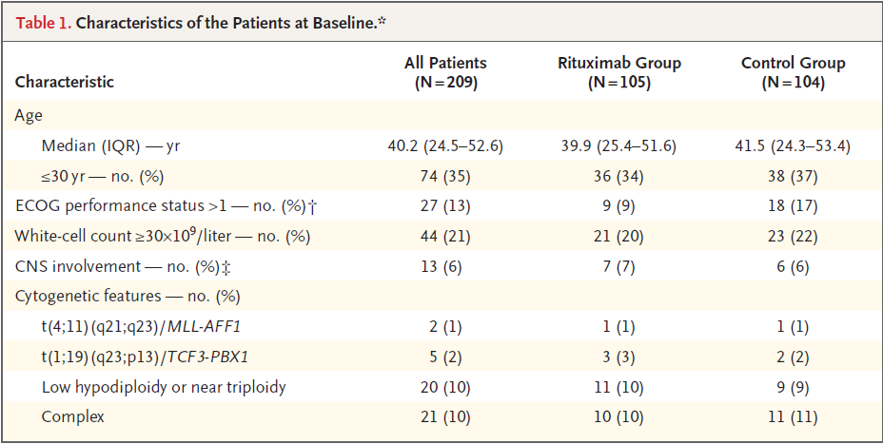

Slide 11
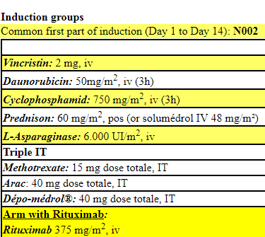
TREATMENT AND PROCEDURES

Slide 12
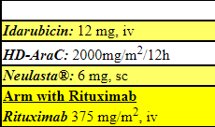
A first peripheral blood (PB) and marrow assessment of response will be done at Day 36 of the induction course
Patients not achieving HCR after induction will receive the following salvage course combining idarubicin (IDA) and high doses of cytarabine.

Slide 13
Patients not achieving remission after induction + salvage will go out of the study. Patients achieving remission after induction +/- salvage will then all receive two series of 3 consecutive blocks of consolidation (namely 1 HD-AraC block, 1 HD-MTX block, and 1 HD-CPM block).
These three blocks will be administered at Day 1, Day 15, and Day 29 strictly, without waiting for the myeloid recovery between two consecutive blocks of each series.
During the first complete remission, allogeneic hematopoietic stem-cell transplantation was offered to patients who were 55 years of age or younger if they had a suitable donor and were considered to be at high risk.

Slide 14
High-risk patients were those who met one or more of the following criteria:
CNS involvement
a white-cell count of 30×109/ L or higher
a CD10-negative immature immunophenotype
low hypodiploidy or near triploidy on karyotype
Poor early peripheral-blood blast clearance, poor early bone marrow blast clearance, at the end of the first week of induction chemotherapy.

Slide 15
STATISTICAL ANALYSIS
The primary end point of the study was event free survival. Events were failure of complete remission induction, relapse, and death.
Secondary end points were the rate of hematologic remission, cumulative incidences of relapse and death during the first remission, overall survival, and safety.

Slide 16
RESULT
After a median follow-up of 30 months, a total of 101 patients (48%) had had at least one event: 44 patients (42%) in the rituximab group and 57 (55%) in the control group.
 | Total | Rituximab | Control
Induction Failure | 17 | 8 | 9
Relapses | 57 | 22 | 35
Death | 27 | 14 | 13

Slide 17
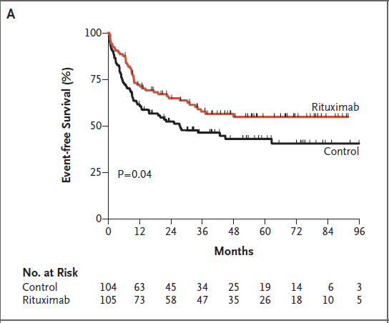

Slide 18
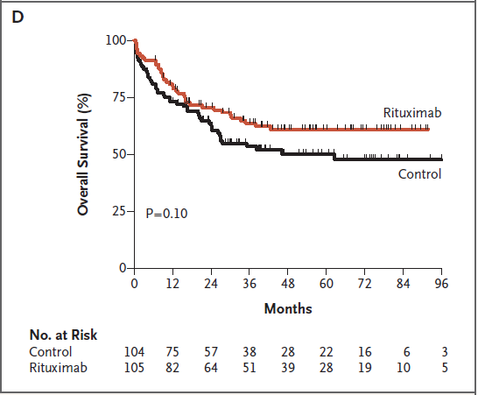

Slide 19
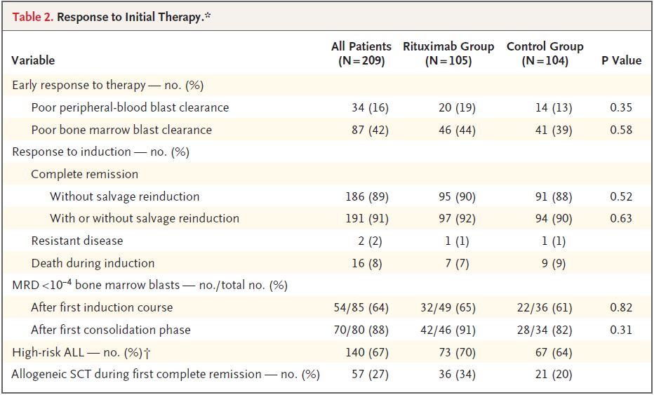

Slide 20
PROGNOSTIC FACTORS AND SUBGROUP ANALYSIS
In addition to randomized assignment to the control group, factors associated with significantly shorter event-free survival were older age, central nervous system involvement, and a higher white-cell count at diagnosis.
A more pronounced effect of rituximab was observed in patients with higher levels of CD20 expression, although the difference was not significant.

Slide 21
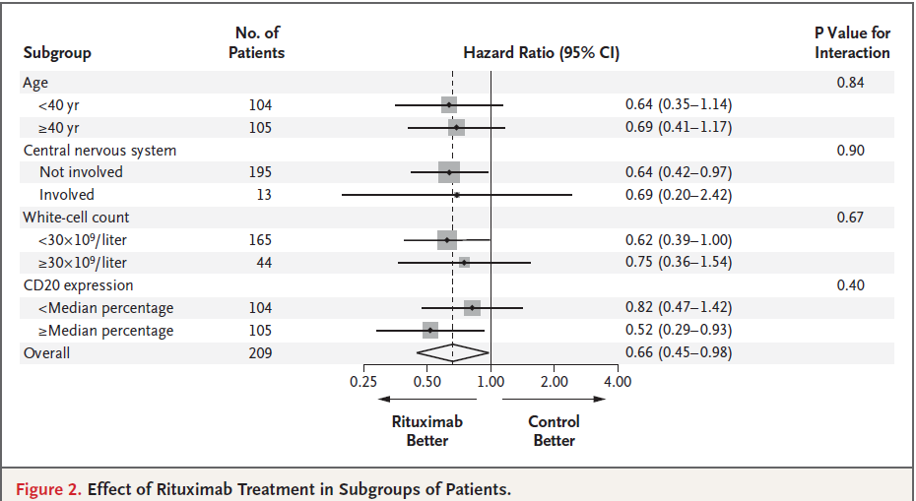

Slide 22
DISCUSSION
This randomized study showed that the addition of rituximab to standard chemotherapy significantly improved event-free survival among adults with CD20-positive ALL.
Which was explained by reduction in the cumulative incidence of relapse, with no significant increase in toxic effects or the cumulative incidence of death during the first remission.
A direct effect of rituximab, mediated by its binding to leukemic cells, is more beneficial with higher levels of CD20 expression on their leukemic blasts.

Slide 23
However, an indirect mechanism observed in rituximab group was allergic reactions to asparaginase, suggesting that patients treated with rituximab may have received a higher cumulative dose of asparaginase during their treatment course.
Such a protective effect of rituximab could be related to inhibition of the production of antiasparaginase antibodies which may also impair the efficacy of asparaginase therapy.

Slide 24
THANK YOU

