Slide 1
SPONTANEOUS BACTERIAL PERITONITIS

Slide 2
Is the most common infection in cirrhosis
Called spontaneous as it occurs without a contiguous source of infection (eg – intestinal perforation, intra-abdominal abscess) and in the absence of an intra-abdominal inflammatory focus (abscess, pancreatitis)
It is blood-borne and 90% are monomicrobial.
Bacteria of gut origin are the most commonly isolated organisms.
Thus, migration of enteric bacteria cross the mucosa to extraintestinal sites has been implicated.

Slide 3
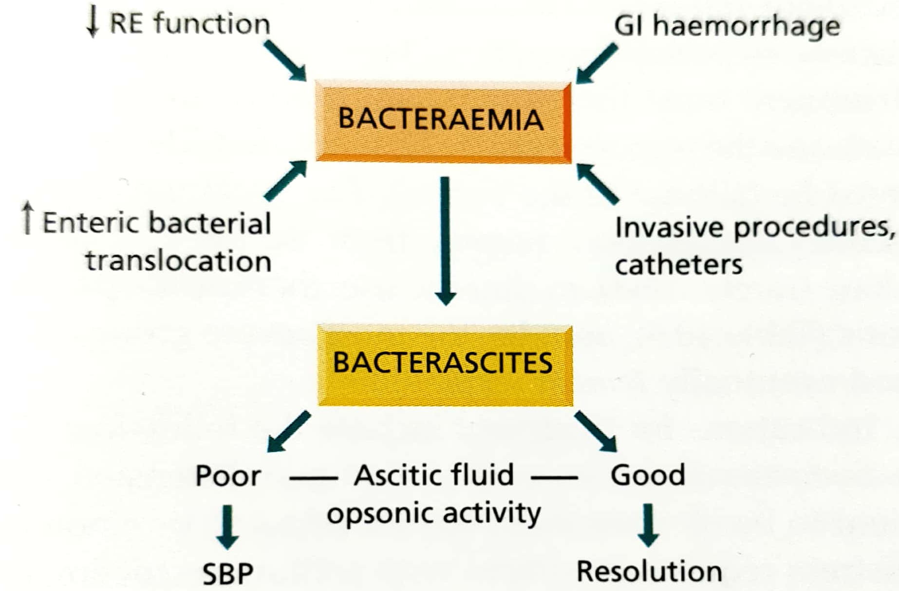
In cirrhosis, an overactive sympathetic system slows gut motility and facilitates bacterial stasis thus facilitation translocation.
Persistence of bacteria in extraintestinal sites is favoured by impaired host defenses.
Ascitic fluid favours bacterial growth and deficient ascitic opsonins leads to defective coating of bacteria which are indigestible by polymorphs.

Slide 4
Should be suspected when a patient of cirrhosis deteriorates, particularly with encephalopathy and/or jaundice.
Patients with variceal bleed or previous SBP are at an increased risk.
Pyrexia, local abdominal pain and tenderness , and systemic leukocytosis

Slide 5
diagnosis
Ascitis PMN count > 250/mm³
Commonly – E.coli or group D streptococci
Anaerobic bacteria rarely
Blood cultures positive in 50%
Bacterascites (positive culture, PMN < 250/mm³) may progress to SBP
These patients are a particular risk for renal complications

Slide 6
Prognosis
1-year probability of SBP recurrences is 69% and median survival is 9 months
Mortality depends on development of renal dysfunction and site of acquisition of the infection, with nosocomial infection being an important predictor of death.
SBP resolution and immediate survival are 100% for community-acquired SBP that is uncomplicated.

Slide 7
Treatment
Antibiotics should be started empirically in all patients with ascites showing >250 mm³ PMN except in those whom local inflammatory reaction is identified.
5-7 days of a third-generation cephalosporin such as cefotaxime administered IV. 2g 12 hourly.
Amovycillin-clavulanic acid is as effective.
Aminoglycosides avoided due to renal toxicity.
Extended spectrum antibiotics should be used as initial empirical therapy
Because of reduced survival, SBP is an indication to consider hepatic transplantation, particularly if recurrent.

Slide 8
Prophylaxis
Risk is particularly high in patients with cirrhosis with the upper GI haemorrhage.
Oral administration of norfloxacin ( 400 mg/12 hr for a minimum of 7 days)
IV ceftriaxone should be considered in high quinolone resistance or in patients with – malnutrition, ascites, encephalopathy, or serum bilirubin more than 3 mg/dL.
SBP and other infections should be ruled out before starting prophylaxis.
In a patient with a previous episode of SBP, the risk of recurrence during the subsequent year is 40-70%. Oral administration of norfloxacin (400mg/day) is recommended and then evaluated or transplant.

Slide 9
Norfloxacin in patients with advanced liver failure (child-Pugh score > 9 points with serum bilirubin >3 mg/dL) or impaired renal function (serum creatinine > 1.2 mg/dL =, blood urea nitrogen >25 mg/dL or serum sodium level < 130)
In these, the 1-year probability of first SBP is 60% and this risk is reduced by prophylaxis.
In patients with high ascitic protein (>1 g/dL) without a past history of SBP there is no need of prophylaxis as the the 1-year probability is nil.

Slide 10
Thank you

