Slide 1
TREATMENT OF ULCERATIVE COLITIS

Slide 2
Primary treatment is medical
The components of therapy are:
Antidiarrhoeals (lomotil)
Antibiotics (sulfasalazine)
Corticosteroids
Diet
Vitamin and minerals
General support

Slide 3
The medical management for mild and mod attack is as follows:
Prednisolone 5 mg 4x a day, sulfasalazine 0.5g 4x a day and predsol retention enema shd be cont.
Remission- cont the treatment
If relapse breaks out-medical management fr severe attack shd be adopted.

Slide 4
Medical management for severe attack is as follows:
IV fluids, Blood transfusion
Vitamin supplement and maintenance of nutrition.
iv Prednisolone 60 mg/day in divided doses, hydrocort sod succinate 100 mg in 120 ml rectal drip twice a day.
Parenteral feeding by aminosol with fructose or ethanol
Broad spectrum antibiotic
Metronidazole, morphine or lomotil.

Slide 5
Immunosuppressive drug like azathioprine can be used as the disease has a autoimmune background.
Dose of 2-2.5 mg/kg body wt.
25% of the pts have shown clinical improvement.

Slide 6
Surgical treatment-
75-80% cases managed by medical t/t
Only 10% need surgery.
INDICATIONS for emergency surgery:
Massive and unrelenting haemorrhage
Toxic megacolon with impending perforation
Fulminating acute ulcerative colitis

Slide 7
INDICATIONS for elective surgery:
partial intestinal obstruction
Confined perforation with abcess formation
Chronic disease
Pararectal complications such as fistula and abcesses
Serious systemic or distant complications not resp. to medical t/t
In long cont. colitis which carries higher risk of colonic cancer.

Slide 8
The main t/t is single staged TOTAL PROCTOCOLECTOMY.
This procedure is performed through midline incision
colon is examined carefully with part
reference to any adhesions to the neighbouring structures
If so, colon is mobilized to prevent the contamination of abd. Cavity by spillage of the faeces
Asc and des colon are mobilised

Slide 9
ureters are identified and nylon tape is passed round each one .
DISSECTION OF THE RECTUM-surrounding tissue is distended by 1:200,000 NA in normal saline.
Small intestine is divided 8 inches above the ileocaecal valve, prox end is sutured with the purse string suture.
Colon and rectum are now removed.
Peritoneum in pelvis is sutured, perineal skin is sutured with a pelvic drain in middle of the perineal wound.

Slide 10
ileostomy opening is made by cutting a disc of skin & subcut. Tissue 3 cm in diameter from ant abd wall
Cruciate incision is made on the rectal sheath
The ends of a purse string suture of ileum are used to pull the ileum out through hole in abd wall until it protrudes abt 3 inches.
Ileum is anchored to the post. Rectal sheath by a no. interuppted sutures to prevent prolapse.

Slide 11
The purse string suture on the end of ileum is removed,
ileum is turned inside out & the edge of the mucosa is anchored to the edge of the skin and a suitable ileostomy appliance is immediately fixed.

Slide 12
Early postoperative care:
care of ileostomy-
nowadays a ileostomy bag is fitted to the ileostomy spout and is supported by a waist strap and is adhered to skin by adhesive plaster.
The lower rim of the bag should not press on the lower margin of the ileostomy spout.
complications-prolapse, retraction, stenosis, bleeding and paraileostomy hernia.

Slide 13
Other methods include:
  Continent ileostomy(Koch)-
  Ileostomy reservoir is made from which the terminal ileum opens the surface by a one way valve.
  It doesn’t require a bag or appliance and can be emptied at the time pt desires to do so.
  End ileostomy(Brooke)-
  Ileum is brought out through the lateral edge of rectus abdominis msc, spout of ileum is made to project 4cm from the skin surface.

Slide 14
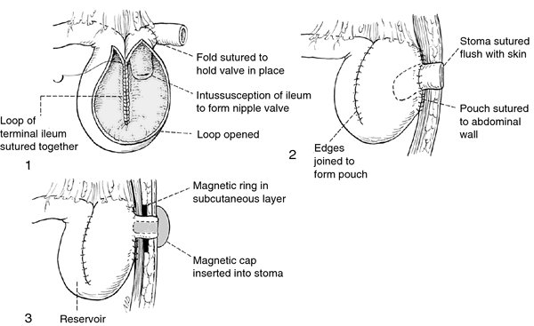

Slide 15
Post opertive complications:
Infection- Gm –ve septicaemia
Paralytic ileus
Intestinal obstruction
A persistent perineal sinus
Ileostomy prolapse
Skin problems
Other alternative operations are subtotal colectomy with ileorectal anastomosis, colectomy, mucosal proctectomy and endorectal ileoanal anastomosis.

Slide 16
      THANK YOU

