Slide 1
APPROACH TO ARTHRITS
DR UDAYAN SAHA
DR KUNAL PATIL
07/03/18

Slide 2
Arthritis is a term often used to mean any disorder that affects joints .Symptoms generally include joint pain and stiffness .Other symptoms may include redness, warmth, swelling , and decreased range of motion of the affected joints .In some types other organs are also affected . Onset can be gradual or sudden.

Slide 3
EVALUATION OF ARTHRITIS
Articular or Nonarticular
Inflammatory or Noninflammatory
Acute or chronic
Monoarticular or polyarticular
Extra articular signs

Slide 5
Articular
Nonarticular
Involved structure :
extraartucular ligaments, tendons , bursae ,muscle, fascia , bone ,nerve , overlying skin.
Symptoms
localized pain
Point or local tenderness
Painful active movements but not on passive
Physical findings are remote from joint capsule.
swelling , crepitation ,joint instability, deformity are rare.
Involved structure :
synovium , synovial fluid , articular cartilage , intra articular ligaments ,joint capsule , juxtaarticular bone
Symptoms
Deep or diffuse pain.
Painful or limited range of movement in both active and passive .
SIGNS
Swelling of joint
Crepitation.
Joint instability.
Locking of joint.
Deformity.

Slide 6
Inflammatory
Noninflammatory
infectious , crystal induced , immune related , reactive or idiopathic.
Cardinal signs
Systemic symptoms.
Morning stiffness , (precipitated by prolonged rest , lasts for hours and improve with activity and anti inflammatory drugs )
lab evidences shows:
ESR ,CRP , Thrombocytosis anaemia, hypoalbuminemia.
Trauma, degenaration , ineffective repair ,neoplasm , repetitive use .
No Cardinal signs .
No Systemic symptoms .
Intermittent stiffness precipitated by brief period of rest , usually lasts for 60 min and exacerbeted by activity.
No such findings in lab investigastions .

Slide 7
Acute or chronic
acute- < 6 wks eg.infectious arthritis crystal arthropathy reactive arthritis.
Chronic - >6 wks eg. Non inflamatory arthritis (OA) Inflammatory arthritis(RA) ,Fibromyalgia.
EVOLUTION –
chronic eg.OA
intermittent eg. Crystal / lymes arthritis
migratory arthritis eg.Rheumaticfever, Gonococcal, viral arthritis

Slide 8
Monoarticular or polyarticular
The extend of distribution of articular involvement is often classified by number of joints are involved
Monoarticular(1 joint ) crystal and infectious
Oligoarticular / pauciarticular (2-3 jont) OA & RA
Polyarticular (more than 4 joint)
Symmetric and Asymmetric
RA tends to be symmetric where as OA spondyloarthropathies , gout are often asymmetric
Extra articular signs Constitutional symptoms  Skin rashes  Mucous membrane lesions  Ocular  Nails  Raynauds  Serositis

Slide 10
Clinical history
Age :
YOUNG AGE SLE & reactive arthritis
MIDDLE AGE RA & Fibromyalgia
Elderly AGE GOUT & Polymyalgia rehumatica
SEX
Male are prone for gout and ankylosig spondylitis
FEMALE are prone foe RA, fibromyalgia , lupus
RACE
WHITEs are prone for polymyalgia , rheumatica , giantcell arteritis and wegner’s granulomatousis.
BLACKs are prone to sarcoidosis and SLE.
Familial aggregation may seen in ankylosing spondylosis , gout, OA

Slide 11
Chronology of the complaints
Important diagnostic feature and divided into the onset ,evolution , duration
Gout , septic arthritis tend to be abrupt onset.
OA, RA, fibromyalgia may more indolent presentation.
precipitating factors such as
Trauma
Drug induced
Intercurrent illness
Co morbidities: DM, renal insufficency
Cancers

Slide 12
Approach to regional complaints
Hand pain
Focal or unilateral hand pain may result from trauma , infection or reactive or crystal arthritis by contrast B/L complaints suggestive of degenerative OA , systemic or inflammatory.
Degenerative arthritis OA may manifests as DIP &PIP pain with bony hypertrophy sufficient to produce heberden’s node and bouchard’s node associated with pain with or without bony swelling involving the base of the thumb.
Inflammatory/ immune arthritis RA tends to involve PIP, MCP, Intercarpal and carpometacarpal jonts.
Psoriatic arthritis may mimic like OA but distinguished by the presence of inflammation .

Slide 14
Focal wrist pain
Dequervian’s tenosnovitis:
Resulting from inflammation of the tendon sheath involving abductor pollicis longus or extensor pollicis brevis commonly seen in post pregnancy or over use .
Carpal tunnel syndrome :
Result from compression of the median nerve with in the carpal tunnel .patient having symptoms of pain in the wrist that may radiate with paresthesia to the thumb and fingers. Associated with trauma ,pregnancy , infiltrative disorder.
Finkelestin’s sign
Tinel’s sign
Phalen’s sign

Slide 15
Knee pain
Result from intra articular OA , RA or peri articular and may referred from hip pathology .
Bony swelling of the knee joint commonly results from hypertrophic osseous changes seen in OA.

Slide 16
Hip joint is best evaluated by observing the patient’s gait and assessing range of motion.
Localizing hip pain or radiated down the postero lateral aspect of the thigh and may not associated with back pain caused by degenerative arthritis or involvement of nerve roots between L4 S1.
Siatica is caused by impingment of L4, L5 , S1 and manifests as unilateral neuropathic pain .

Slide 18
Laboratory investigation
Laboratory tests should be used to confirm a specific clinical diagnosis and not to be used to screen or evaluate patient with vague complaints.
Monoarticular conditions , traumatic , inflammatory or condition accompanied by neurologic manifestations or symptoms persists more than 6 weeks required lab investigations.
ESR & CRP which can be useful in discriminating inflammatory to Noninflammatory disorders but not as much sensitive can raised in many other conditions .
Sr uric acid level is a important in diagnosis of gout and monitoring the response to urate lowering drugs .some time levels do not correlate with severity of articular disease my be increased in other conditions .

Slide 19
Rheumatoid factor
A positive RF result was strongly associated with rheumatoid arthritis or another rheumatic disease. For rheumatoid arthritis, sensitivity = 0.28 and specificity = 0.87, while for any rheumatic disease, sensitivity = 0.29 and specificity = 0.88.
Other diseases in which it is positive :
SLE | Primary biliary cirrhosis
Sjogrens | Essential mixed cryoglobulinemia
Interstitial pulmonary fibrosis | Bacterial endocarditis
Hepatitis B, chronic liver disease | leprosy
Infectious mononucleosis | sarcoidosis
malaria | tuberculosis
leukaemia | syphilis

Slide 20
Anti -CCP
The sensitivity and specificity of anti-CCP reactivity for the diagnosis of rheumatoid arthritis (RA) were 66.0% and 90.4%, respectively.
Rheumatoid arthritis
Psoriatic arthritis
Sjogrens syndrome
Polymyalgia rheumatica
Palidromic rheumatism

Slide 21
ASO TITRE
ANA
Group A streptococcus infections used for rheumatic fever.
Also positive in :
Ear infection
Glomerulonephritis
Guttate psoriasis
Mastoiditis
Peritonsillar abscess
Rheumatic fever
Scarlet fever
Sinusitis
SLE
Sjogrens
Scleroderma
Mixed connective tissue disorder
Polymyositis
Dermatomyositis
Autoimmune hepatits
Drug induced lupus

Slide 22
HLA B 27
Specific for:
Psoriasis
Ankylosing Spondylitis
Inflammatory bowel disease
Reactive arthritis

Slide 24
SYNOVIAL FLUID ANALYSIS
Always indicated In acute monarthritis or infectious or crystal induced arthopathy is suspected .
Test for Glucose , protein ,LDH , lactic acid ,auto antibodies are not recommended as they have no diagnostic value .
Normal synovial fluid is clear , viscous with a WBC count of <2000/UL and predominance of mononuclear cells.
Inflammatory fluid is turbid and yellow with an increased cell count of 2000-50000/UL and reduced viscosity. (RA & GOUT)
Septic fluid opaque and purulent and WBC count >50000/UL with
predominance of polymormhoneuclear leukocytes and low viscosity.
Hemorrhagic synovial fluid may be seen in trauma , hemarthrosis .
Monosodium urate crystals are seen in gout.
When infection is suspected synovial fluid is should be gram stained and culture appropriately .

Slide 25
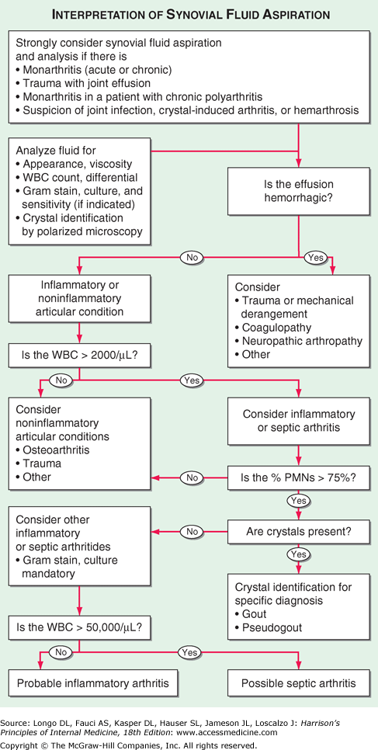

Slide 26
IMAGNG STUDY
Conventional radiography has been a valuable tool in diagnosis and staging of articular disease.
X RAY are most widely used when there is history of trauma ,chronic infection , progressive disability, mono articular involvement or when baseline assessment is desired to rule out chronic cases.
However in acute inflammatory arthritis is early radiography is rarely helpful in establishing a diagnosis
As the disease process progress calcification , joint space narrowing , erosion , bony ankylosing , subchondral cyst and suggest specific clinical entities .
Ultrasonograhy is useful in detection of soft tissue abnormalities such as tenosynovitis ,rotator cuff tear , tendinitis and tendon njury.

Slide 27
Radionucleotide scintingraphy provides useful information regarding the metabolic status of bone. Its is very sensitive but poorly specific means of detecting inflammatory or metabolic alteration in bone or prearticular soft tissue structure.
CT provides detailed visualization of the axial skeleton .
Articulations like zygapophyaseal , sacroiliac , sternoclavicular joints was difficult to visualize by radiography can be effectively evaluating CT.
Useful in demonstrated spinal stenosis vs. herniated disk , sarcoiliitis , osteoid osteoma and stress fracture .
Helical or spiral CT with our without contrast is novel technique , cost effective and sensitive in diagnosing obscure fracture .
Positron emission tomography(PET)and single photon emission CT (SPECT) is useful in metastatic evaluation .

Slide 28
MRI can image fascia ,vessels , nerve , muscle , cartilage , ligaments , tendons , synovial effusion and bone marrow.
Visualization of particular structures can be enhanced by altering the pulse sequance to produce either T1- T2 weighted spin.
Because of its sensitivity to changes in marrow fat MRI is sensitive but nonspecific means to detecting osteonecrosis , osteomyelitis and marrow inflammation indicating osteitis .
MRI is more sensitive than arthrography and CT Scan in the diagnosis of soft tissue injuries .

Slide 29
THANKYOU

