Slide 1
AUTOIMMUNE HEPATITIS
DR. PRITI SHAHAPURE

Slide 2
INTRODUCTION
Autoimmune hepatitis is characterised by continous hepatocellular necrosis and inflammation usually with fibrosis, which can progress to cirrhosis and liver failure.
It presents as a chronic relapsing hepatitis with plasma cell hepatic infiltrate, hypergammaglobulinaemia and positive autoantibodies.
Exclusion of the drug precipitants, inherited metabolic liver disorders and negative viral studies help in reaching over the diagnosis of autoimmune hepatitis.

Slide 3
AETIOLOGY
Cell mediated immunologic attack against the liver cells.
Histocompatibility haplotypes are HLA-B1, B8, DR3, and DR4.
Environmental and Drug triggers: such as nutritional supplementations, herbal chemical compounds, drugs such as minocycline are considered as the triggers.
Viral triggers: following hepatitis A.

Slide 4
Along with other autoimmune disorders such as thyroiditis, RA, autoimmune haemolytic anemia, ulcerative colitis, juvenile DM, and Sjogren’s syndrome.

Slide 5
CLINICAL MANIFESTATIONS
All age groups with a female preponderence.
There is a broad spectrum of clinical manifestations ranging from asymptomatic to fulminant hepatic failure with 10 % of them presenting as acute liver failure.
Symptoms include fatigue, malaise, anorexia, arthralgia, arthritis, jaundice.
occasionally maculopapular eruptions , colitis, pericarditis , anemia and sicca syndrome can be seen.

Slide 6
In some patients complications of cirrhosis such as ascites, odema, encephalopathy, coagulopathy and variceal bleeding may be present.
A subset of patients particularly middle aged females in whom there are absence of symptoms with abnormal liver function tests and marked hypergammaglobulinemia with high titres of ANAs termed initially as lupoid hepatits who have other autoimmune features in common.

Slide 7
The clinical course may be variable.
In patients with mild disease with limited histologic lesions progression to cirrhosis is limited.
Whereas in those with severe symptomatic autoimmune hepatitis( transaminases>10x, marked hyperglobulinemias, aggressive histologic lesions like bridging necrosis, multilobular collapse and cirrhosis) the 6 month mortality is as high as 40%.

Slide 8
LABORATORY FEATURES
Liver biochemistry and immunoglobulins:
Elevated transaminases (100-1000 units)
In severe cases the serum bilirubin level is moderately elevated(3-10mg/dl)
Hypergammaglobulinaemia(>2.5g/dl)
Hypoalbuminaemia and deranged pro time in advanced disease.
Serum alkaline phosphatase levels are near normal to moderately elevated. ( marked elevation i.e >3X PBC should be considered).

Slide 9
2. serology
Depending upon the serological patterns of autoreactivity two major types have been described,
Type 1 is characterised by ANA and/ antismooth muscle antibodies and is seen in young females with marked hypergammaglobulinemia, lupoid features and associated autoantibodies such as against actin and atypical pANCA.
They show an excellent response to the treatment.
Type 2 AIH is usually seen in children and is associated with anti LKM1 autoantibodies directed against cytochrome p450 2D6 and are usually resistant to the treatment.

Slide 10
A third subtype is occasionally described in patients who lack ANA and antiLKM but have circulating autoantibodies to liver soluble antigen.
These patients have clinical features similar or more severe than the type 1 AIH.

Slide 11
3.Imaging
Unlikely to help in the diagnosis of AIH but mainly to exclude imp D/Ds such as acute Budd-chiari syndrome and infiltrative diseases.
Radiologically it may show pseudocirrhotic appearance and in advanced disease ascites and spleenomegaly can be present.
Periportal lymphadenopathy is common in AIH and is rarely due to lymphoma.
Biliary overlap is variably reported particularly in those presenting in childhood and MR cholangiography should be considered.

Slide 12
4. Liver Biopsy
Biopsy findings are similar to that of chronic viral hepatitis.
These include interface hepatitis with mononuclear cell infiltrate along with plasma cell infiltrate.
Septal fibrosis, bridging fibrosis and cirrhosis are frequent changes that are seen.
While in case of acute hepatitis like illness lobular and centrilobular necrosis has been reported.

Slide 13
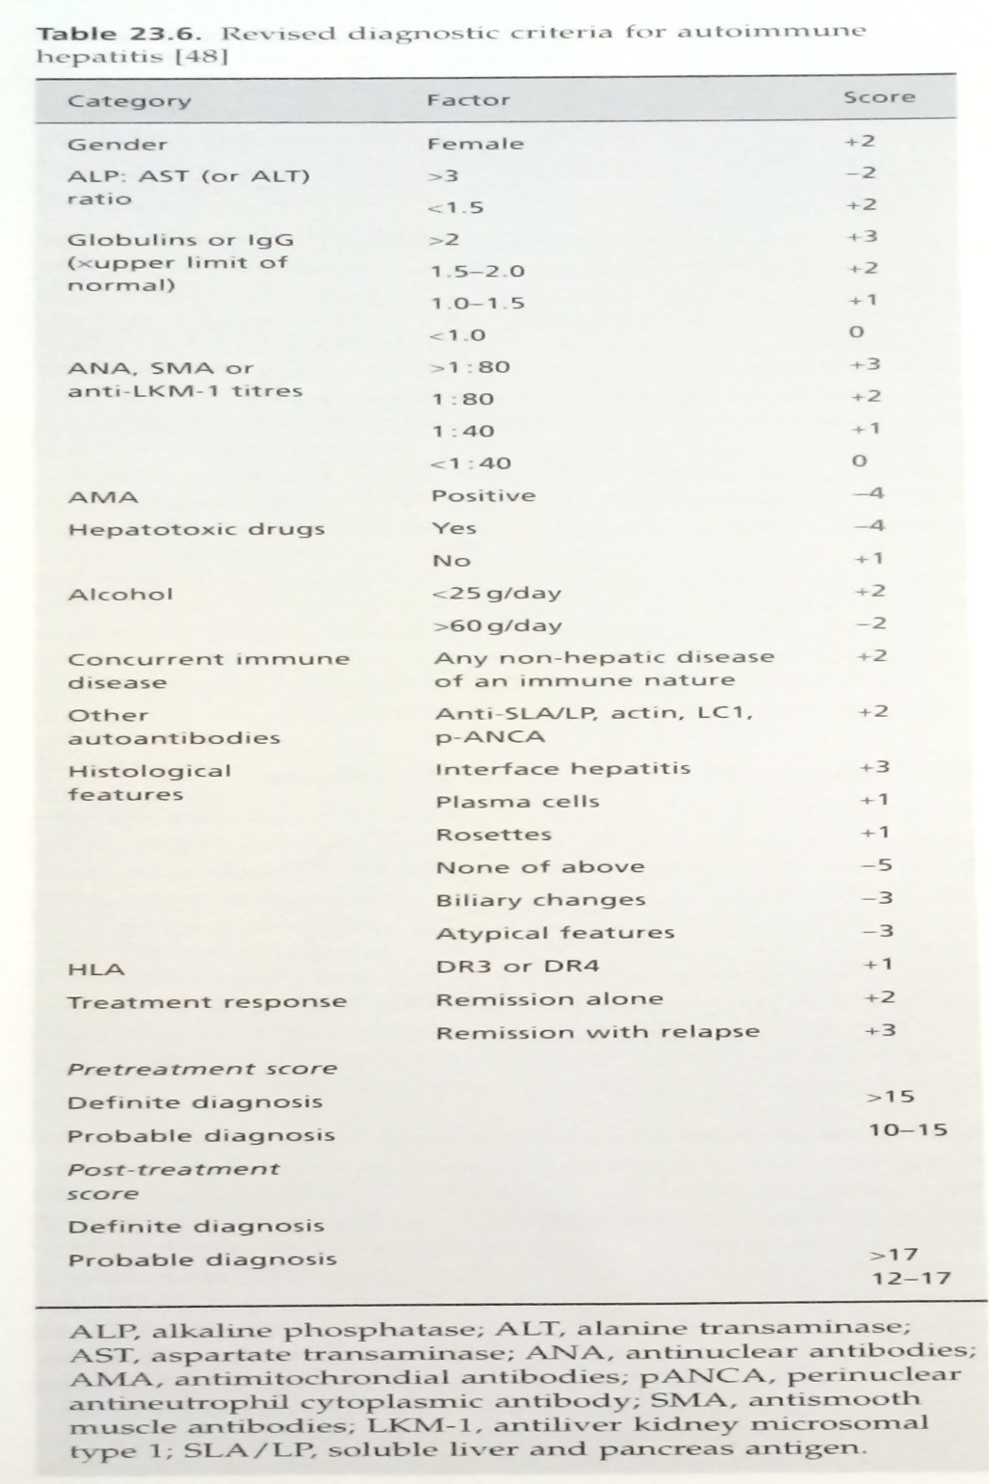

Slide 14
Differential diagnosis
AIH is usually a diagnosis of exclusion thus following conditions should be excluded to investigate for AIH.
Drug injury: minocycline, nitrofurantoin, statins, Anti-TNF agents, methyldopa, halothane, interferon alpha may lead to liver cell injury that may mimic AIH.
significant lymphadenopathy, rash and peripheral blood eosinophilia may suggest a drug injury.
Viral hepatitis: pts should be screened for HbsAg and antiHBc in case of hep B and HCV RNA in case of Hep C as the antiHCV can be negative usually in the early exposure.

Slide 15
Wilsons disease: it presents as chronic hepatitis much before the appearene of neurological features.
The serum cerruloplasmin, serum and urinary copper, KF rings with co-existant hemolysis help to differentiate it from AIH.
Budd chiari syndrome: painful hepatomegaly, ascites, and vascular imaging are clues for the diagnosis.
Biliary overlap: marked elevation of alkaline phosphatase, with positive antimitochondrial antibodies and imaging are helpful.

Slide 16
Treatment
The mainstay of management in AIH is glucocorticoid theraupy.
The theraupy has been shown to be effective for severe AIH ( transaminases > 10x ULN or transaminases> 5x with twofold elevatin in IgG, and histological evidence of bridging or multiacinar necrosis).
It is generally not indicated for mild forms and its efficacy here is not established.
Theraupy may be initiated at 60mg/d of prednisone which is tapered over a period of month at 20mg/d.

Slide 17
The alternative equally effective appraoch is to start with 30mg/d of prednisone along with azathioprine 50mg/d which reduces the life threatening complications of steroid theraupy.
Also this combination reduces the 18 months span of theraupy.
The response to the thraupy is assessed clinically, biochemically and possibly by repeat histological evaluation.
Improvement in the symptoms is seen within days to several weeks with biochemical improvement which occurs over the course of several weeks to months.

Slide 18
The histological improvement characterised by decrease in mononuclear infiltration and hepatocellular necrosis may be delayed for 6-24 months.
After tapering of the theraupy 50% relapse rate is seen and continuing azathioprine alone 2mg/kg/d has been shown to reduce the frequency of relapse.
The patients should be vaccinated against hep B & A ideally before the immunosupressive theraupy is started.

