Slide 1
Bedaquiline and Delamanid Combination Treatment of 5 Patients with Pulmonary Extensively Drug-Resistant Tuberculosis
Dr. Sanjana Bhagwat
Moderator : Dr. S. Jotkar

Slide 2
Published in October 2017 in the CDC (Centers for disease Prevention and Control) Emerging Infectious Diseases Journal
EID’s 2017 impact factor is 7.42, first among open-access infectious disease journals and fourth among the 88 tracked infectious disease journals
International circulation

Slide 3
Authors : Andrey Maryandyshev, Emanuele Pontali, Simon Tiberi, Onno Akkerman, Shashank Ganatra, Tsetan Dorji Sadutshang, Jan-Willem Alffenaar, Rohit Amale, Jai Mullerpattan, Sonam Topgyal, Zarir Farokh Udwadia, Rosella Centis, Lia D’Ambrosio, Giovanni Sotgiu, Giovanni Battista Migliori

Slide 4
INTRODUCTION
According to the World Health Organization (WHO):
4,80,000 multidrug-resistant (MDR) tuberculosis (TB) and 1,00,000 rifampin-resistant TB cases, and 2,50,000 deaths attributable to these 2 conditions, occurred globally in 2015.
6,00,000 new cases of MDR/RR-TB estimated in 2016.

Slide 5
Multidrug-resistant TB (MDR TB) :
caused by an organism that is resistant to at least isoniazid and rifampin.
Extensively drug resistant TB (XDR TB) :
caused by an organism resistant to isoniazid and rifampin, plus any fluoroquinolone and at least one of three injectable second-line drugs (i.e., amikacin, kanamycin, or capreomycin).

Slide 6
MDR TB and XDR TB treatments are of long duration, expensive, and complicated by a high rate of adverse events, making determining an effective drug regimen often difficult considering that a minimum of 4 active drugs are required according to WHO recommendations.
In this regard, bedaquiline and delamanid might be crucial for designing effective treatment regimens.

Slide 7
Bedaquiline:
It is the first drug to be specifically introduced for MDRTB.
It targets the mycobacterial ATP-synthase and inhibits its activity.
100 mg tablet for oral administration.
T1/2 of about 30 hours and a terminal half-life of 4-5 months.

Slide 8
Recommended Dose
The recommended dose of bedaquiline for the treatment of pulmonary MDR in adults is:
Weeks 1 – 2: 400 mg once daily
Weeks 3 – 24: 200 mg 3 times/week Bedaquiline is to be used for a period of 24 weeks.
discontinue bedaquiline 4–5 months prior to discontinuing other drugs in regimen avoid an extended period of exposure to low levels of bedaquiline as a single drug and subsequent acquired resistance.

Slide 9
Adverse effects :
Nausea / Vomiting
Dizziness
Headache
Hemoptysis
Increased blood amylase
Increased serum transaminases
Rash
Arthralgia / Myalgia
Chest pain
Anorexia, fatigue, jaundice
Important cardiovascular adverse effect is QT prolongation

Slide 10
Delamanid :
nitroimidazole derivative.
It acts by inhibiting the synthesis of mycobacterial cell wall components – Bactericidal.
Dosage : 100mg twice a day for 24 weeks.
Adverse effects :
Dizziness, insomnia, paraesthesia, tremor, haemoptysis, anaemia, eosinophilia, thrombocytopaenia, leucopaenia, increased LFTs, QTc prolongation

Slide 11
Although these drugs are increasingly used in combination in complicated cases, there are concerns that the co-administration of bedaquiline and delamanid could increase the occurrence of adverse events, particularly for QT prolongation.

Slide 12
Only 2 reports describe the co-administration of these drugs.
As of July 2017, the WHO does not recommend their combined use, given the lack of evidence regarding their safety.

Slide 13
MDR TB reference centers belonging to the International Bedaquiline Study Group performed a large study investigating safety, tolerability, and effectiveness of bedaquiline- containing regimens for MDR and XDR TB patients treated through and not through national TB programs.

Slide 14
However, no information on co-administration of bedaquiline and delamanid was included.
A retrospective and observational subanalysis was conducted which consisted of patients from the International Bedaquiline Study Group study who were undergoing treatment with bedaquiline and delamanid.

Slide 15
The Study
The study enrolled patients ≥15 years of age from the International Bedaquiline Study Group study who underwent treatment during January 1, 2008–August 30, 2016, on the basis of their exposure to both bedaquiline and delamanid during the intensive and/or continuation phase of the study.
Bedaquiline was administered at the recom- mended dosage of 400 mg/d for 14 days and then 200 mg 3×/wk with delamanid at 200 mg/d.

Slide 16
Ethhics approval was obtained for this retrospective research from the coordinating center and each clinical center that enrolled the patients.

Slide 17
The following were considered adverse events:
an absolute QT interval corrected with Fridericia’s formula (QTcF) prolongation of >500 ms;
cardiac arrest;
ventricular tachycardia or atrial fibrillation;
syncope;
and events suggestive of arrhythmia, dizziness, seizures, and palpitations.

Slide 18
Of the 428 patients with culture-confirmed MDR TB who were treated with bedaquiline, 5 received combined treatment with delamanid.
Considering the long half-life of bedaquiline (>5 months), 2 additional patients could have also been considered to have combined treatment; they were treated with delamanid shortly after bedaquiline.

Slide 19
Bedaquiline and delamanid were given concurrently to 5 patients with pulmonary XDR TB who lived in Russia (2), India (2), or the Netherlands
The characteristics of the patients were as shown :

Slide 20
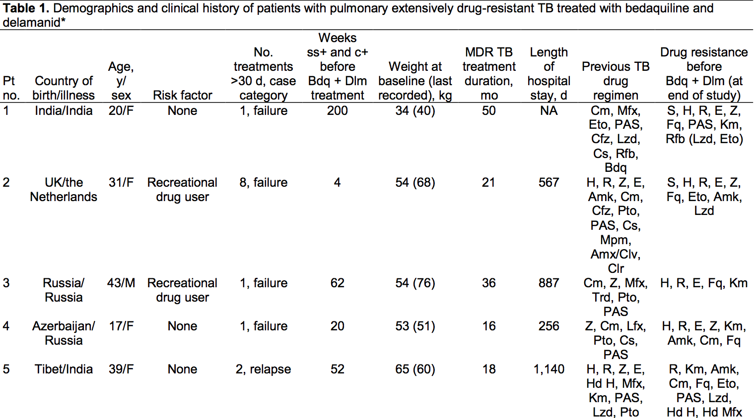

Slide 21
Chest radiographs indicated that 3 patients had extensive bilateral cavities, 1 had bilateral lesions (without cavities), and 1 had monolateral cavitary lung disease.
All patients were sputum-smear and culture positive for mycobacteria and had been potentially infectious for a mean of 65 weeks.

Slide 22
The resistance patterns of the isolated Mycobacterium tuberculosis strains were extensive, ranging from 5 to 10 drugs
Salvage regimens were designed for each patient on the basis of their unique resistance patterns, which lead to their treatments including bedaquiline and delamanid

Slide 23
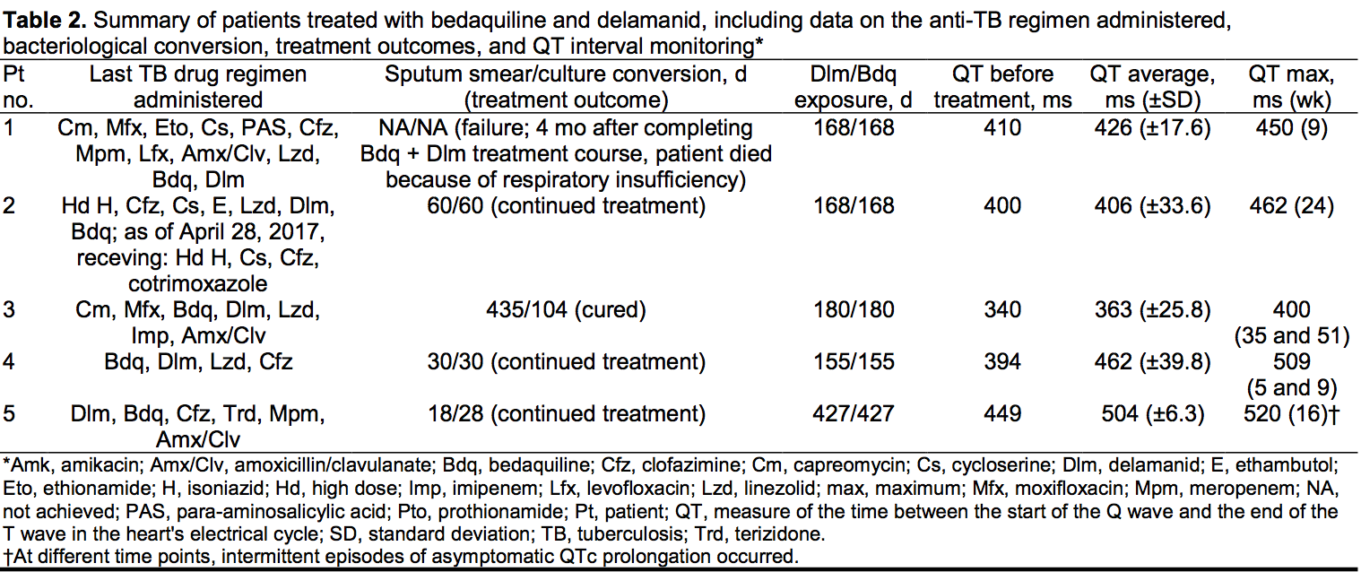

Slide 24
All regimens included another QT-prolonging drug in addition to bedaquiline and delamanid :
moxifloxacin (patients 1 and 3) or
clofazimine (patients 2, 4, and 5).

Slide 25
As of April 28, 2017, patient 3 had been declared cured;
patients 2, 4, and 5 were continuing therapy, although patient 2 was receiving a different drug regimen.
Patient 1 had received 4 months of salvage therapy, but treatment failed, and she died from respiratory insufficiency.
Patient 2 switched therapies because bedaquiline and delamanid had been already administered for a fixed period of 168 days as recommended by WHO.

Slide 26
With the exception of patient 1, who remained sputum-smear and culture positive, the other 4 patients’ sputum smears converted to negative after 18–435 days, and cultures converted after 28–218 days.

Slide 27
As recommended, all patients underwent QTcF-interval monitoring at baseline, at 2 weeks, and then monthly, even though no patient had a history of heart problems or electrocardiogram abnormalities.
A QTc interval >500 ms is considered a risk factor for fatal arrhythmia;
when this sign is found in patients, clinicians should either stop treatment with >1 QTc-prolonging drugs and start verapimil or watch and closely monitor.

Slide 28
The baseline QTcF intervals were <500 (range 340–449) ms for all patients.
Patients 1, 2, and 3 did not report adverse events for bedaquiline or delamanid, and their QTcF intervals remained below the threshold.
Patient 5’s QTcF interval reached 520 ms at week 16, which required a dose adjustment and the introduction of verapamil.

Slide 29
Patient 5’s treatment continued without further problems; she continued improving clinically, with improved chest radiograph findings and continuously negative sputum smears and cultures.
Patient 4 had a QTcF interval of 509 ms twice. Each time the treating physician practiced closer clinical observation with more frequent electrocardiogram monitoring, and her QTcF interval normalized spontaneously without changes in treatment.

Slide 30
Conclusions
We report that of 5 patients receiving bedaquiline and delamanid in combination 2 had potentially life-threatening QTcF prolongation.
The clinical centers took the necessary precautions and acted promptly to manage the problem, and no arrhythmias occurred

Slide 31
When patients received bedaquiline, delamanid, and another QTc-prolonging agent, clinically significant cardiac events and permanent discontinuation of bedaquiline and delamanid did not occur.

Slide 32
For patient 1, additional resistance to ethionamide and linezolid was detected in a drug susceptibility test in the final phase.
This treatment failure highlights that great care is needed when deciding drug regimens; the resistance threshold of both repurposed and new drugs still needs to be determined.

Slide 33
Although these data are preliminary and more work is needed, the findings from this cohort suggest that providing bedaquiline and delamanid in combination as part of therapy against XDR TB is justified when clinical options are limited.

Slide 34
Two ongoing randomized controlled trials have experimental arms containing these drugs in combination, so additional datasets will be available in the future.

Slide 35
Thank you

