Slide 1
SGLT2

Slide 2
SGLT 2 RECEPTORS
Sodium-glucose co-transporters are symporters and are of 2 types – SGLT 1 and SGLT 2.
The SGLT proteins use the energy created by the downhill sodium ion gradient by the Na⁺⁻ K⁺ pump to transport glucose across the apical membrane against an uphill glucose gradient.
This is an example of secondary active transport.
Members of the GLUT family then transport the glucose across the basolateral membrane and into the peritubular capillaries.
SGLT2 is the major cotransporter involved in glucose reabsorption in the kidney.

Slide 3
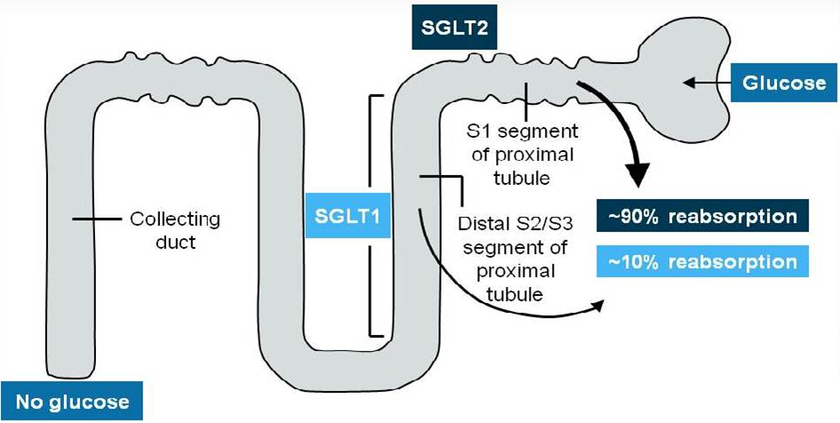

Slide 4
SGLT 2 INHIBITORS
SGLT 2 inhibitors are called gliflozins.
Examples are Canagliflozin, Dapagliflozin, and Empagliflozin.
By inhibiting SGLT-2, medications of the gliflozin class prevent the kidneys' reuptake of glucose from the glomerular filtrate and subsequently lower the glucose level in the blood and promote the excretion of glucose in the urine (glucosuria).

Slide 5
CANAGLIFLOZIN

Slide 6
It is a SGLT 2 inhibitor used for glycemic control in type 2 diabetes mellitus.
CONTRAINDICATIONS
type 1 diabetes mellitus
End stage renal disease
patients on dialysis
Diabetic ketoacidosis
Pregnancy
Volume depletion

Slide 7
BENEFITS
Glycemic control
Body weight reduction
Decreases blood pressure due to osmotic diuresis
Reduction in cardiovascular risk

Slide 8
Caution is advised when to be used in patients of CHF, elderly, alcohol abuse, risk of ketoacidosis, prior amputation history, PVD, neuropathy.
DOSE
Recommended to start at a dose of 100mg OD
If patient requires additional dosing to maintain glycemic control and if the egfr is >60/ml/min/1.73m² thn dose can be increased to 300 mg once a day.

Slide 9
SIDE-EFFECTS :
Hypoglycemia
Hypotension
Genital thrush (vulvovaginal candidiasis)
Increased incidence of UTI
Polyuria
Constipation
Nausea
Increases LDL colesterol
Decrease in kidney function (a lowering of eGFR)

Slide 10
CANVAS TRIAL

Slide 11
Randomized, Multicenter, Double-Blind Study of the Effects of Canagliflozin on Cardiovascular Outcomes in Patients with Type 2 Diabetes Mellitus
comprised of data from two sister trials
The participants in CANVAS randomized in a 1:1:1 ratio were given:
Canagliflozin 300 mg
Canagliflozin 100 mg
Placebo
Participants in CANVAS-R randomized in 1:1 ratio were given:
Canagliflozin at initial dose of 100 mg daily with optional increase to 300 mg at week 13
Placebo

Slide 12
Time to first occurrence of major adverse cardiovascular Events, including CV Death, nonfatal Myocardial Infarction (MI), and Nonfatal Stroke
Time Frame: Baseline, time to event up to end of study (approximately 8 years)
statistically significant reduction in cardiovascular death, heart attacks, strokes, and total mortality were noted as also in kidney endpoints, specifically albuminuria.
statistically significant, approximate doubling in the risk of amputations seen with canagliflozin in the CANVAS trial

Slide 13
THANK YOU

