Slide 1
ANTICOAGULANTS

Slide 2
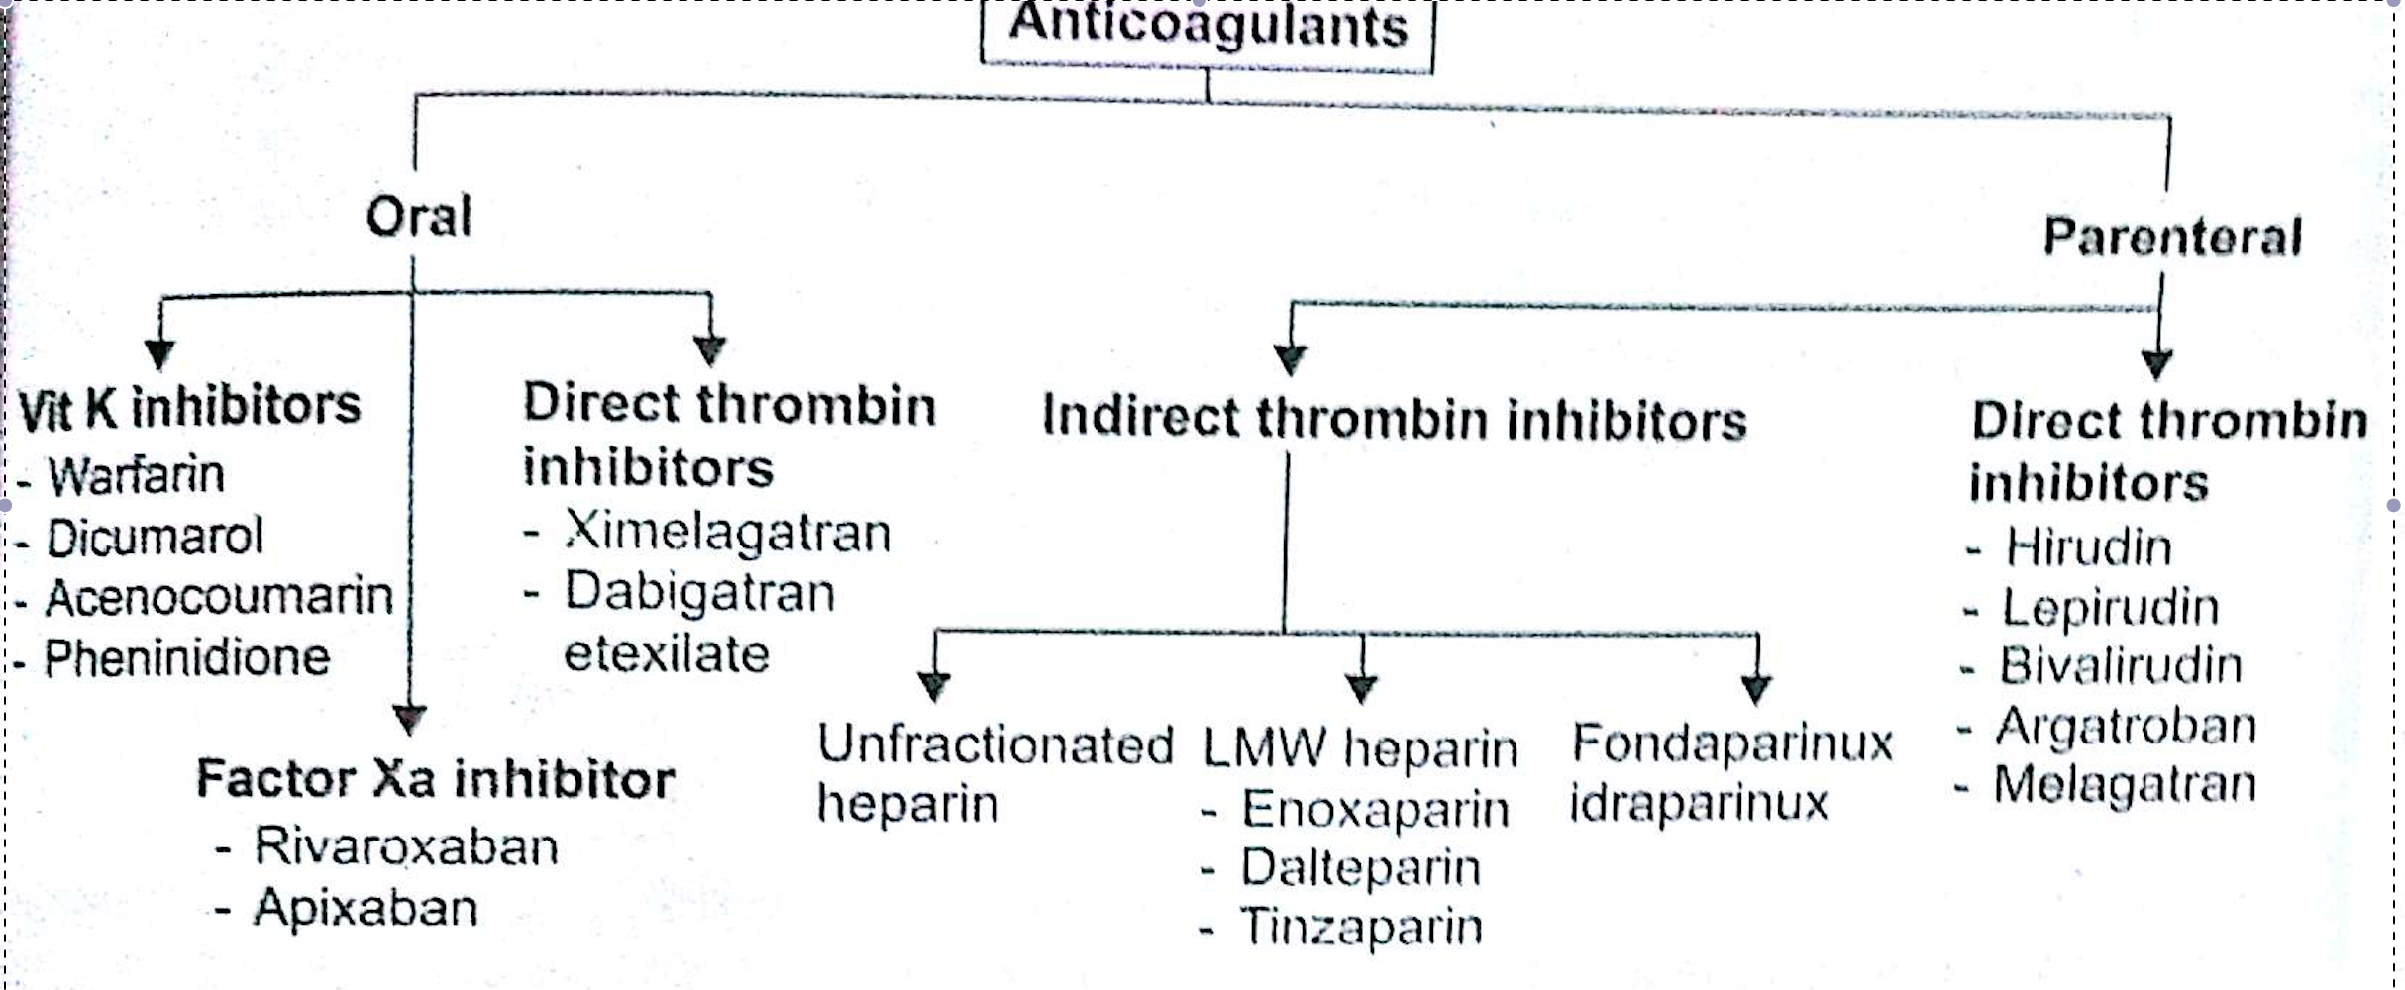
CLASSIFICATION

Slide 3
DABIGATRAN

Slide 4
Dabigatran etexilate is a prodrug which after oral administration is rapidly hydrolysed to dabigatran, an oral direct thrombin inhibitor.
It reversibly blocks the catalytic site of thrombin and thus produces a rapid anticoagulant effect.
It acts within 2 hours of administration.
Oral bioavailability is low (about 6%)

Slide 5
The t1/2 is 12-14 hours and duration of action is 24 hours.
Excretion is primarily in urine.

Slide 6
Adverse effects
Most common is dyspepsia and gastritis-like symptoms.
Others are bleeding and less commonly hepatobiliary disorders.

Slide 7
Indications
DVT (new and recurrent)
Pulmonary embolism (new and recurrent)
Strokes
Systemic embolism.

Slide 8
contraindications
Severe renal impairment
Bleeding diasthesis or haemorrhagic manifestations.
Lesions at a risk for bleeding (extensive infarction within the last 6 months) or active peptic ulcer disease.
Contraindicated in patients with mechanical prosthetic heart valves.
Not recommended in pregnancy as not enough data available.

Slide 9
Dose
The main advantage of this drug is that it does not require monitoring.
150 mg twice a day is the recommended dose for treatment and prevention of recurrence of DVT and pulmonary thromboembolism.
110 mg twice a day is recommended for prophylaxis following hip replacement surgeries.
Lower doses can be used in patients with CrCL of 15- 30 ml/min
Those with CrCL < 15 dabigatran is not recommended.

Slide 10
Patient on warfarin can be switched to dabigatran once INR falls to <2.
To switch from a parenteral anticoagulant, dabigatran is to be administered 2 hours before the dose of the parenteral drug is due.
If patient is to be switched from dabigatran to parenteral anticoagulant, wait for 24 hours after the last dose and then start the parenteral drug.

Slide 11
Reversal agent
Idarucizumab has recently been approved as a reversal agent for dabigatran.

