Slide 1
HAEMOLYTIC ANAEMIAS
DR. SANJANA BHAGWAT
MODERATOR : DR.A.GANPULE

Slide 2
DEFINITION
The haemolytic anaemias are a group of disorders characterised by increased RBC destruction with bone marrow compensating for haemolysis by increased erythropoiesis.

Slide 3
Shortening of the RBC lifespan may not result in anaemia, as compensatory bone marrow hyperplasia may increase RBC production 6 to 8-fold to maintain a normal Hb level.
Anaemia occurs only when the marrow hyperplasia is unable to compensate for the increased destruction.

Slide 4
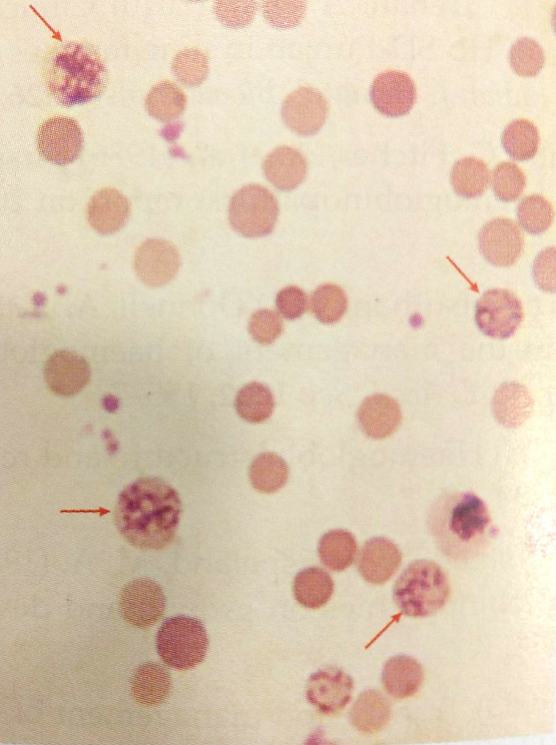
The term ‘compensatory haemolytic diseases’ is applied to the disorders in which anaemia is absent.
But they will show reticulocytosis, marrow hyperplasia and evidence of increased RBC destruction :
Elevated plasma Lactate Dehydrogenase (LDH)
Reduced plasma haptoglobins
Reticulocytes

Slide 5
Normal RBC destruction and Hb Breakdown
Average life span of RBC : 100-120 days
Changes occur in the cell surface making the cell more susceptible to phagocytosis by the RE system in spleen, liver and bone marrow.
The integrity of the RBC depends on its normal metabolic activities which in turn depend on the various enzymes.
With ageing of the cell, enzyme activity declines, the glycolytic system ultimately fails thus causing the cell to be less deformable than normal with subtle membrane changes.

Slide 6
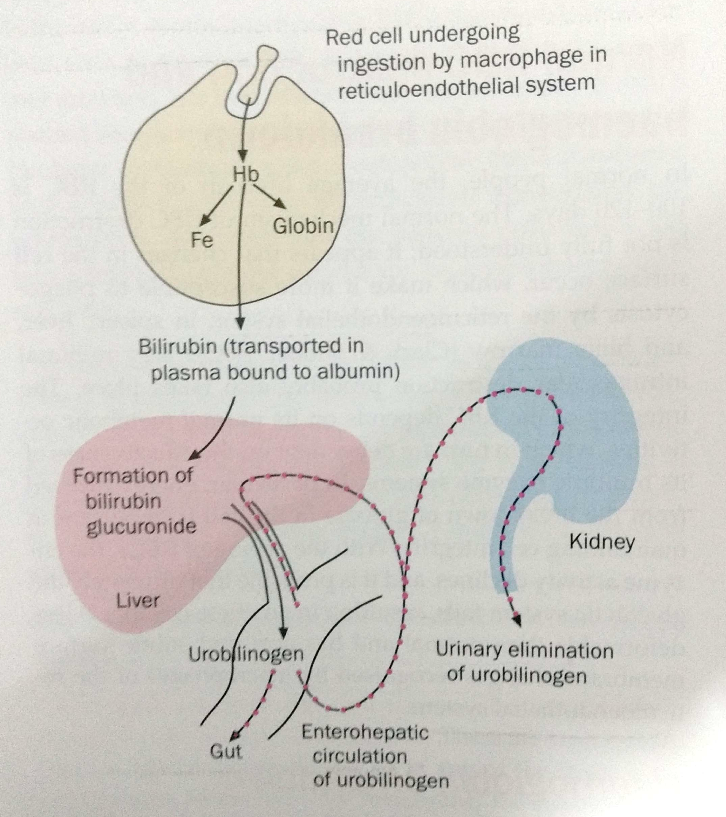

Slide 7
CLASSIFICATION

Slide 8
 | Intracorpuscular defects | Extracorpuscular defects
Hereditary | Haemoglobinopathies | Familial (atypical) haemolytic-uremic syndrome
 | Enzymopathies
 | Membrane-cytoskeletal defects
Acquired | Paroxysmal nocturnal haemoglobinuria | Mechanical destruction (microangiopathic)
 |  | Toxic agents
 |  | drugs
 |  | Infections
 |  | Autoimmune

Slide 9
INTRACORPUSCULAR MECHANISMS (INTRINSIC)
CONGENITAL
MEMBRANE DEFECTS
Hereditary spherocytosis
Hereditary elliptocytosis
Abetalipoproteinemia (acanthocytosis)
Hereditary stomatocytosis
Hereditary xerocytosis and hydrocytosis
HAEMOGLOBIN DEFECTS
Haemoglobinopathies (sickle cell anaemia)
Other homozygous disorders ( Hb-C, Hb-E, Hb-D etc.)
Unstable haemoglobin disease
Thalassaemia – beta-thalassaemia major, Hb-H disease
Double heterozygous disorders ( Sickle-cell beta-thalassaemia, Hb E beta thalassaemia etc)

Slide 10
Intrinsic cont…
ENZYME DEFECTS
Non spherocytic congenital haemolytic anaemia.
Deficiency of pyruvate kinase or other pathways of the Embden-Meyerhof pathway.
Deficiency of the glucose-6-phosphate dehydrgenase or other enzymes of the pentose phosphate pathway
Drug-induced haemolytic anemia and favism
ACQUIRED
Paroxysmal nocturnal Haemoglobinuria

Slide 11
EXTRACORPUSCULAR DEFECTS (EXTRINSIC)
ACQUIRED
IMMUNE MECHANISMS
Autoimmune acquired haemolytic anaemia
Warm antibody
Cold antibody
Haemolytic disease of the newborn
Incompatible blood transfusion
Drug-induced haemolytic anaemia
NON-IMMUNE MECHANISMS
Mechanical Haemolytic anaemia
Cardiac Haemolytic anaemia
Micorangiopathic Haemolytic anaemia
March Haemolytic anaemia

Slide 12
MISCELLANEOUS
Due to direct action of drugs and chemicals
Venoms
Haemolytic anaemia due to infection :
protozoa
Malarial
Toxoplasmosis
Leishmaniasis
Bacterial
Cholera
Salmonella
clostridial
Due to burns
Hypophosphataemia
Lead poisoning
Thermal injury

Slide 13
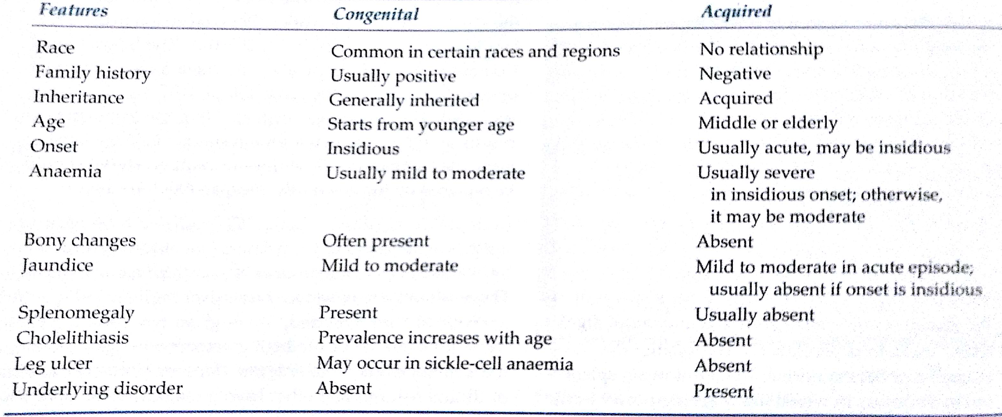
DIFFERENCE BETWEEN CONGENITAL AND ACQUIRED

Slide 14
APPROACH TO HAEMOLYTIC ANAEMIA

Slide 16
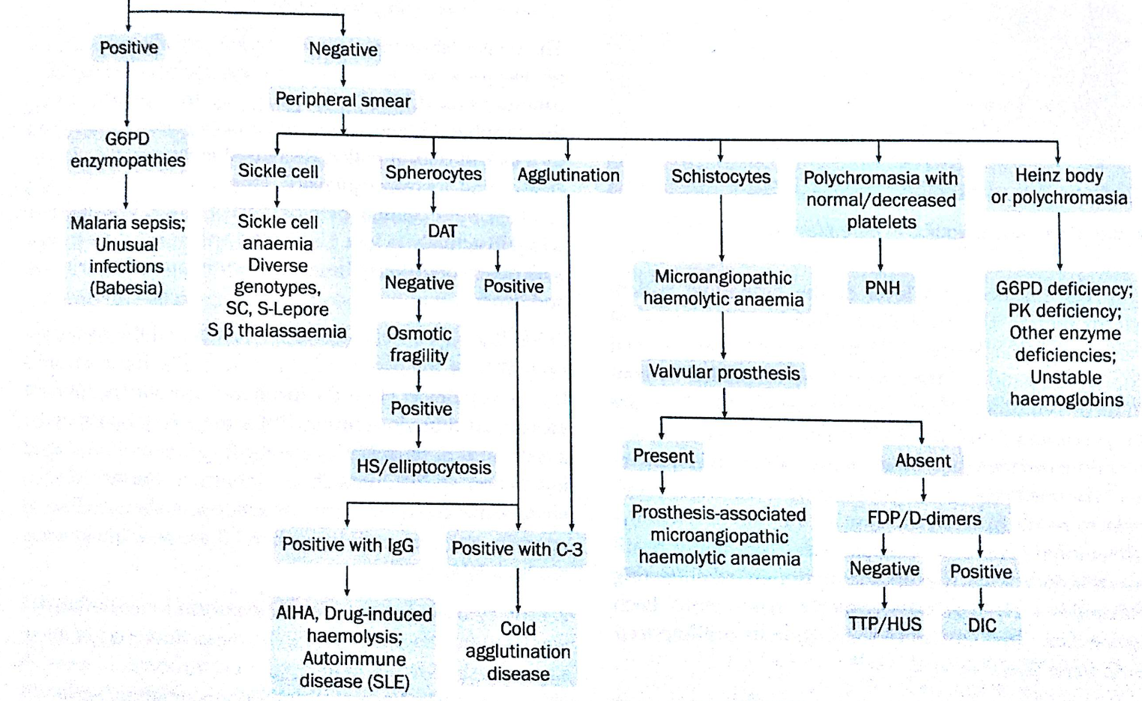

Slide 17
EVIDENCE OF HAEMOLYTIC NATURE OF ANAEMIA

Slide 18
EVIDENCE OF INCREASED HB BREAKDOWN | EVIDENCE OF COMPENSATORY ERYTHROID HYPERPLASIA
Reduction in blood Hb levels ( >1g/dl/week) | Reticulocytosis
Jaundice and hyperbilirubinemia | Macrocytosis and polychromasia
Reduced plasma haptoglobulin and haemopexin levels | Erythroid hyperplasia of bone marrow
Reduced glycosylated Hb | Radiological changes in skull and tubular bones (in congenital anaemias)
Increased plasma LDH levels | EVIDENCE OF RBC DAMAGE
(EVIDENCE OF INTRAVASCULAR HAEMOLYSIS) | Spherocytosis and increased RBC fragility
haemoglobinaemia | Fragmentation of RBCs
haemoglobinuria | Heinz bodies
Methhaemoglobinaemia | DEMNSTRATION OF SHORTENED RBC LIFE SPAN
haemosiderinuria

Slide 19
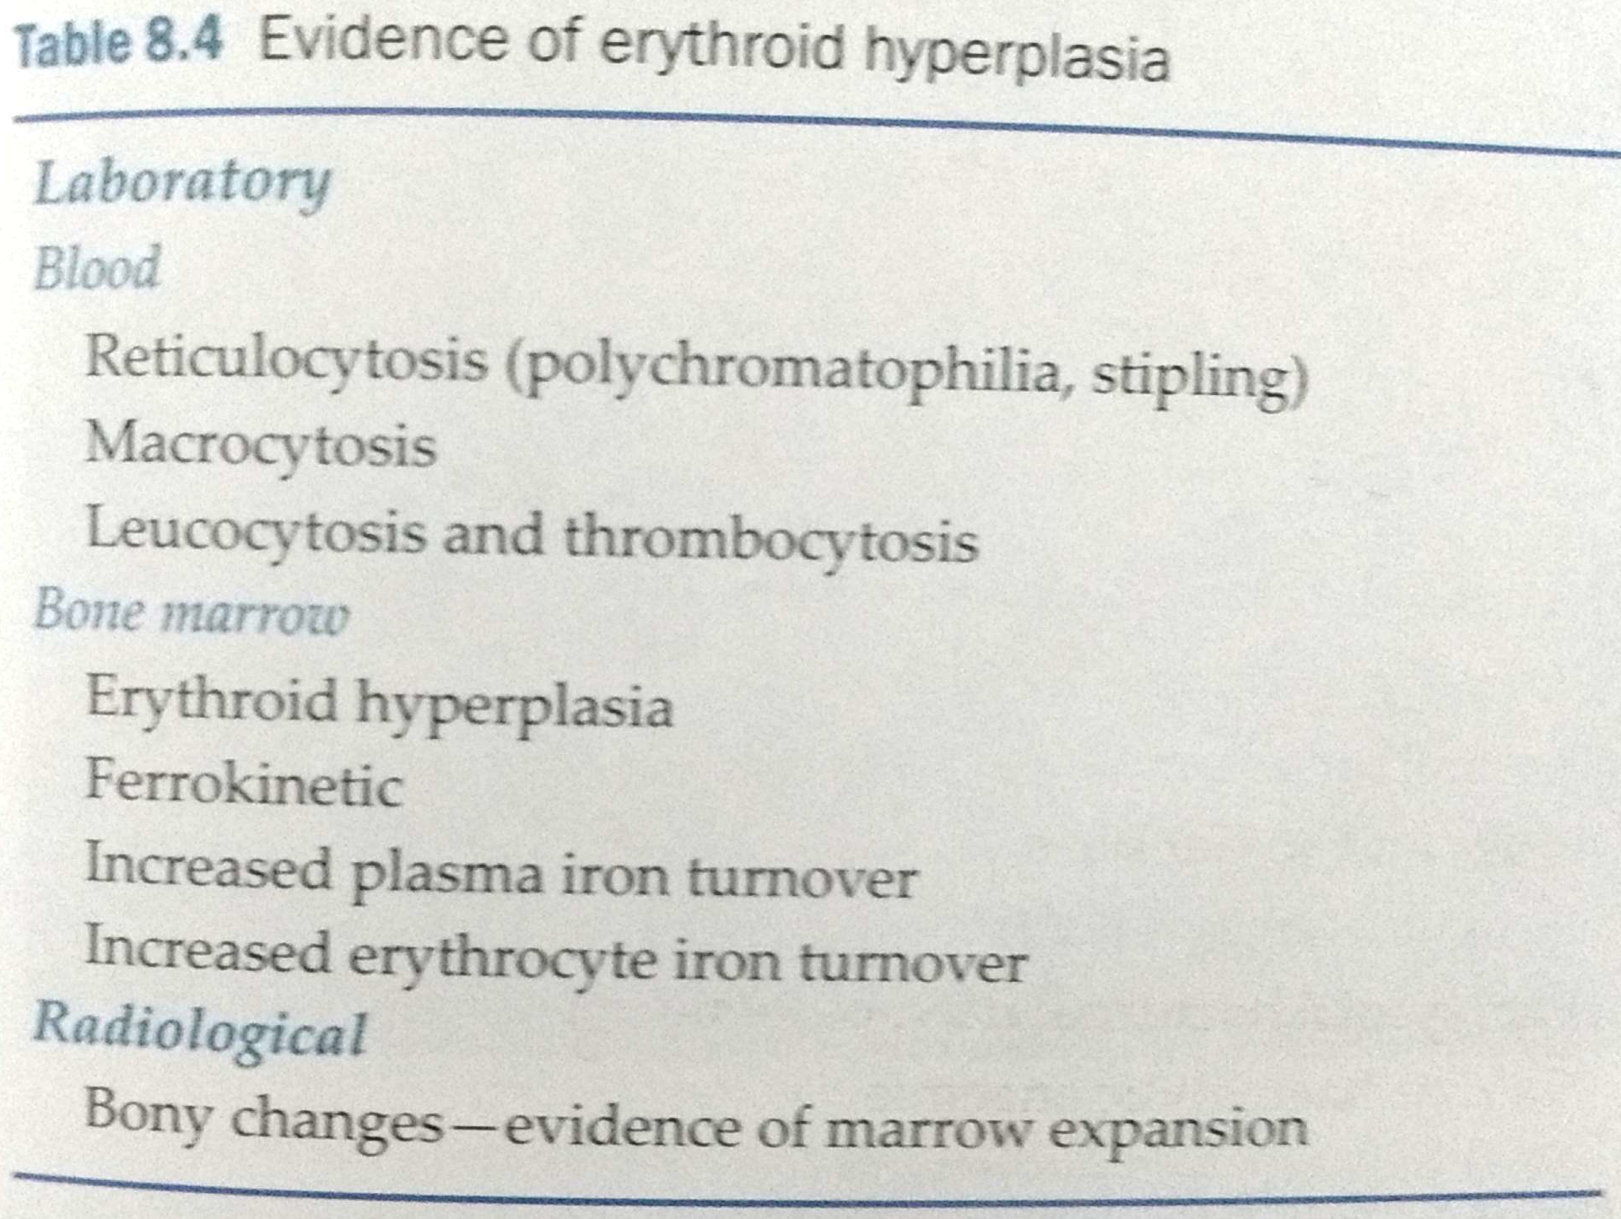
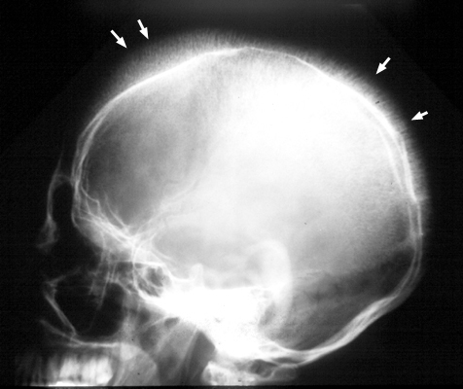

Slide 20
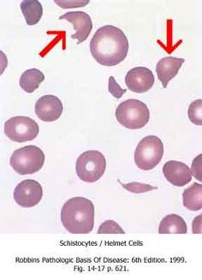
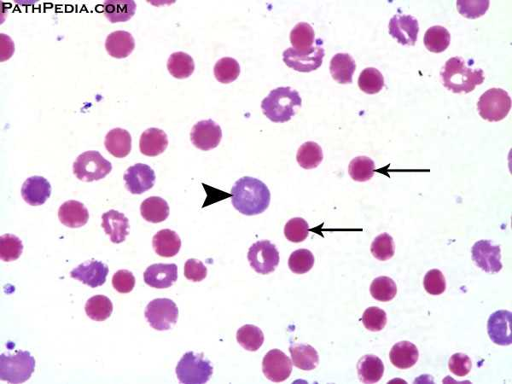
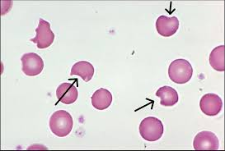
Schistocytes/ Helmet Cells
Small red cells : spherocytes
Bluish cell : Reticulocyte
Bite Cells

Slide 21
AUTOIMMUNE HAEMOLYTIC ANAEMIAS

Slide 22
CLASSIFICATION
1. IDIOPATHIC 2. SECONDARY
DRUGS : | Penicillin, methyl dopa, procainamide
UNDERLYING DISORDERS:
Infections | Mycoplasma pneumoniae, infectious mononucleosis, CMV, rubella
Chronic lymphocytic leukaemia
Malignant disorders | lymphoma
Immune defciency states | Common variable immunodeficiency
Autoimmune | SLE, autoimmune lymphoproliferative disorders, RA, chronic active hepatits, myaesthenia gravis, ulcerative colitis
Post transplantation | Allogenc stem – cell transplantation, post organ transplant
Miscellaneous (uncommon) | Carcinoma, sarcoidosis, ovarian teratoma, ovarian dermoid cyst

Slide 23
MECHANICAL HAEMOLYTIC ANAEMIAS

Slide 25
DRUGS AND CHEMICAL AGENTS

Slide 27
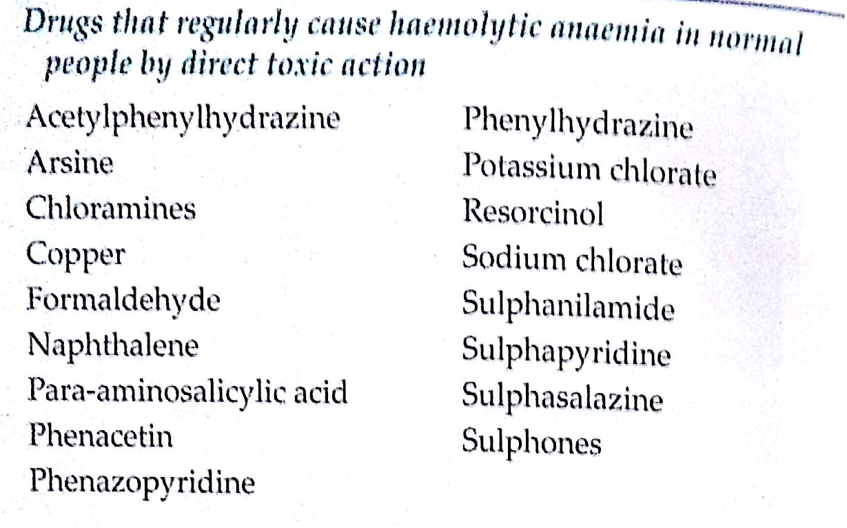

Slide 29
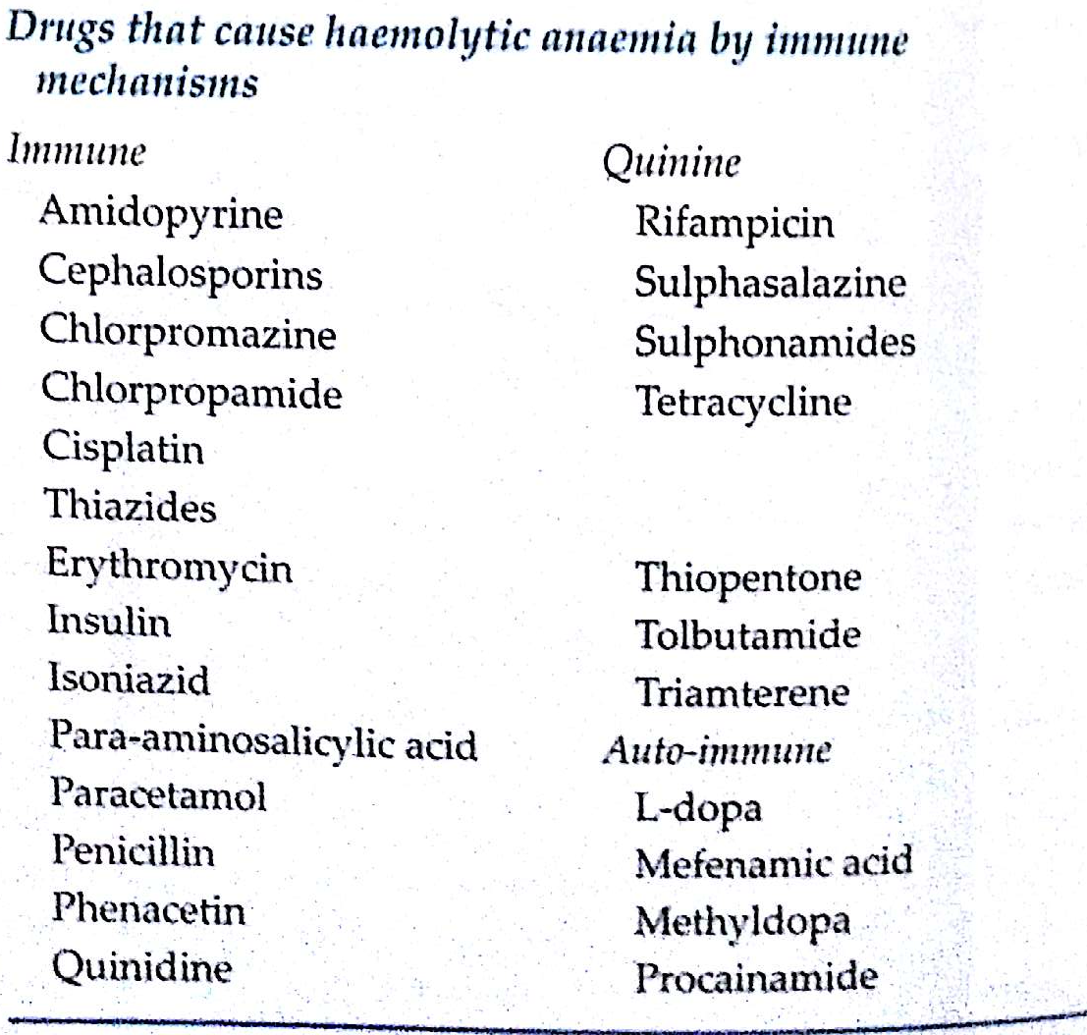

Slide 30
THANK YOU

