Slide 1
Caplacizumab for Acquired Thrombotic Thrombocytopenic Purpura
Dr. Sanjana Bhagwat
Moderator : Dr. A. Ganpule
NEJM; 11 Feb, 2016; VOL. 374 No. 6

Slide 2
INTRODUCTION
Acquired thrombotic thrombocytopenic purpura (TTP) :
aggregation of platelets on ultralarge von Willebrand factor multimers.
Caused by a severe deficiency of ADAMTS13 due to the presence of inhibitory autoantibodies.
Aggregation – microthrombi formation.

Slide 3
Microthrombi cause tissue ischemia and organ dysfunction.
Treatment:
rapid initiation of plasma exchange
immunosuppressive therapy.
Although the survival rate among patients with acquired TTP exceeds 80%, patients remain at risk for microthrombotic complications until remission is achieved.

Slide 4
Potential new approach : rapid onset therapy by targeting the binding of the platelets to the ULvWf multimers
Caplacizumab :
Immunoglobulin
anti–von Willebrand factor
humanized single-variable-domain
targets the A1 domain of Von Willebrand factor,
preventing interaction with the platelet glycoprotein Ib-IX-V receptor.

Slide 5
methods

Slide 6
STUDY DESIGN
Single-blind, parallel-design, randomized, placebo-controlled study at 56 sites worldwide
Inclusion criteria :
Adults with an acute episode of acquired TTP
If platelet count of <1,00,000/mm³without active bleeding, and required plasma exchange
Patients were assigned in a 1:1 ratio to active treatment or placebo with the use of a computerized randomization schedule.

Slide 7
The study enrolled patients from October 2010 to January 2014.
Seventy-five patients underwent randomization.
All patients still in the study in January 2014 finished the assigned study treatment and attended at least the 1-month follow-up visit before the study was formally ended in March 2014.
Notes:
sanajajanjajnana

Slide 8
TREATMENTS
In addition to standard-of-care treatment for acquired TTP, patients received
an intravenous loading dose of caplacizumab (10 mg) or placebo
anytime from 6 hours before to 15 minutes before the start of the first plasma exchange performed after enrollment.

Slide 9
Throughout the plasma-exchange (PE) treatment period, including tapering and Pes for exacerbations, the study drug (10 mg) was administered subcutaneously daily within 30 minutes after the end of each exchange.
Once-daily subcutaneous administration of the study drug (10 mg) was continued for 30 days after the last PE.
The maximum duration of study-drug administration was 90 days.

Slide 10
END POINTS
The primary end point was the time to confirmed normalization of the platelet count (i.e., time to a response).
Normalization defined as :
a platelet count that was 1,50,000/mm³ or higher,
and confirmation consisted of a repeat platelet count at 48 hours that was 1,50,000/mm³ or higher
and a lactate dehydrogenase level that was no more than twice the upper limit of the normal range.

Slide 11
Secondary end points included :
exacerbations,
relapse,
complete remission after the initial course of daily plasma exchange
Duration
volume of plasma exchange
Mortality
safety

Slide 12
INVESTIGATIONS DONE
Platelet counts
ADAMTS13 activity
antidrug antibodies
Von Willebrand factor antigen
Factor VIII clotting activity
Von Willebrand factor–ristocetin cofactor activity
Total drug and antidrug-antibody levels were measured

Slide 13
Statistical Analysis

Slide 14
Planned sample size : 110
Power of study : 80% (1- beta error)
44% reduction in the median time to a response with caplacizumab as compared with placebo.
at a one-sided alpha level of 2.5%
assuming a 15% dropout rate.

Slide 15
The primary end point was evaluated with the use of a Kaplan– Meier analysis stratified for the absence or presence of one plasma-exchange session before randomization.
All efficacy analyses were performed on the intention-to-treat population
safety and immunogenicity analyses were performed on the safety population (comprising all patients who received at least one dose of the study drug).

Slide 16
results

Slide 17
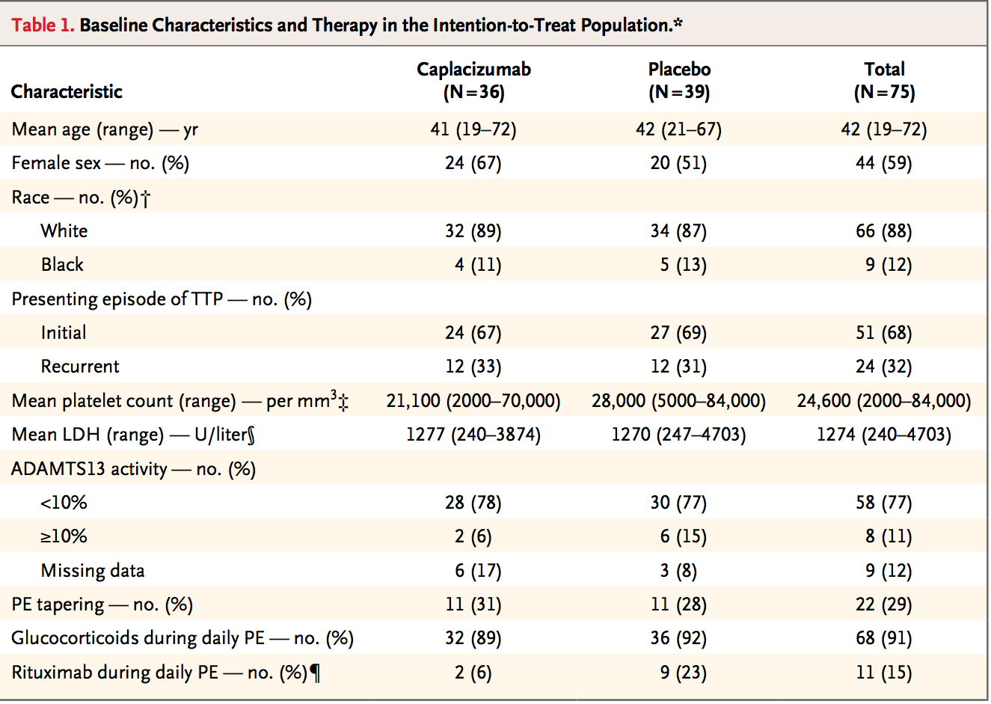

Slide 18
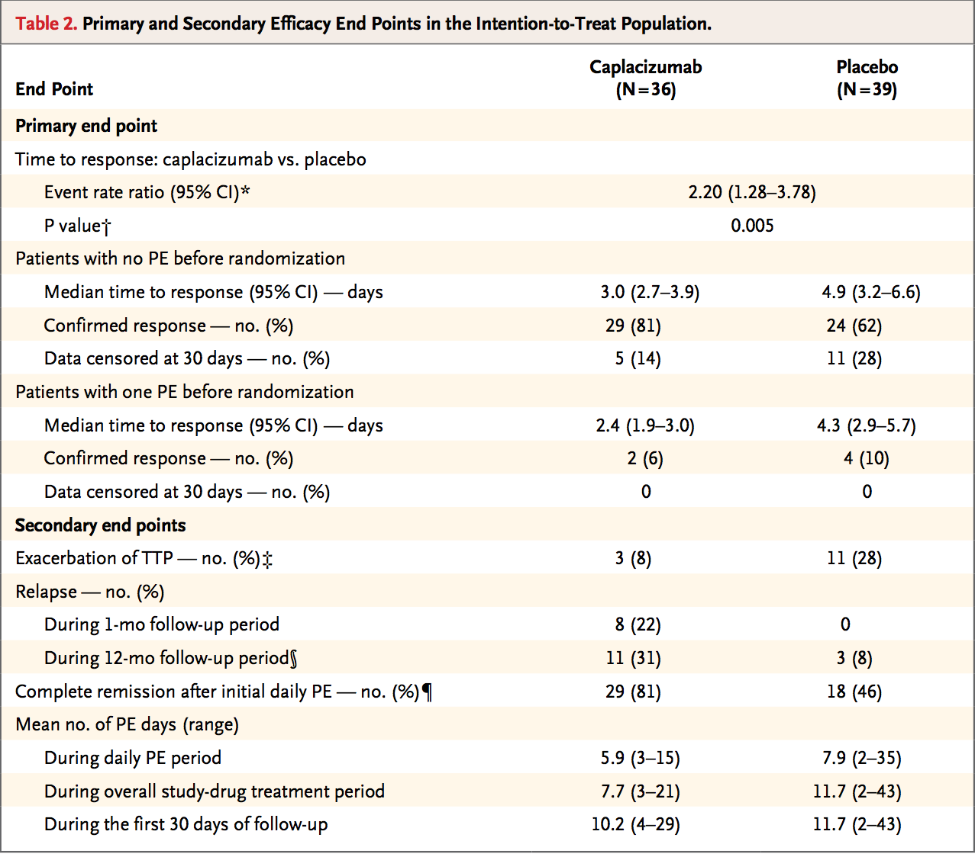

Slide 19
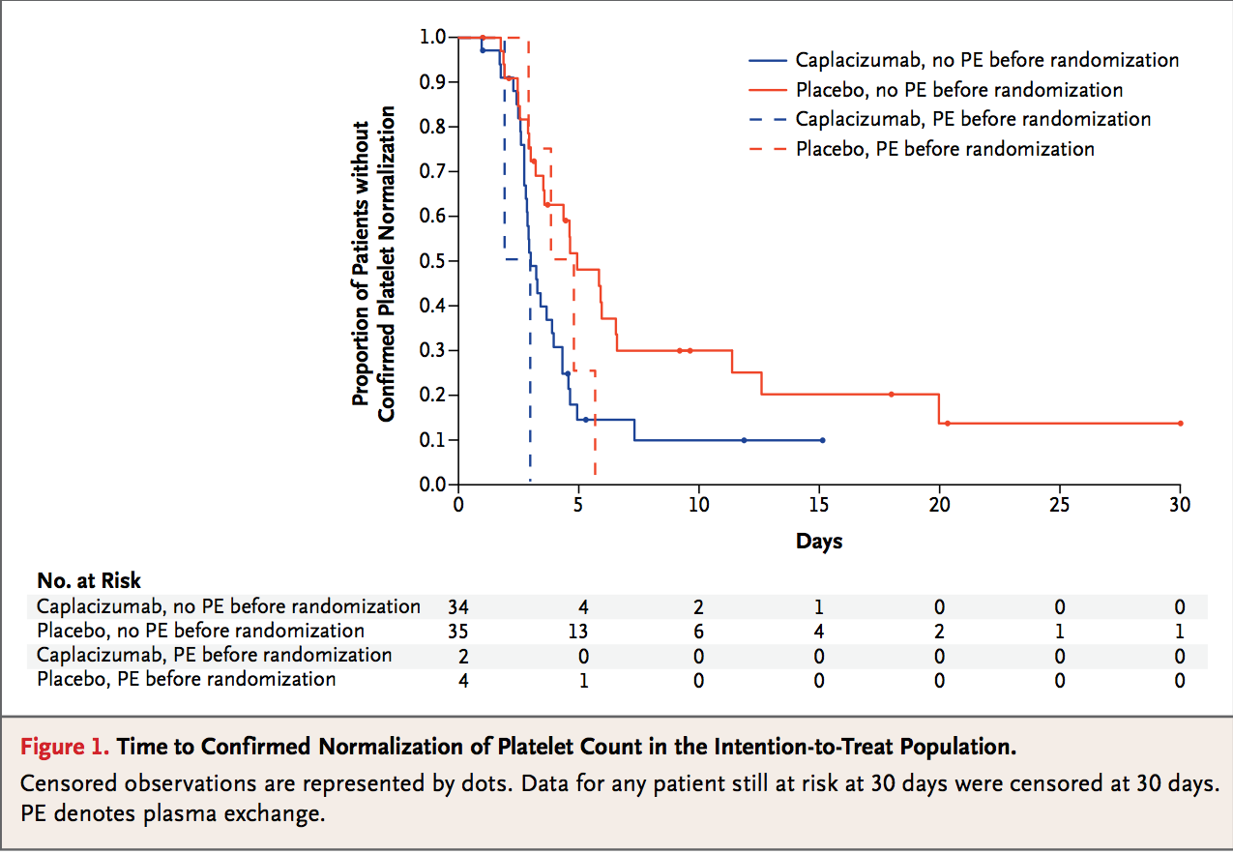

Slide 21
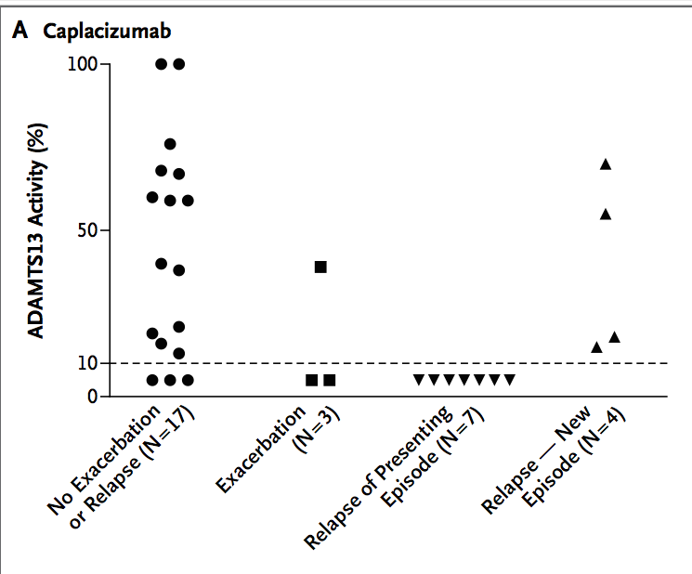
ADAMTS13 Activity in Relation to Exacerbation or Relapse

Slide 22
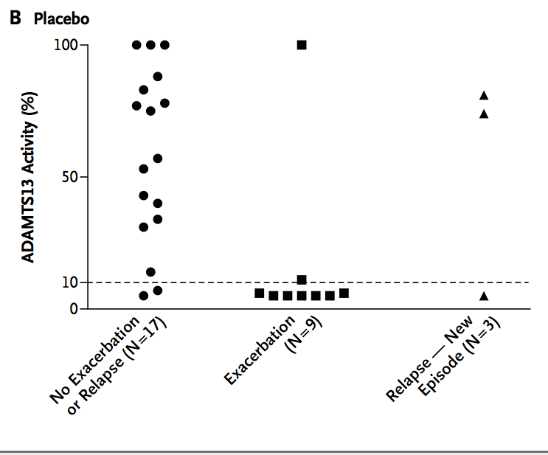

Slide 23
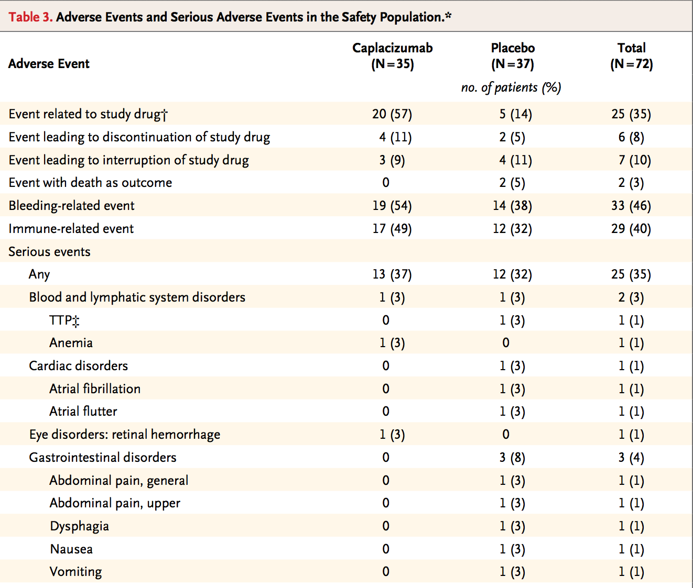
ADVERSE EVENTS

Slide 24
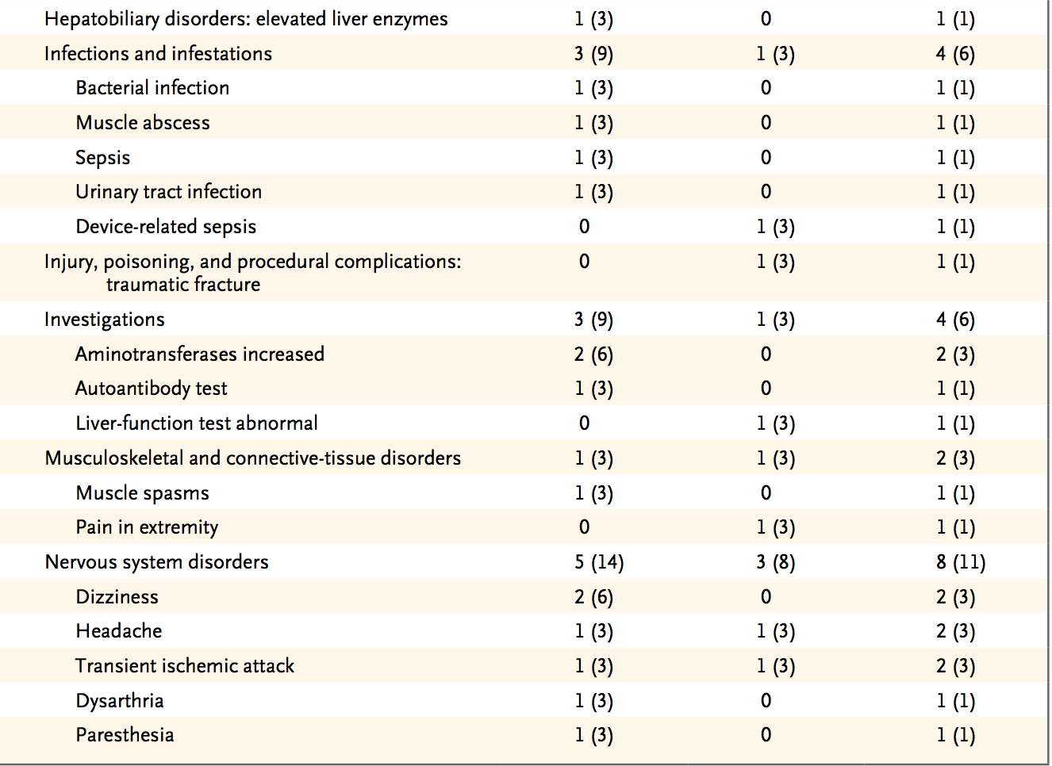

Slide 25
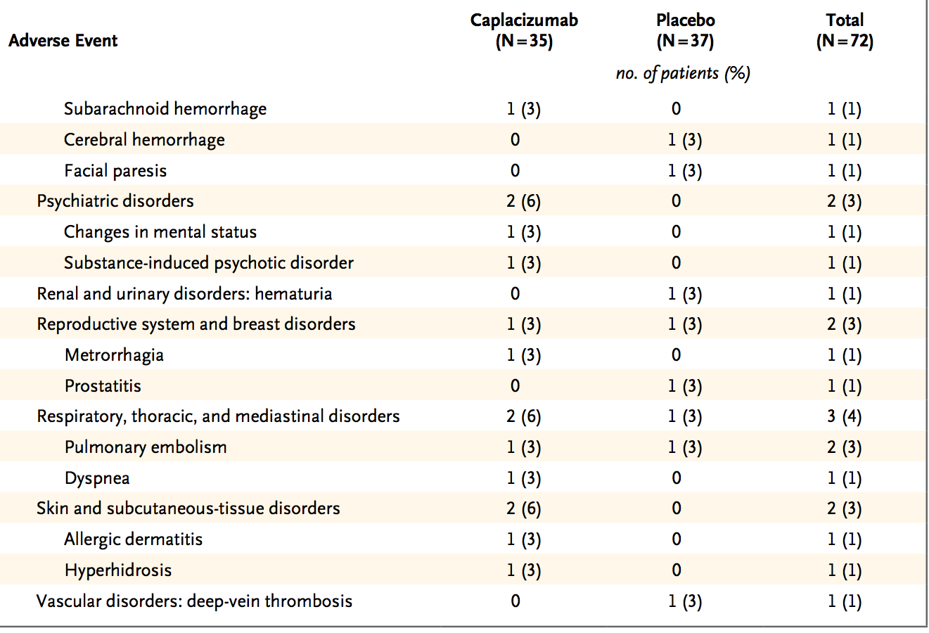

Slide 26
DISCUSSION

Slide 27
This phase 2 trial showed that caplacizumab, as compared with placebo, results in a more rapid resolution of TTP episodes.
Faster platelet-count normalization - caplacizumab prevents further consumption of platelets into micro-thrombi
Thus consequent progression of tissue ischemia can be prevented

Slide 28
Focus of current treatment – target the auto-antibodies against ADAMTS13
Daily plasma exchange removes the autoantibodies and replenishes ADAMTS13 activity - gradually restoring platelet counts.
whereas immunosuppressive treatment acts on the underlying auto-immune process.
A crucial goal of treatment is to control the pathologic microvascular thrombosis as quickly as possible because the thrombotic consequences are unpredictable and associated with high morbidity and mortality.

Slide 29
The results of this study show that caplacizumab immediately inhibits the pathophysiological mediator of the microthrombosis.
Paralleling the rapid arrest of platelet consumption in the microthrombotic process, organ-damage markers appeared to resolve more rapidly in the caplacizumab group than in the placebo group.
The relevance of a platelet-protective effect of caplacizumab was further demonstrated by the smaller number of exacerbations in the caplacizumab group than in the placebo group during the study-drug administration period.

Slide 30
During the 1-month follow-up period after study-drug administration :
8 patients in the caplacizumab group had a relapse, and 7 of those patients had a relapse within 10 days after cessation of study-drug treatment;
no patients in the placebo group had relapses during this 1-month follow-up period.
This between-group difference suggests that among patients who were destined to have an exacerbation, it occurred during study-drug administration in the placebo group, whereas caplacizumab may have delayed the exacerbation until after the period of study-drug administration.

Slide 31
ADAMTS13 activity in these patients was persistently less than 10%, indicating incomplete resolution of the underlying autoimmune disorder.
This observation highlights the importance of providing immunosuppressant treatment for the immune-mediated component of the disease.

Slide 32
These results also support the use of ADAMTS13 activity as a predictive marker to identify patients at risk for relapse.
Although bleeding events were observed more frequently in the caplacizumab group than in the placebo group, these events were generally mild and did not require treatment.

Slide 33
conventional therapy for TTP takes time to achieve resolution of the disease, and even with a response to therapy, there is still a risk of microvascular thrombi.
Caplacizumab, through rapid blocking of von Willebrand factor–mediated platelet aggregation, prevents further plate- let aggregation more rapidly than conventional treatment alone, which could potentially prevent short- and long-term end-organ injury due to ischemia.

Slide 34
Thank you

