Slide 1
COMPLICATIONS OF LIVER CIRRHOSIS
DR. SANJANA BHAGWAT
MODERATOR : DR. SHIMPA SHARMA
DR. R MANE

Slide 2
TOPICS DISCUSSED :
Hepatic encephalopathy
Spontaneous bacterial peritonitis
Hepatorenal syndrome
Hepatopulmonary syndrome

Slide 3
HEPATIC ENCEPHALOPATHY

Slide 4
Hepatic encephalopathy : Potentially reversible neuropsychiatic abnormalities seen in patients with liver dysfunction or porto-systemic shunting
Minimal Hepatic Encephalopathy Subclinical encephalopathy in patients with liver dysfunction, only detectable with specialized neuropsychiatric tests in a clinically normal patient.
The pathogenesis is still unclear.
Both hepatocellular failure and porto-systemic shunting are key elements in its development.

Slide 5
TYPES

Slide 7
WEST-HAVEN GRADING
GRADE | FEATURES | NEUROLOGICAL FINDINGS
0 | No abnormalities detected | Normal examination or impaired psychomotor testing (MHE)
I | Trivial lack of awareness Euphoria or anxiety Shortened attention span Impairment of addition and subtraction | Mild asterixis or tremor
II | Lethargy or apathy Disorientation for time Obvious personality change Inappropriate behaviour | Obvious asterixis; slurred speech
III | Somnolence to sime-stupor Responsive to stimuli Confused Grosss disorientation Bizarre behaviour | Muscular rigidity and clonus; Hyper-reflexia
IV | Coma | Decerebrate posturing

Slide 8
CLASSIFICATION
COVERT HE : clinically normal but have abnormalities of cognition and neuropsychiatric variables.
OVERT HE : manifests as neuropsychiatric syndrome.
May be episodic or persistent.

Slide 9
Pathogenesis theories

Slide 10
Hepatocellular failure and porto-systemic shunting are the key factors in the development of encephalopathy in patients with cirrhosis.
In such patients the hepatic clearance of gut-derived bacteria is impaired.
This impinges on the brain resulting in direct and indirect impairment of astroyte function.
Other key factors:
Gut-derived neurotoxins
Brain water homeostasis
Oxidative/nitrosative stress
Astrocyte dysfunction
Neurotransmitter dysfunction
Infection and inflammation

Slide 11
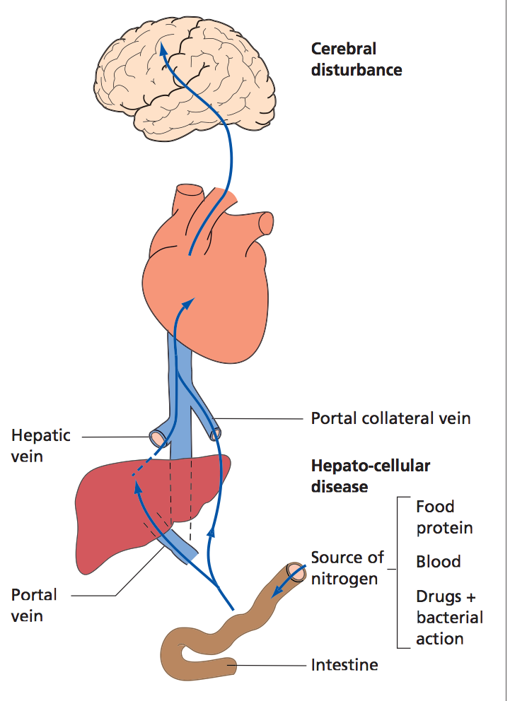

Slide 12
Ammonia escapes hepatic detoxification and impinges on the brain.
Induces astrocyte swelling via its effect on glutamine synthesis causing low grade cerebral oedema.
NMDA activation causes oxidative/nitrosative stress.
Thus astrocyte function is compromised resulting in alterations in gene expression, protein modification and RNA and also disturbed intracellular signal transduction and neurtransmission.
Inflammatory cytokines, hyponatremia and benzodiazepines can have similar effect as that of ammonia.
Astroglial osmolyte pool is depleted as the organic osmolytes taurine and myoinositol shift to counter the osmotic stress.
Thus they too play a role in the mechanism.

Slide 15
CLINICAL FEATURES
Personality changes
Intellectual deterioration
Disturbed consciousness
Foetor hepaticus
Changes in motor function
Asterixis
Speech
Deep tendon reflexes are usually exaggerated
Excessive appetite, muscle twitching, grasping and sucking reflexes may also be seen
Visual disturbances : reversible cortical blindness and alternating gaze deviation

Slide 16
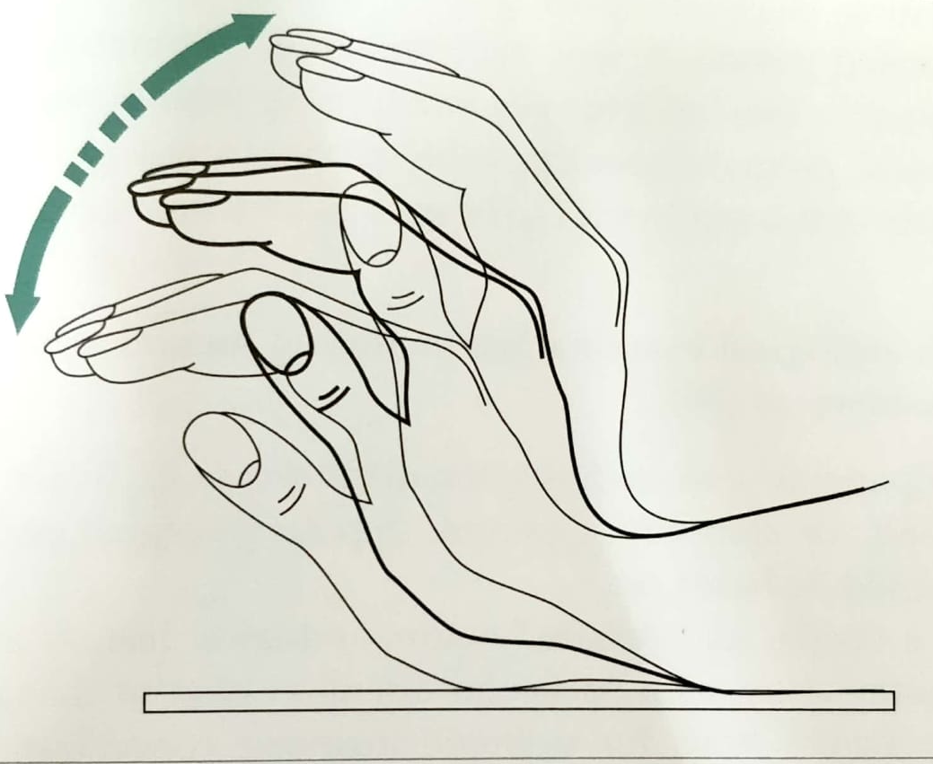
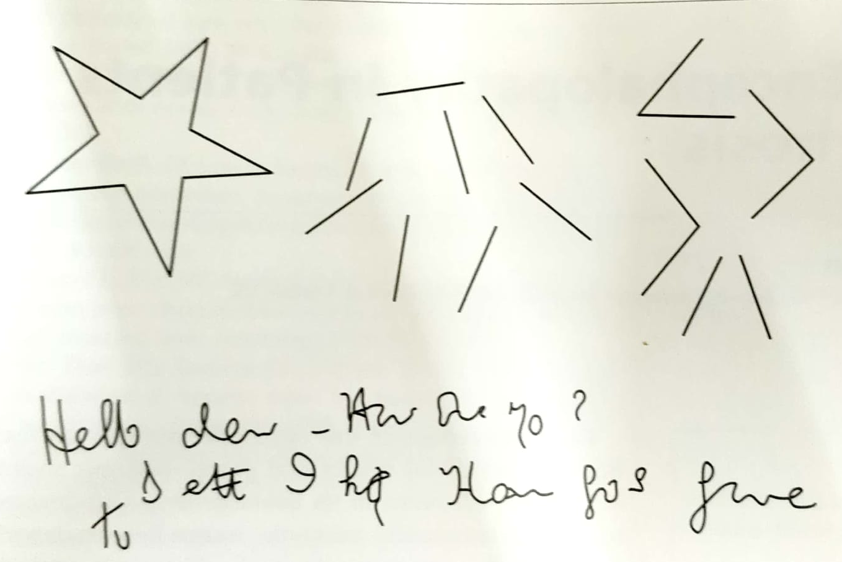

Slide 17
diagnosis

Slide 18
Neurological examination including mental state assessment :
Neuropsychiatric history and examination – changes in mental state, memory, concentration, cognition and consciousness and to changes in energy and activity levels.
Use of 2 grading systems – West-Haven criteria and the Glasgow Coma Scale. Others – Mini Mental score test
Comprehensive neurological exam – subtle motor abnormalities – hypomimia, dysarthria, increased tone, reduced speed or difficulty in executing rapid alternating movements, ataxia, increased DTR, impairedpostural reflexes, Tremors, esp asterixis
Exclusion of other potential causes

Slide 19
Psychometric performance :
Number connection tests
Line tracing
Serial dotting
Digit symbol tests
This has been called the Psychometric Hepatic Encephalopathy Score

Slide 20
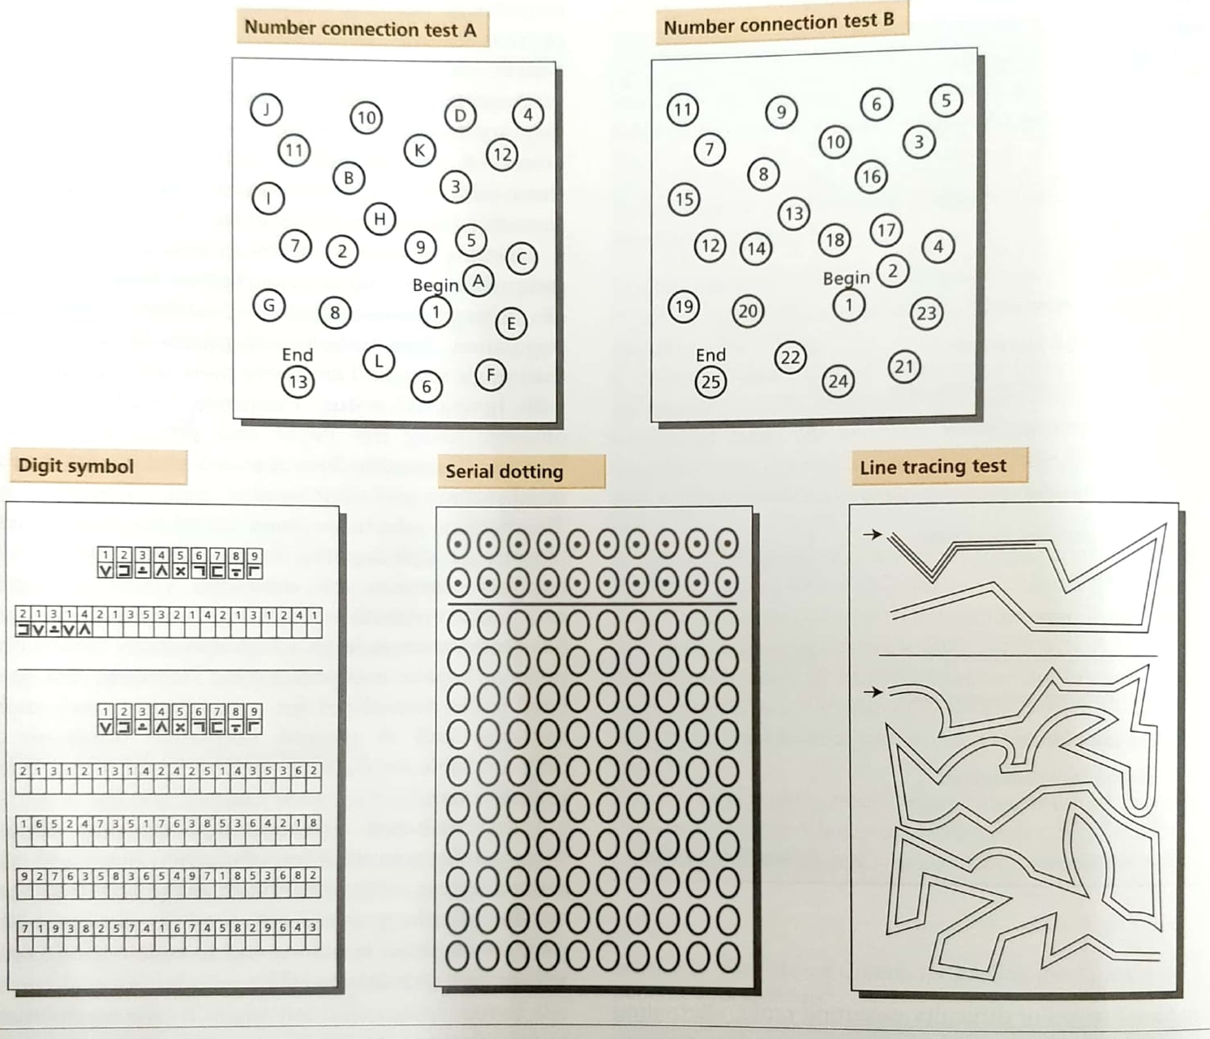

Slide 21
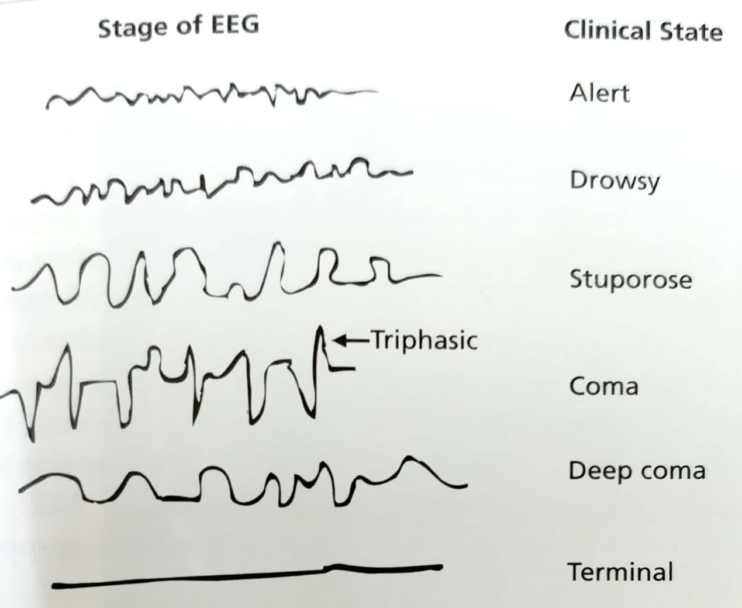
Neurophysiology :
EEG – sensitivity varies
But seen in 43- 100% patients.
May be seen in other metabolic encephalopthies, and drug-induced encephalopathies but these can be distinguished clinically.

Slide 22
Evoked Potentials : can detect minimal HE and can also be used for monitoring of patients with mild to moderate HE over time.
This is not useful for patients with higher degree of impairment as there is need for patient co-opertion.
Critical flicker fusion frequency : again requires patient co-operation and not sensitive enough as a stand-alone technique.
Smooth pursuit eye movements :
Show clear disruption of smooth pursuit in patients with minimal HE and more pronounced or complete loss in those with overt HE

Slide 24
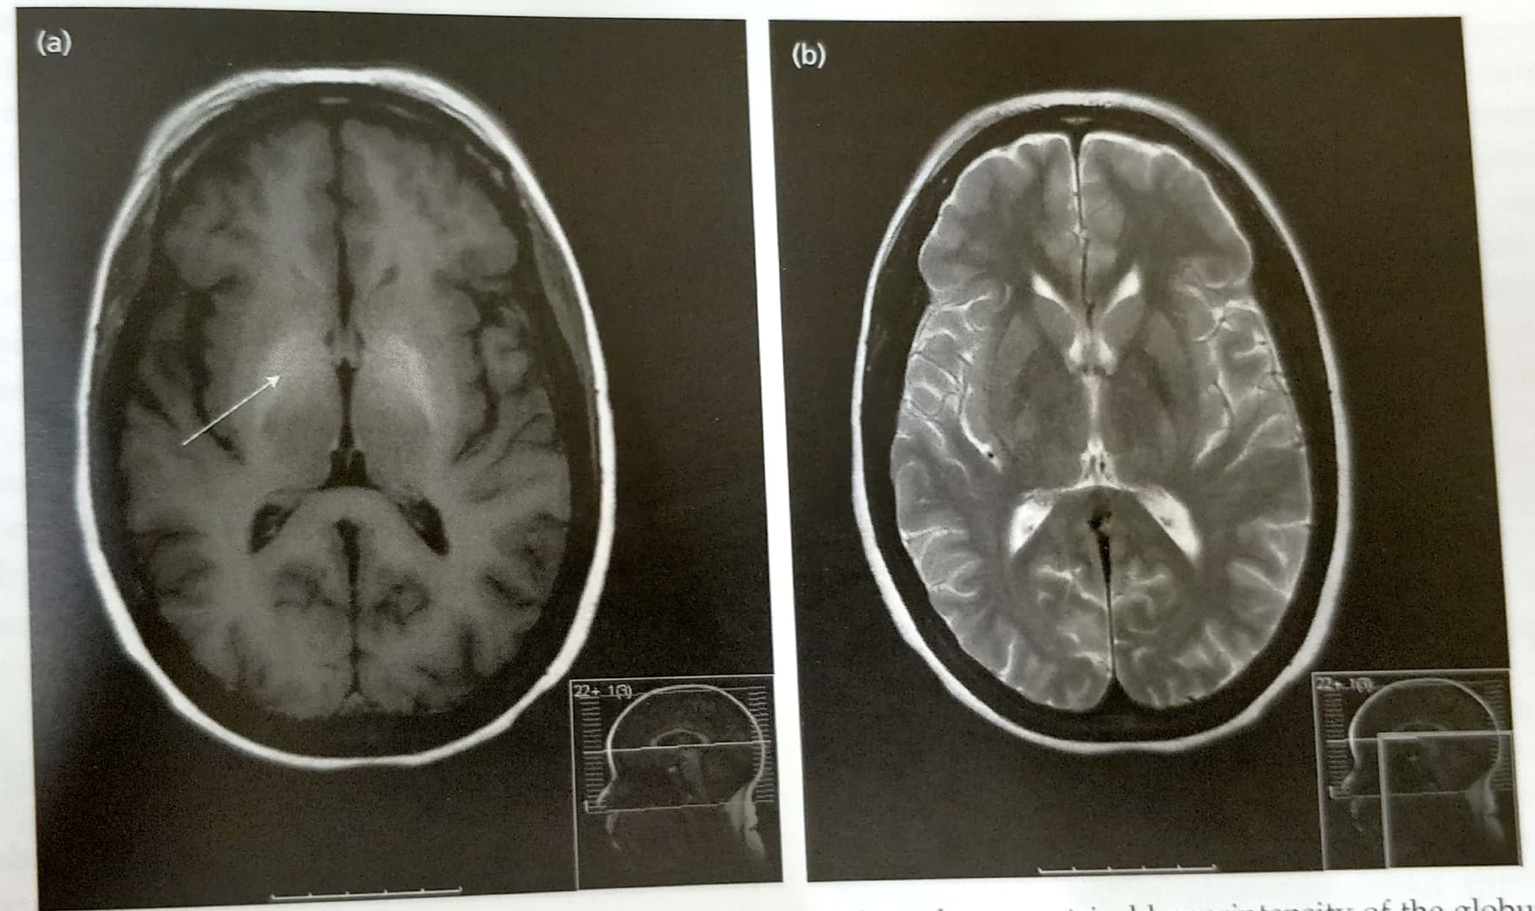
Functional and structural cerebral imaging:
Cerebral CT and MR imaging – hyperintensity in the basal ganglia on T₁-weighted images may be seen but does not correlate. These reflect pallidal deposition of manganese.
Total body manganese is increased in patients with cirrhosis
No diagnostic importance.
Globus
pallidus

Slide 25
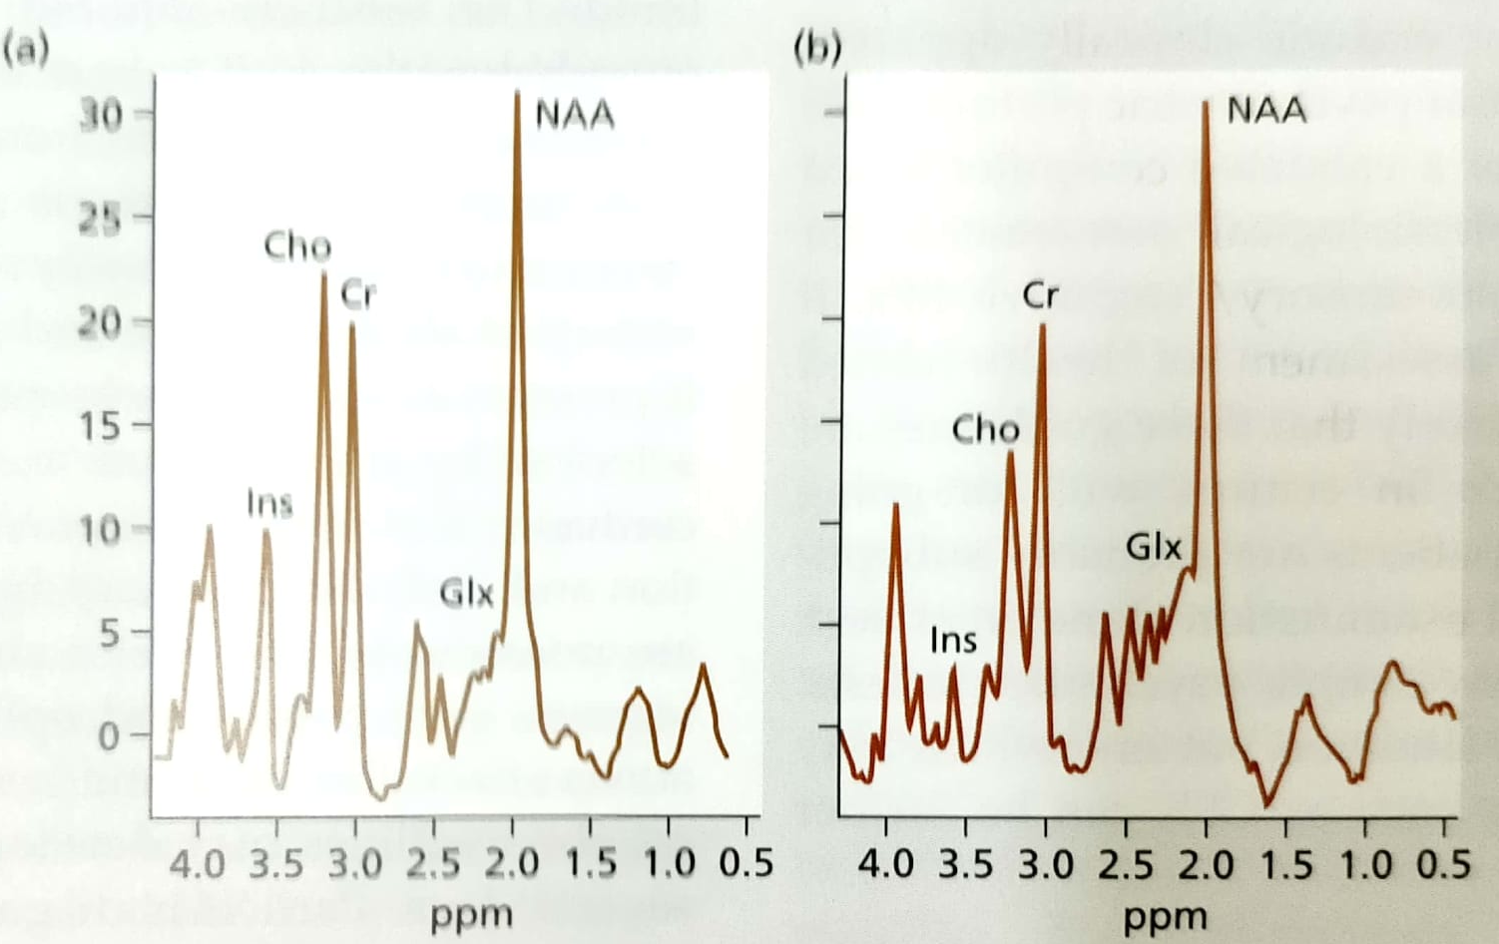
Cerebral MRS : relative increase in the glutamine/glutamate resonance and relative reductions in the myoinositol and choline resonances.

Slide 26
Radiotracer imaging : SPECT and PET for insight into pathophysiology.
Blood ammonia : for differential diagnosis
The pH-dependent partial pressure of gaseous ammonia in arterial blood correlates more closely with the clinical and neurophysiological changes observed than plasma conventrations.
CSF : glutamine concentrations may be increased

Slide 27
DIFFERENTIAL DIAGNOSIS
Hyponatremia: headache, lethargy, seizures. May precipitate HE
Alcohol withdrawal (delirium tremens) : motor and autonomic overactivity, profound insomnia, hallucinations, fine tremor
Wernicke’s encephalopathy : global confusion, ataxia, ophthalmoplegia, nystagmus or gaze palsies.
Wilson’s disease
Functional psychoses : bipolar disorder

Slide 28
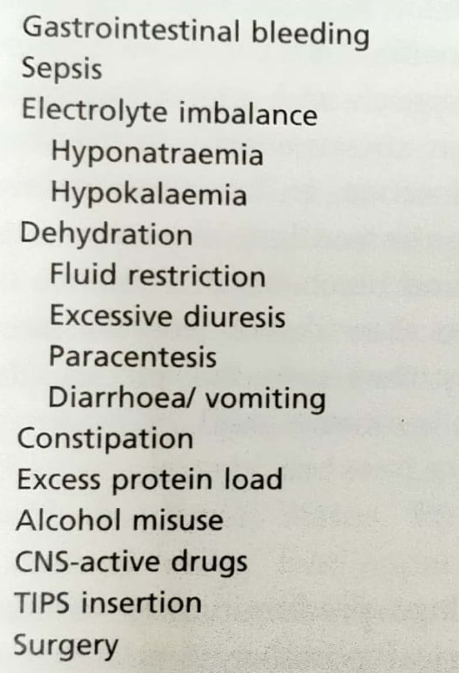
Precipitating factors:

Slide 30
MANAGEMENT

Slide 31
Identification and management of precipitating factors is an important aspect in recurrent episodes of HE.
Measures should be taken to avoid falls, maintain iv lines, monitor vitals, fluid balance and nutrition intake and avoid aspiration pneumonia.
Diet: patients with cirrhosis are unable to effectively store glycogen and rely on gluconeogenesis which uses amino acids. Thus their daily energy and protein requirement is increased.
Daily energy intake- 35-45 kcal/kg and daily protein intake of 1.2-1.5g/kg
Vegetable protein is better tolerated as they are associated with increased intake of dietary fibre.
Food intake is spread evenly to avoid protein loading – six small meals preferable to three big meals.

Slide 32
Hyperosmolar enemata are given to encourage ammonia extraction.
Thus neutral pjosphate or lactulose enema are effective.
Specific treatment is aimed at reducing the production and absorption of gut-derived neurotoxins.
Non-absorbable disaccharides – latulose, lacitol :
Laxative ; uptake of ammonia by colonic bacteria causing it to be trapped ; reduction in intestinal ammonia production by inhibiting glutaminase activity.
Dose is adjusted to ensure passage of 2-3 soft stools/day.
Antibiotics – neomycin, a poorly absorbed aminoglycoside in a dose of 4-6g/day.
Rifaximin – better tolerated.
Combination therapy

Slide 33
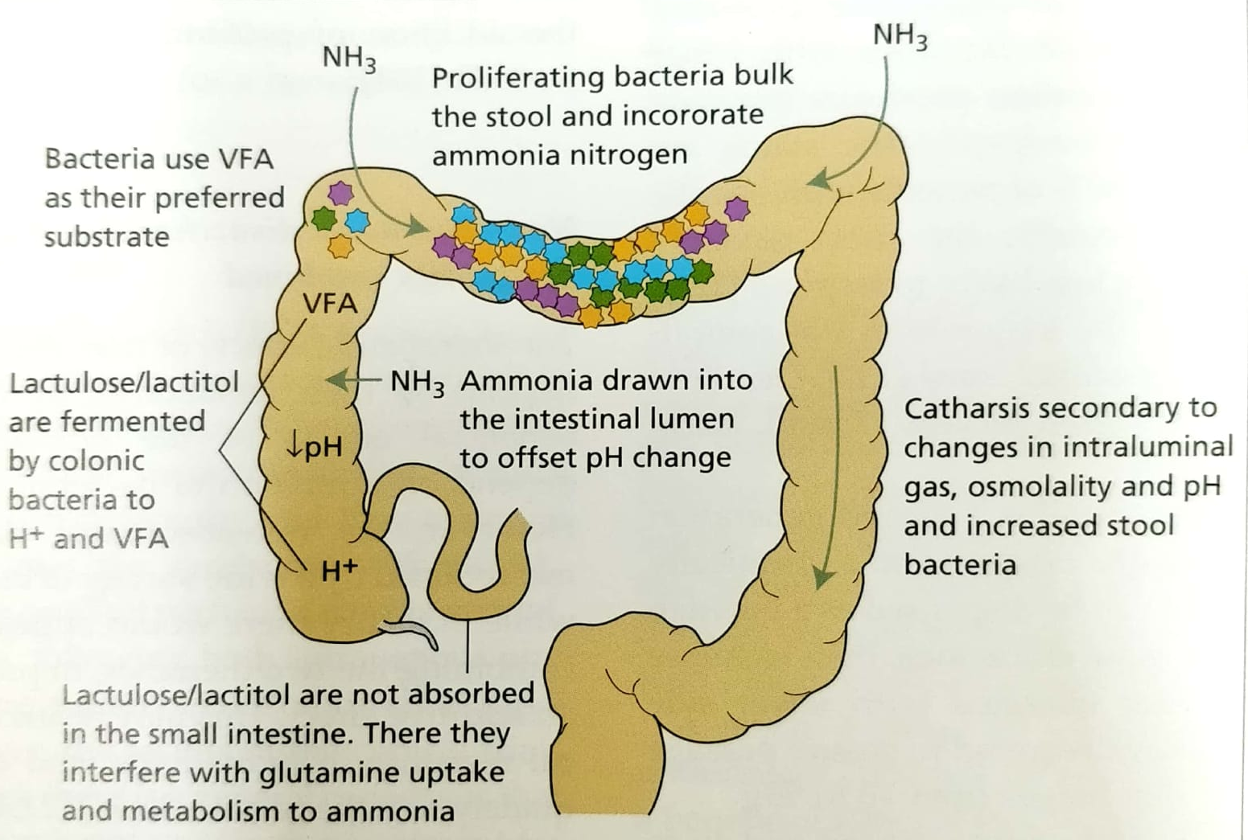

Slide 34
Bromocriptine is considered in patients with compensated liver disease, with stable, chronic persistent hepatic encephalopathy with prominent extrapyramidal features resistant to other therapy.
LOLA ( L-ornitine L-aspartate) : promotes hepatic removal of ammonia by stimulating residual hepatic urea cycle activity and promoting glutamine synthesis esp in skeletal muscles.
Branched amino acids – benefit on nutrition and long-term survival.
Probiotics : generally shoe improvement
Sodium benzoate : one trial showed it to be as effective as lactulose
Zinc : poor zinc status impairs nitrogen metabolism by reducing the activity of urea cycle enzymes.

Slide 35
Shunt occlusion : when patient responds poorly to standard treatment. Vascular embolization ,vascular plugging or balloon occlusion.
Liver transplantation
Artificial liver support systems : MARS dialysis

Slide 36
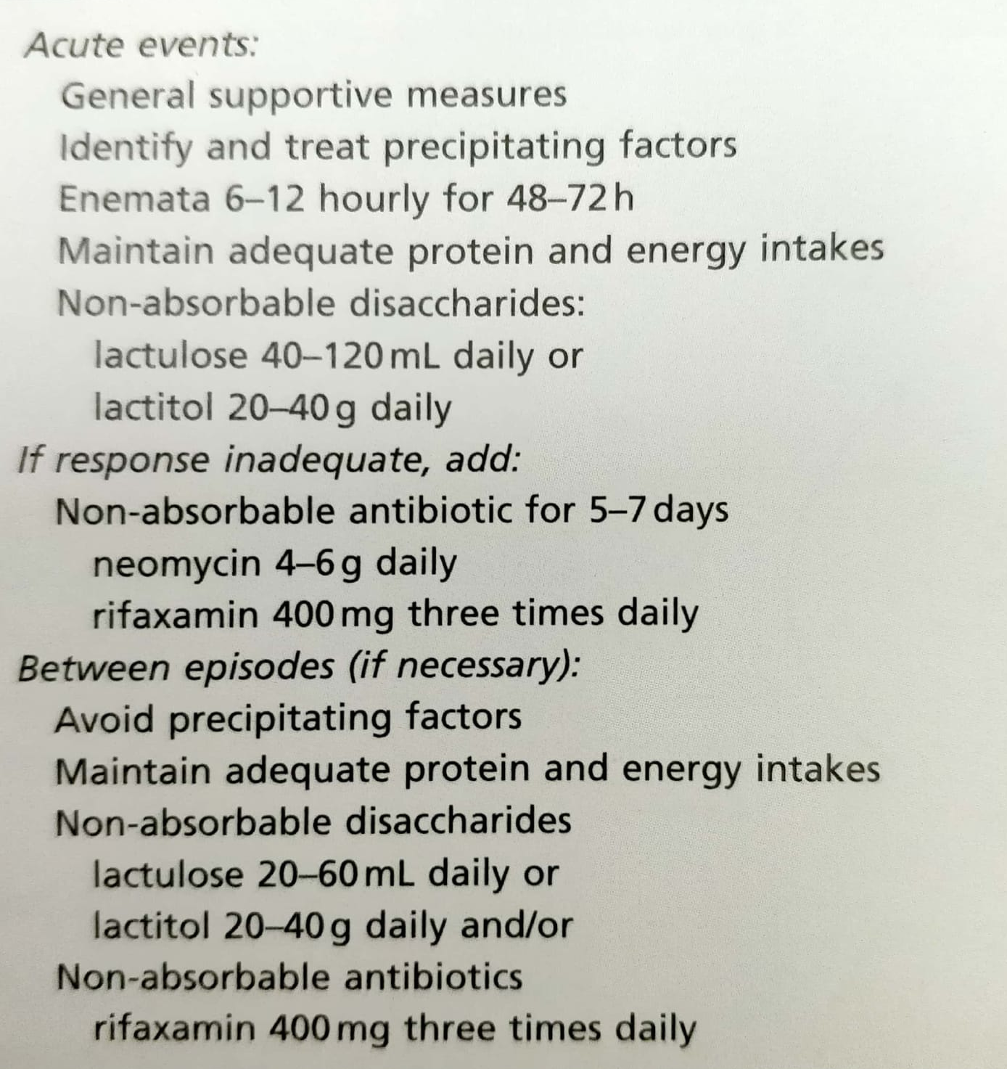
Treatment of recurrent or episodic of HE :

Slide 37
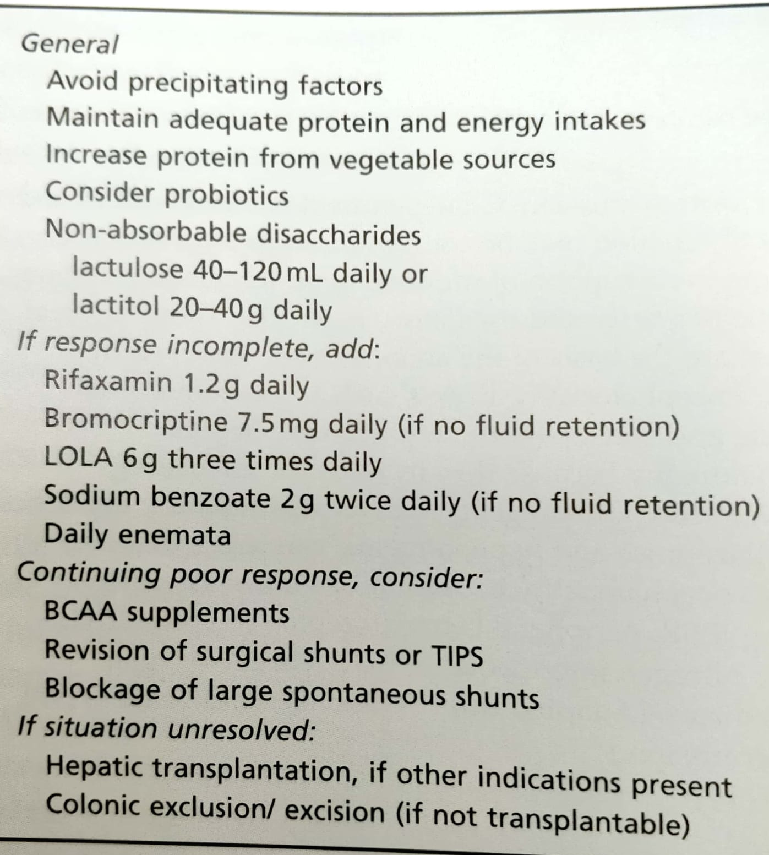
Treatment of persistent HE:

Slide 38
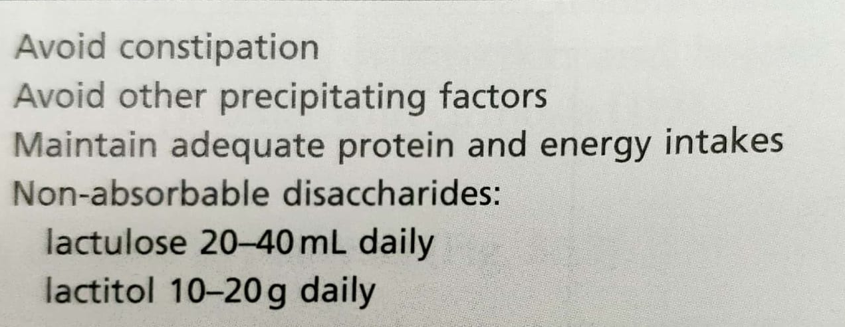
Treatment of minimal HE :

Slide 39
POTENTIAL FUTURE THERAPIES
L-CARNITINE : activation of metabotropic glutamate receptors at the level of brain ammonia uptake or mitochondrial energy metabolism.
RIVASTIGMINE : reversible cholinesterase inhibitor as acetyl choline levels are reduced in these patients.
ENDOCARBINOIDS : augmentation of AMP-activated protein kinase.
SILDENAFIL : pharmacological modulation of extracellular cGMP concentrations
mGluR1 ANTAGONISTS : normalizes motor activity (glutaminergic neurotransmission)
SYSTEMIC INFLAMMATION : anti inflammatory agents should be considered

Slide 40
SPONTANEOUS BACTERIAL PERITONITIS

Slide 41
Is the most common infection in cirrhosis
Called spontaneous as it occurs without a contiguous source of infection (eg – intestinal perforation, intra-abdominal abscess) and in the absence of an intra-abdominal inflammatory focus (abscess, pancreatitis)
It is blood-borne and 90% are monomicrobial.
Bacteria of gut origin are the most commonly isolated organisms.
Thus, migration of enteric bacteria cross the mucosa to extraintestinal sites has been implicated.

Slide 42
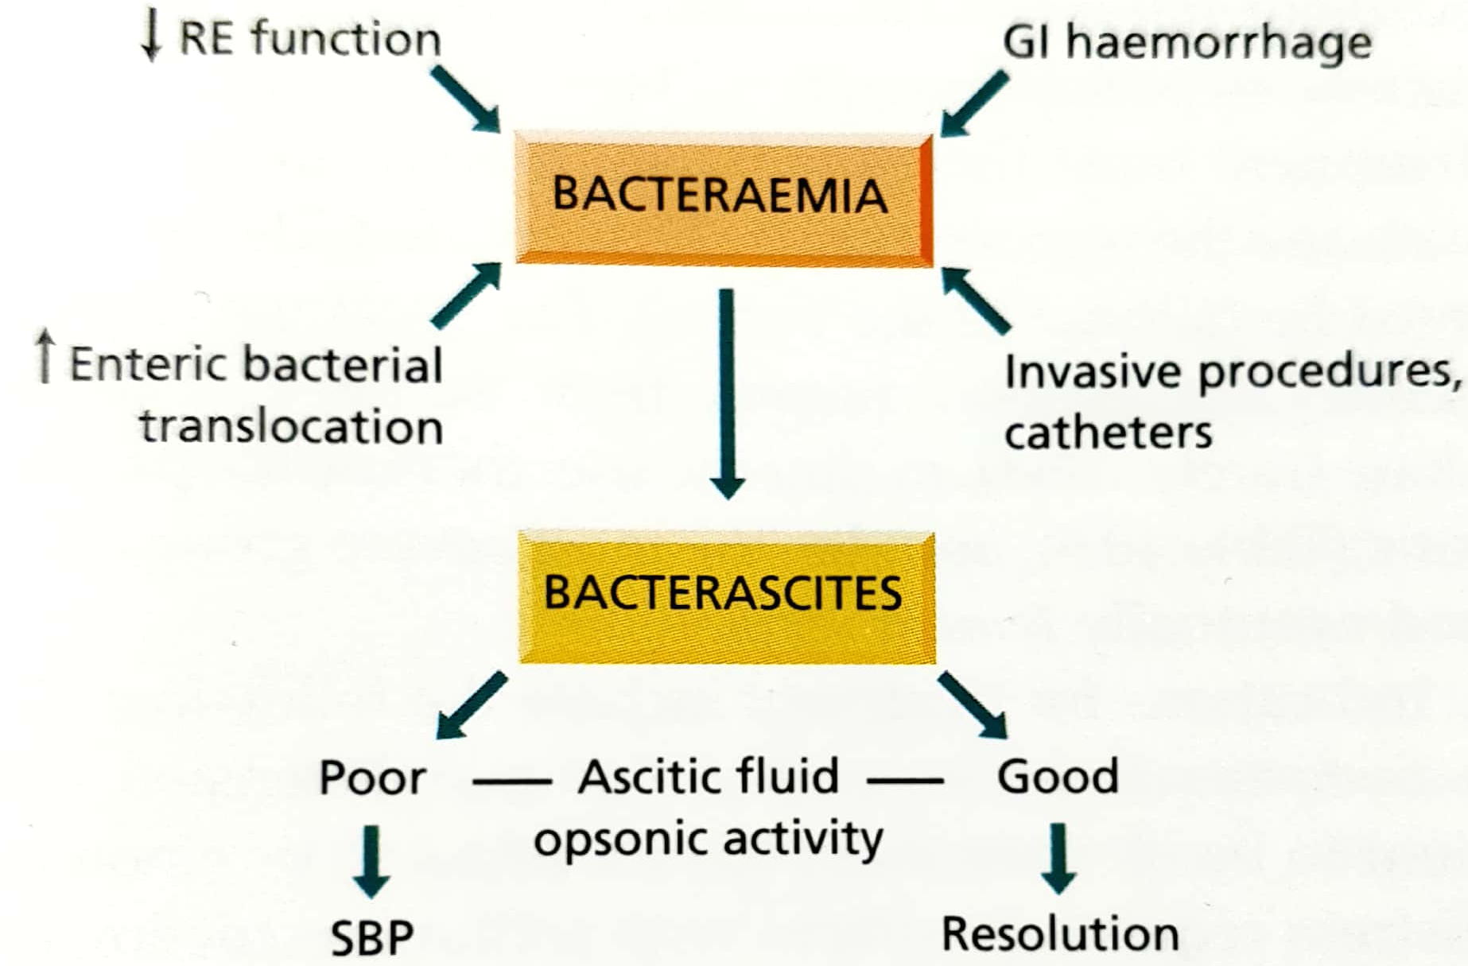
In cirrhosis, an overactive sympathetic system slows gut motility and facilitates bacterial stasis thus facilitation translocation.
Persistence of bacteria in extraintestinal sites is favoured by impaired host defenses.
Ascitic fluid favours bacterial growth and deficient ascitic opsonins leads to defective coating of bacteria which are indigestible by polymorphs.

Slide 43
Should be suspected when a patient of cirrhosis deteriorates, particularly with encephalopathy and/or jaundice.
Patients with variceal bleed or previous SBP are at an increased risk.
Pyrexia, local abdominal pain and tenderness , and systemic leukocytosis

Slide 44
diagnosis
Ascitis PMN count > 250/mm³
Commonly – E.coli or group D streptococci
Anaerobic bacteria rarely
Blood cultures positive in 50%
Bacterascites (positive culture, PMN < 250/mm³) may progress to SBP
These patients are a particular risk for renal complications

Slide 45
Prognosis
1-year probability of SBP recurrences is 69% and median survival is 9 months
Mortality depends on development of renal dysfunction and site of acquisition of the infection, with nosocomial infection being an important predictor of death.
SBP resolution and immediate survival are 100% for community-acquired SBP that is uncomplicated.

Slide 46
Treatment
Antibiotics should be started empirically in all patients with ascites showing >250 mm³ PMN except in those whom local inflammatory reaction is identified.
5-7 days of a third-generation cephalosporin such as cefotaxime administered IV. 2g 12 hourly.
Amovycillin-clavulanic acid is as effective.
Aminoglycosides avoided due to renal toxicity.
Extended spectrum antibiotics should be used as initial empirical therapy
Because of reduced survival, SBP is an indication to consider hepatic transplantation, particularly if recurrent.

Slide 47
Prophylaxis
Risk is particularly high in patients with cirrhosis with the upper GI haemorrhage.
Oral administration of norfloxacin ( 400 mg/12 hr for a minimum of 7 days)
IV ceftriaxone should be considered in high quinolone resistance or in patients with – malnutrition, ascites, encephalopathy, or serum bilirubin more than 3 mg/dL.
SBP and other infections should be ruled out before starting prophylaxis.
In a patient with a previous episode of SBP, the risk of recurrence during the subsequent year is 40-70%. Oral administration of norfloxacin (400mg/day) is recommended and then evaluated or transplant.

Slide 48
Norfloxacin in patients with advanced liver failure (child-Pugh score > 9 points with serum bilirubin >3 mg/dL) or impaired renal function (serum creatinine > 1.2 mg/dL =, blood urea nitrogen >25 mg/dL or serum sodium level < 130)
In these, the 1-year probability of first SBP is 60% and this risk is reduced by prophylaxis.
In patients with high ascitic protein (>1 g/dL) without a past history of SBP there is no need of prophylaxis as the the 1-year probability is nil.

Slide 49
Thank you

