Slide 1
Albuminuria and masked uncontrolled hypertension in chronic kidney disease
Dr. Sanjana Bhagwat
Moderator : Dr. A. Korane sir

Slide 2
INTRODUCTION
Masked hypertension is defined as blood pressure which is normal in the clinic but elevated at home.
This has long been sown to have an association with cardiovascular arterial and ventricular damage.
Now Cardiovascular disease and Chronic Kidney disease often co-exist.
The main question thus is that does the masked hypertension have a more profound effect, in terms of end organ damage, on the cardiovascular system or the renal system.

Slide 3
If masked hypertension is associated with renal end organ damage, that would be indicated by albuminuria and if it affects the cardiovascular system that can be assessed by the left ventricular mass or increased arterial stiffness.
If this can be established it would provide clues as to the mechanism of development of masked uncontrolled hypertension and its pathogenesis which is yet largely unknown.
Thus, this study explores the relationship of MUCH with target organ damage.

Slide 4
MATERIALS AND METHODS
This study was a prospective study.
It included CKD patients of stage 2 to stage 4 (eGFR defined using the modification of diet in renal disease equation <90 mL/min/ 1.73 m² but >15 mL/min/1.73 m²).
Patients with stage 2 CKD, albuminuria (A2 or >300 mg/g creatinine) was required for inclusion in the cohort.
Those with an initial clinic BP of 140/90 mmHg or less were considered eligible and studied further. (However few of the patients were found to be hypertensive on subsequent measurement of blood pressure but were not excluded.)

Slide 5
Healthy control veterans were selected to participate if they did not have hypertension, diabetes, prior history of cardiovascular disease, CKD and were not current smokers.
Clinical history, physical examination, basic laboratory tests, measurements of BP in the clinic (average of three visits) and by 24-h ambulatory monitoring were performed.

Slide 6
Classification of Hypertension
Masked uncontrolled Hypertension (MUCH) was defined as controlled clinic BP (<140/90 mmHg on an average of measurements on three clinic visits by oscillometric BP measurement), but elevated ambulatory blood pressure.
Elevated ambulatory BP was defined as elevated daytime blood pressure (>135/85mmHg).

Slide 7
controlled hypertension (CH) : Those with clinic and daytime ambulatory BP below thresholds.
uncontrolled hypertension (UCH) : those with both above threshold

Slide 8
ASSESSMENT OF TARGET END ORGAN DAMAGE

Slide 9
ASSESSMENT OF ALBUMINURIA
During the time of 24-h ambulatory BP monitoring, participants were asked to collect urine over the 24-h period that was assayed for urine albumin by an immunoassay and urine creatinine using standard methods in the hospital laboratory.
Results are expressed as the ratio of albumin to creatinine (mg/mg).

Slide 10
LEFT VENTRICULAR MASS MEASUREMENTS
Two-dimensional guided M-mode echocardiograms were done during one of the study visits (on the same day or at most within 30 days of ambulatory BP measurement) with a digital cardiac ultrasound machine.
The protocol specified recording of at least 12 cycles of two-dimensional parasternal long- and short-axis left ventricular (LV) views with optimal orientation of the cursor beam used to derive additional M- mode recordings.
Each patient underwent six M-mode measurements of interventricular septal thickness in diastole(IVSTd), LV internal diameter in diastole (LVIDd) and systole (LVIDs), LV posterior wall thickness in diastole (LVPWd) and |systole (LVPWs) and left atrial (LA) diameter using standards of the American Society of Echocardiography.

Slide 11
LV mass was calculated by a previously validated formula :
LV mass (g) = 0.832 x
(IVSTd+LVIDd+LVPWd)^{3 _} (LVIDd)³ +0.60

Slide 12
PWD MEASUREMENTS
Aortic pulse wave velocity is the best to measure arterial stiffness.
This was measured by direct visualization of the descending aorta using echo – Doppler technique.
Flow pulse was recorded by continuous Doppler from the root of the left subclavian artery and just proximal to the bifurcation of the abdominal aorta with simultaneous electrocardiograph recording.
The length of the abdominal aorta was estimated by measuring the body surface distance from the suprasternal notch to the recording site of the aortic signal ( near the umbilicus).

Slide 13
Time elapsed from the peak of the R wave to the foot of the systolic impulse was recorded over six beats.
The length of the descending aorta divided by the difference between the transit times was calculated thus giving the aortic PWV.

Slide 14
STATISTICAL ANALYSIS
To detect the association of BP classification status with targwt end organ damage, unadjusted analyses were done where BP classification was the indicator variables. The reference group was healthy controls.
The p-value reported is the test of the hypothesis that there is no association of BP classification status with target organ damage.
Then adjustments were done in model 1 for :
Age
Sex
race

Slide 15
In model 2, adjustments were made for the variables of model 1 and also :
Cardiovascular risk factors and their treatment,
Including tobacco use, body mass index, diabetes mellitus, serum cholesterol, no. of antihypertensive drugs used, ACE (Angiotensin-converting enzyme) or ARB (angiotensin- receptor blocker) use, CCB (calcium channel blocker) use, beta blocker use, statin use and aspirin use
Model 3 was adjusted for cardiovascular disease like :
Myocardial infarction, coronary artery bypass grafting, percutaneous coronary intervention, peripheral vascular disease and congestive failure.
An analysis for the presence of a trend in coefficients of controls to CH, UCH and MUCH were performed.

Slide 16
RESULTS
Control group – 29 veterans not having CKD, diabetes mellitus, hypertension or cardiovascular disease.
The CKD group of 287 veterans predominantly had CH, 23% MUCH and 9% had UCH.
The average eGFR was 44 ml/min/1.73m² and was similar among the CKD group.
All but 4 participants were on antihypertensive medications.

Slide 17
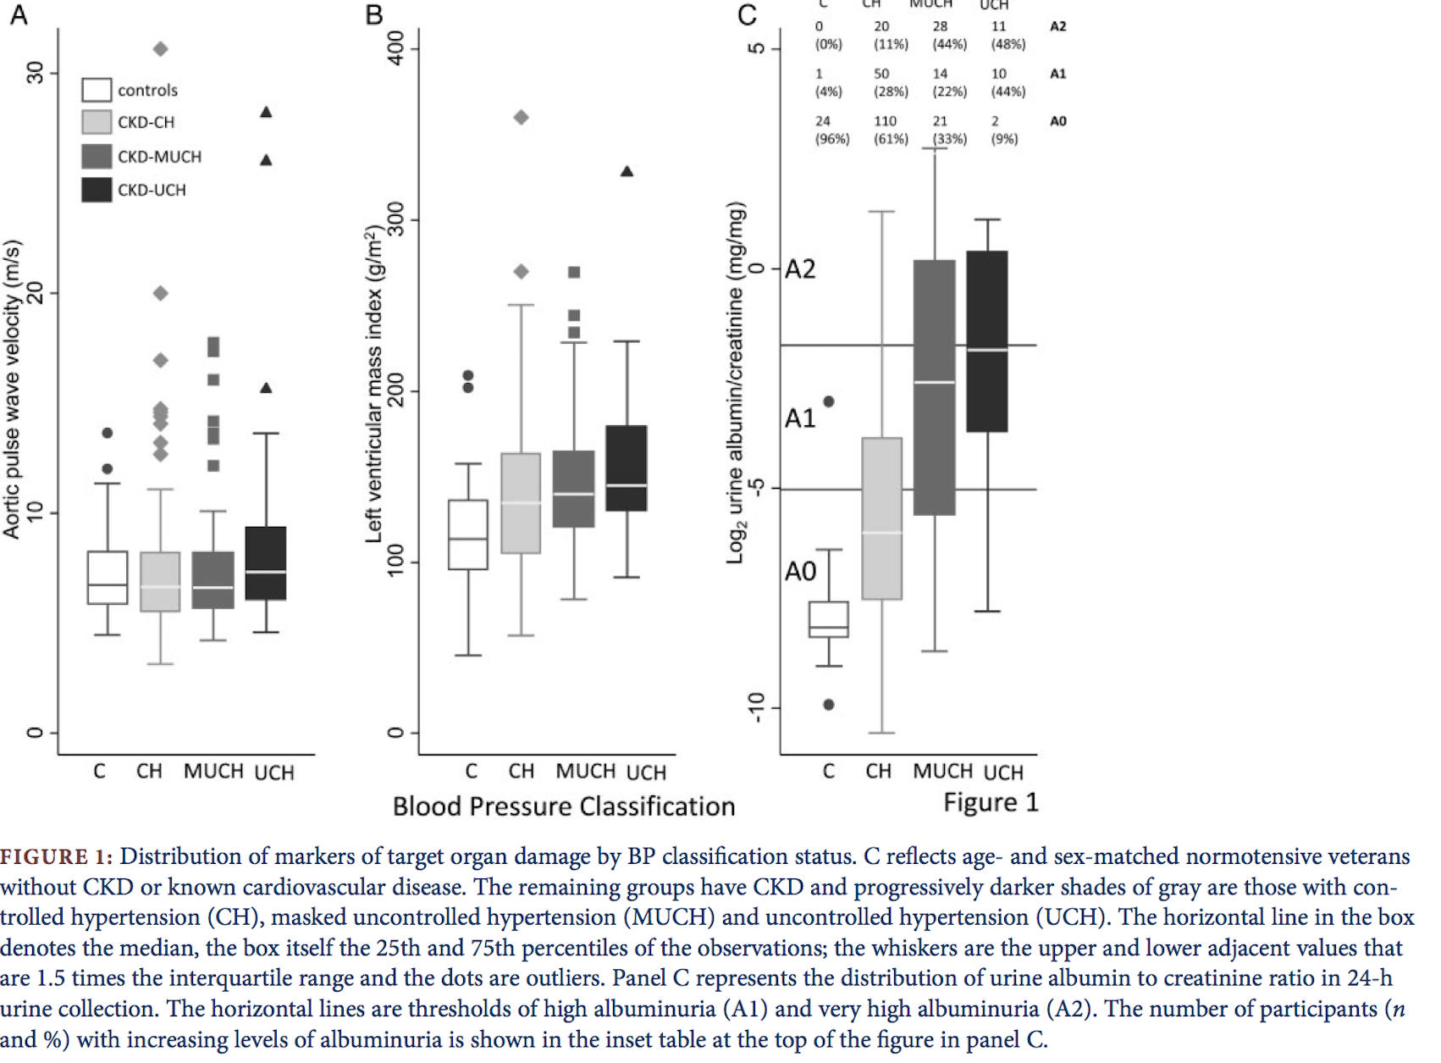

Slide 18
Figure 1 shows the distribution of markers of target end organ damage.
The distribution of severity of albuminuria is shown in panel C. Very high albuminuria (>300 mg/g creatinine, A2) was seen in none of the controls, 11% of CH, 44% of MUCH and 48% of UCH).
In contrast, normoalbuminuria (<30 mg/g creatinine, A0) was seen in 96% of the controls, 61% of CH, 33% of MUCH and 9% of UCH.
The relationship between BP classification status and albuminuria was highly significant.

Slide 19
The second table has results of progressively adjusted models along with the unadjusted model.
The P-value for both among – group differences and the linear trend is highly significant.
As previously mentioned, model 1 is adjusted for age, sex and race.
Model 2 is adjusted for cardiovascular risk factors and its treatment.
Model 3 is adjusted for cardiovascular diseas.
Progressive adjustment did not remove the statistical difference among the groups and linear trend remained significant.
Further adjustment for eGFR also did not remove the difference.

Slide 20
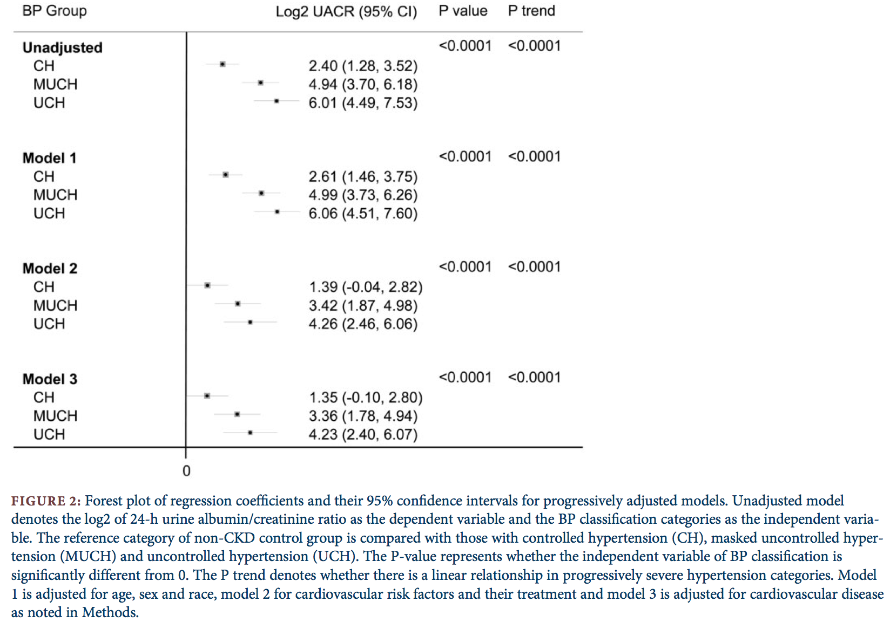

Slide 21
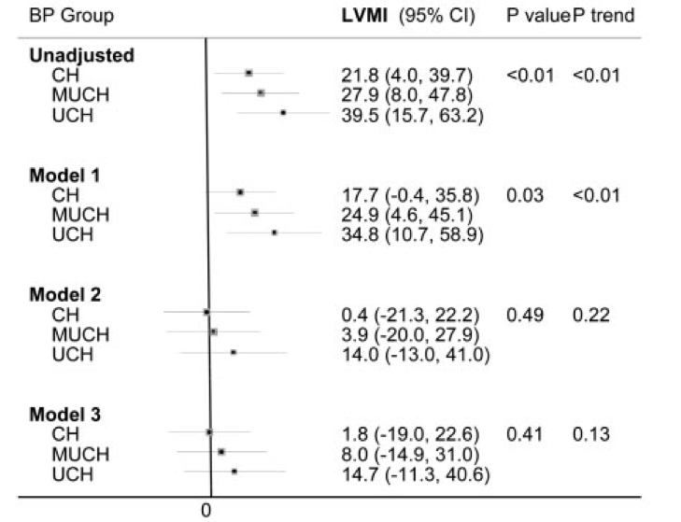
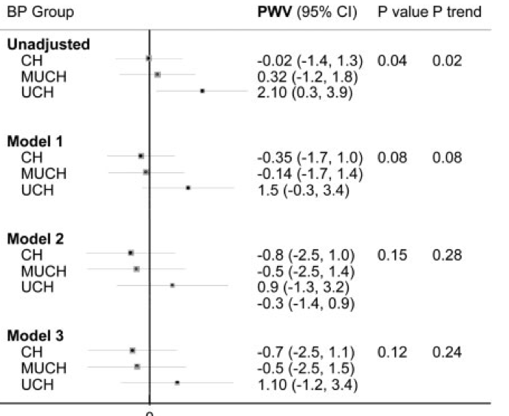
FIGURE 3

Slide 22
Figure 3 shows the progressively adjusted models for LVMI and PWV.
In case of LVMI, clear differences were seen in the unadjusted and model 1, and further adjustment removed the statistical significance.
In the case of PWV, only the unadjusted model was significant.

Slide 23
DISCUSSION
It is well-established that albuminuria is associated with greater ambulatory BP. The strength of the relationship bwtween proteinuria and systolic BP follows the order : ambulatory>home>clinic.
Even slight degrees of albuminuria were associated with an elevated ambulatory BP, independent of eGFR.
The odds of poorly conttrolled hypertension are greater in the presence of albuminuria according to various epidemiological sueveys.
Among those with CKD, after adjusting for baseline clinic BP, odds of sustained hypertension measured by 24- hour ambulatory BP monitoring as compared to white coat hypertension, are greater in the presence of albuminuria.

Slide 24
The Chronic Renal Insufficiency Cohort reported that those with masked hypertension have nearly a 2-fold higher proteinuria than those with well-controlled hypertension.
This study provides a strong association between MUCH and albuminuria.
It extends the above findings by having an age and sex matched group of normotensive subjects without CKD.
It demonstrates a graded relationship among CH, MUCH, and UCH and increasing severity of albuminuria even after multiple adjustments.
The prevalence of MUCH was nearly one in four in this cohort.
Thus MUCH appears to be an intermediate phenotype that lies between those with CH and UCH.

Slide 25
This study also provides information regarding the type of antihypertensive agent used and the propensity for MUCH.
CCB use was more common in those with MUCH and diuretic use was less.
It thus may be causally associated though not established.
CCB use is associated with lower clinical BP and a higher ambulatory recording thus leading to a greater propensity for masked hypertension.
The reverse is the case for diuretics.
This study included CCB and diuretic use in the adjusted models, but excess albuminuria with increasingly severe hypertension classification persisted.
Thus these antihypertensives per se are not sufficient to account for the excess albuminuria with increasingly severe hypertension.

Slide 26
PROBABLE MECHANISMS FOR LINK BETWEEN MUCH AND ALBUMINURIA
Albuminuria is a marker of endothelial dysfunction.
Albuminuria in the nephrotic range is associated with leakage of plasmin in the urine; this serine protease can activate the epithelial sodium channel in the cortical collecting duct and aggregate hypertension.
On the other hand, albuminuria may simply be a marker of renal damage.
If so, the increasing severity of renal damage may lead to volume expansion and impaired natriuresis that may provoke hypertension, especially outside the clinic.

Slide 27
Damage to the renal parenchyma may lead to the accumulation of asymmetric dimethylarginine, a potent inhibitor of nitric oxide synthase.
This in turn would | reduce the production of the potent vasodilator nitric oxide that may further provoke hypertension and target organ damage.
Accumulation of the potent vasoconstrictor endothelin and lack of production of the enzyme renalase that breaks down catecholamines, and adrenergic activation seen even in earlier stages of CKD, may further provoke hypertension.
Whether any of the above mechanisms are of pathophysiological importance for MUCH will require future investigations.

Slide 28
Whereas a direct and strong link was seen between albuminuria and MUCH, a weaker cross-sectional relationship emerged between LVMI and MUCH. Even a weaker relationship was seen between PWV and MUCH.
The fact that the relationship between BP categories and LVMI or PWV disappears after multiple adjustments suggests that other factors besides elevated BP outside the clinic may account for the target organ damage

Slide 29
LIMITATIONS OF THE STUDY
Participation in the study was restricted to veterans who are older and are predominantly men.
Whether our findings apply to younger People and women will need future studies.
The study is cross- sectional in nature and can only detect associations.
Whether the relationships are causal is unclear.

Slide 30
STRENGHTHS
The study used 24-h ambulatory blood pressure monitoring, the gold-standard method to diagnose out-of-office hypertension.
The study was prospective and it collected information on Doppler-assessed PWV, echocardiographic left ventricular mass and 24-h urine albumin collections solely for the purposes of the study.
All measurements were concurrent, unlike some of the earlier reports where median time elapsed between target organ damage assessment and 24-h ambulatory BP measurement exceeded 300 days.
Also, having a group of control age- and sex-matched veterans without CKD increased the validity of the findings.

Slide 31
CONCLUSION
Among patients with CKD, nearly all of whom were taking antihypertensive medications, a graded relationship was found between BP categories and severity of target organ damage in general.
MUCH was most strongly related to renal damage, not when assessed by eGFR, but when assessed by albuminuria.
MUCH was less strongly related to LVMI and PWV. These results are consistent with the notion that kidney damage may have a central role in the pathogenesis of MUCH.
Finally, the strong association of MUCH with albuminuria may in part explain the mechanism of the ability of albuminuria to predict adverse outcomes.

Slide 32
THANK YOU

