Slide 1
NON-HODGKINS LYMPHOMA
DR. SANJANA BHAGWAT
MODERATOR : DR. GANAPULE

Slide 2
Definition
Lymphomas are malignant tumours of lymphoid tissue which give rise to solid tissue masses.
Heterogenous group of disorders.

Slide 3
HODGKINS LYMPHOMA | NON-HODGKINS LYMPHOMA
Localized, single group of nodes | Multiple LNs; extranodal involvement is common
Contiguous spread | Non-contiguous spread
Bimodal distribution | Seen in adults ; mostly elderly
Associated with EBV | May be associated with HIV and autoimmune diseases
Constitutional symptoms (B symptoms) – low-grade fever, night sweats, weight loss | Less common
Staging important for prognosis | Grading more important
Characterized by Reed-Sternberg cells | No RS cells seen

Slide 4
Risk factors :
Infectious agents –
Immunodeficiency increases the risk
Autoimmune diseases- RA, SLE predispose
Environmental exposure to agricultural chemicals
Pesticides implicated in diffuse large cell B-lymphoma.
Polymorphisms in immunoregulatory genes.
Human T-cell lymphotropic virus-1 | adult T-cell lymphoma
Ebstein-Barr virus | Burkitt’s lymphoma Extranodal nasal T-cell lymphoma Non-hodgkins in immunocompromised patients
HIV | B-cell NHL (DLBCL> Burkitt’s) Kaposi’s sarcoma Primary CNS lymphoma
HHV-8 | Primary effusion lymphoma
H.pylori | Gastric MALToma
Notes:
Kaposi’s and primary CNS lymphoma are AIDS defining malignancies. Rest are AID-associated malignancies.

Slide 5
Classification
Earlier the REAL classification was used which had some deficiencies
Currently the WHO classification is followed

Slide 6
WHO classification
Precursor B-cell neoplasms | Precursor T-cell neoplasm
Mature B-cell Neoplasms | mature T-cell and NK-cell lymphomas
Notes:
1.Diffuse large B-cell lymphoma 2.Follicular lymphoma 3. mantle cell lymphoma 4. marginal zone lymphoma 5. MALToma 6. Burkitt’s lymphoma 7.hairy cell leukaemia 8. B-cell chronic lymphocytic leukaemia/small lymphocytic lymphoma.
Mature T-cell : 1. Anaplastic large cell lymphoma 2. angioimmunoblastic T-cell lymphoma 3. mycosis/fungoides/Sezary syndrome

Slide 7
Precursor B cells/lymphoblasts
Development and maturation in the bone marrow
Pre B cells
Express cytoplasmic heavy chains
Immature B cells
Ig M+
Surface immunoglobulin (sIg) + naïve B cells
CD5 +
Small lymphocytes which circulate in the peripheral blood
Ab secreting plasma cells and memory B cells
Some cells form the germinal centre and express sIg , CD10, BCL-6
Exposure to antigen
Post germinal centre memory B cells circulate in the peripheral blood and also in the follicular marginal zones of LN, spleen and MALT

Slide 8
Precursor B cells/lymphoblasts
Development and maturation in the bone marrow
Pre B cells
Express cytoplasmic heavy chains
Immature B cells
Ig M+
Surface immunoglobulin (sIg) + naïve B cells
CD5 +
Small lymphocytes which circulate in the peripheral blood
Ab secreting plasma cells and memory B cells
Precursor B lymphocytic lymphoma/leukaemia
Mantle cell lymphoma
Follicular lymphoma
Diffuse large B-cell lymphoma
Burkitts lymphoma
Marginal zone lymphoma
Germinal centre and Post germinal centre memory B cells circulate in the peripheral blood and also in the follicular marginal zones of LN, spleen and MALT

Slide 9
Precursor in bone marrow
Thymus – undergoes maturation into various types of naïve t-lymphocytes
Cortical thymocytes
Immature – TdT, cCD3, CD5 CD7
Negative for CD4,8
Mature – express CD4, CD8
Medullary thymocytes phenotypically similar to peripheral mature T-cells and NK-cells
After leaving thymus undergo blast transformation – effector and memory T cells
Exposure to antigen
Notes:
T-cell lymphomas in children and young adults derived from innate immune system.
Extranodal in presentation
Adults- nodal

Slide 10
Clinical features
More frequent in elderly
Most subtypes show a male preponderance
Generally present with painless, generalised lymphadenopathy especially in the cervical or supraclavicular region.
Widely disseminated at presentation
Primary extranodal involvement is more common.

Slide 11
Generalised lymphadenopathy –
Enlargement of three or more non-contiguous lymph node groups.
Significant lymphadenopathy –
>1cm in cervical and axillary region
> 1.5 -2 cm in inguinal region
Any supraclavicular or scalene lymphadenopathy is always abnormal.

Slide 12
Nasopharynx or tonsilar involvement :
soreness or pain in throat,
nasal obstruction or bleeding,
lump in throat or dysphagia.
Waldeyer’s ring involvement :
Dysphagia
Compression of trachea

Slide 13
GI mc extranodal site – stomach, mesenteric LNs, peritoneum, liver, small bowel, oesophagus.
GI bleed,
abdominal pain,
vomiting, dyspepsia, nausea,
change of bowel habits
weight loss.
Hepatosplenomegaly
Compression syndrome
Gut obstruction
Ascites
SVC obstruction

Slide 14
Skin involvement –
nodules on head or trunk
CNS-
headache,
lethargy,
hemiparesis
seizures.
May infiltrate meninges.
Blurring of vision, loss of visual acuity – ocular lymphoma.

Slide 15
Kidney or testicular involvement –
urinary tract obstruction or testicular mass.
Metabolic complications –
Hyperuricemia
hypercalcemia

Slide 16
Systemic features less common than in Hodgkins.
Pruritis uncommon
Fever indicates secondary infection.
If present indicate advanced disease and apoorer prognosis.
Autoimmune disorders more common.

Slide 17
Blood picture –
normal hematological parameters early in the disease.
Advanced – Hb falls, may be thrombocytopenia and neutropenia.
Marrow involvement in 30-70%

Slide 18
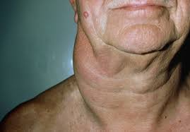
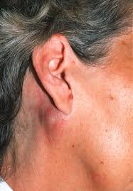
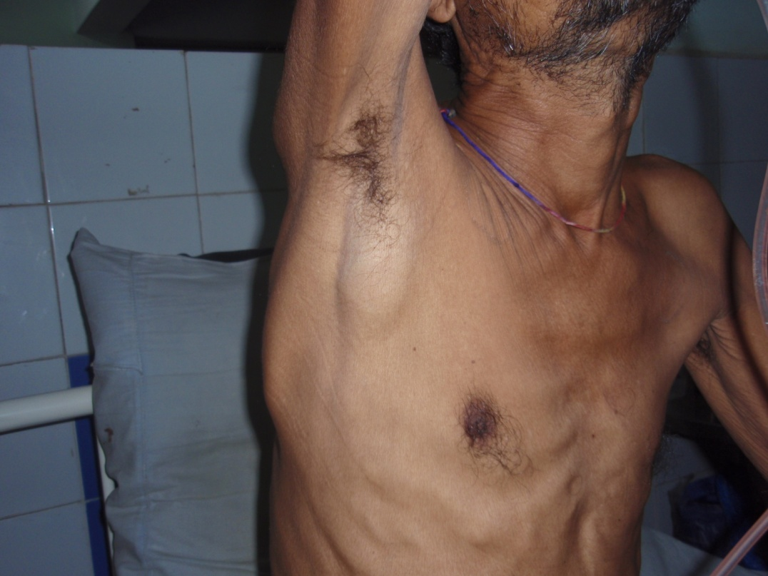

Slide 19
Diagnosis
Rule out other causes of LN enlargement.
Bacterial | Viral
parasitic | Others
Notes:
Acute bacterial infections 2. tuberclosis 3. atypical mycobaterial infections 4. cat-scratch fever
1. Infectious mononucleosis 2. cytomegalovirus 3.AIDS 4. Herpes virus
Toxoplasma
1. castleman’s disease 2. rheumatoid arthritis 3. SLE 4. Sarcoidosis 5. malignant diseases 6. drugs – carbamezapine, hydralazine

Slide 20
Lymphadenopathy at one site – usually localised inflammatory process especially in cervical region.
Supraclavicular – always abnormal.
Bigger nodes usually reflect underlying malignancy.
Texture in malignancy – large, rubbery, non-tender, firm.

Slide 21
Lymph node biopsy
Fine-needle aspiration cytology
Immunophenotyping
Immunohistochemistry
Flow cytometry
Genetics – PCR or southern blotting.
If liver or BM involvement suspected – trephine biopsy of BM or liver biopsy.
Occassionally, diagnostic laparotomy.

Slide 22
Notes:
It has been found in studies that 2 samples of bone marrow biopsy have a better yeild than single sample. Bilateral samples are better than unilateral for morphological analysis.
Protein electrophoresis – monoclonal gammopathy and hypogammaglobulinemia found
High serum LDH and beta-2 microglobulin indicate a poor prognosis

Slide 23
Serum albumin is used as a prognostic factor in DLBCL. A new prognostic index A- IPI (albumin adjusted) has also been proposed.
Recent studies have also shown that vitamin D3 deficiency is a negative prognostic factor in aggressive lymphomas.
Current studies are focused on supplementation of vitamin D3 in deficient patients during treatment and to see if there is any benefit.

Slide 24
Subtyping of NHL
Lineage markers
Lymphoma specific markers
Morphology
Genetics

Slide 25
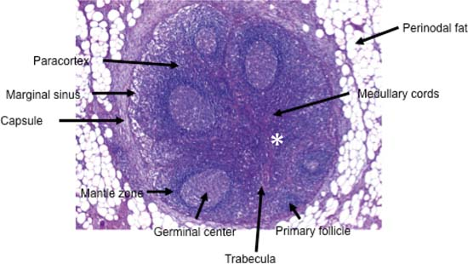
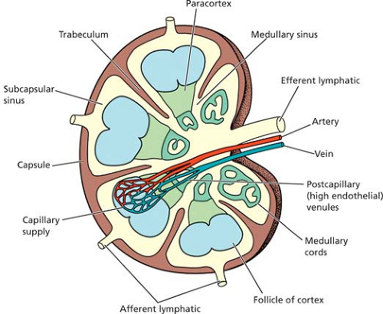
Normal lymph node

Slide 26
Lineage markers :
B cells | CD10, CD19-23, CD79a
T cells | CD3, CD4, CD5, CD8 (CD1, CD2 uncommon)
NK cells | CD16, CD56
Lymphoma specific markers
Cyclin D1 (BCL-1) FMC -7 | Mantle cell lymphoma
BCL-2 (anti-apoptotic) | Follicular
BCL- 6 | Burkitt
TdT | ALL (B and T)
ALK-1 CD30 | Anaplastic large cell lymphoma ( T-cell)
Annexin A1 CD25 CD103 | Hairy cell leukaemia
CD5 (T cell maarker) | Aberrently expressed in Mantle cell B-CLL/SLL

Slide 27
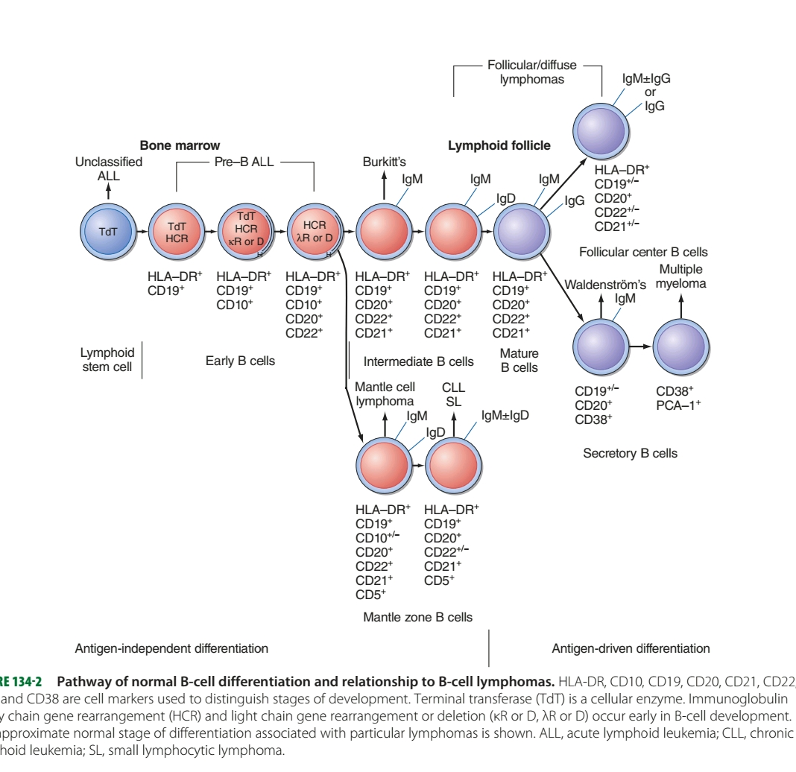
Notes:
Cd 19 20 common to all

Slide 28
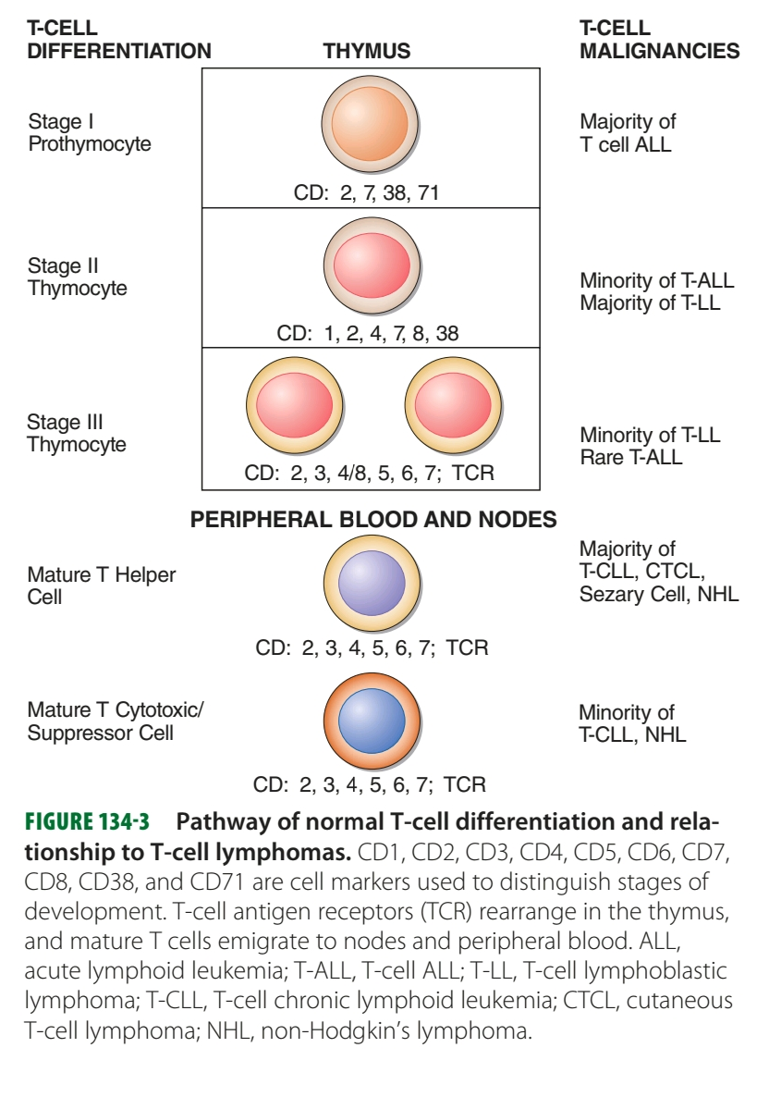

Slide 29
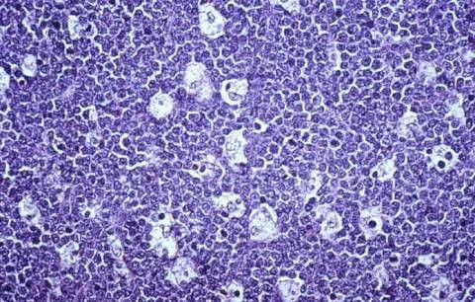
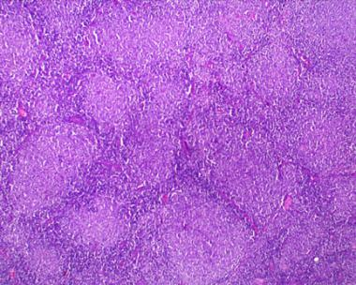
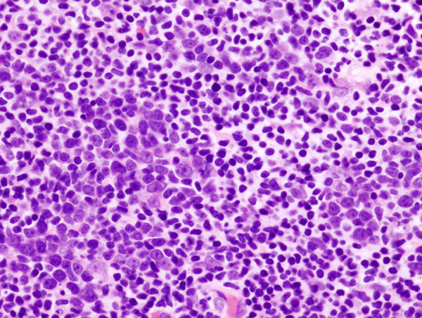
Morphological patterns
Starry sky pattern | Burkitt’s
Follicular pattern | Follicular
Pseudofollicular | BCL-SLL
Diffuse | DLBCL
Notes:
Starry sky pattern due to engulfed apoptotic bodies by macrophages

Slide 30
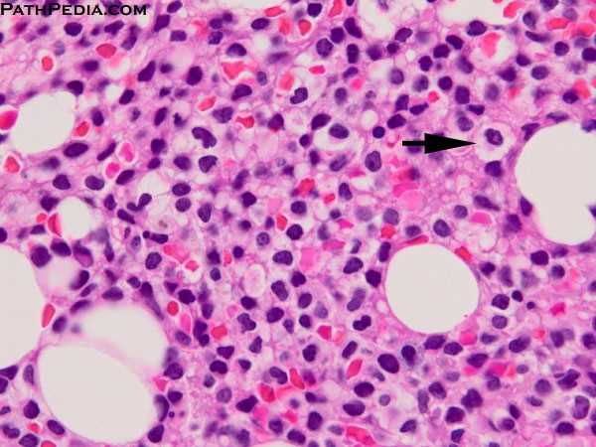
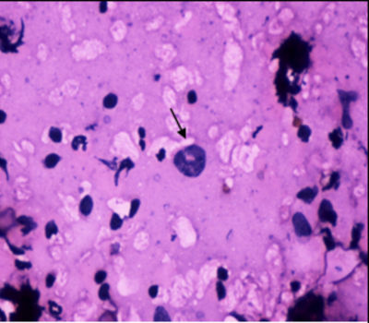
Fried egg appearance | Hairy cell leukaemia
Cells with hair-like projections | Hairy cell leukaemia
Doughnut cells Hallmark cells | ALCL

Slide 31
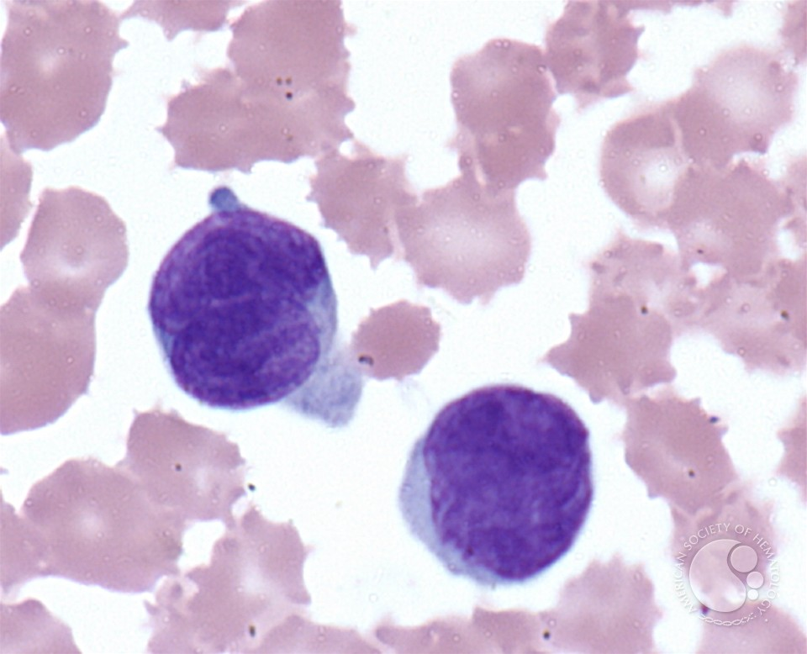
Smudge cells | CLL
Cerebriform nuclei / sezary cells | Disseminated cutaneous T-cell lymphoma
Notes:
Smudge cells due to damaged cells while preparing the sma=ear due to the physical stress as the cells are more fragile.

Slide 32
t(2:5) – codes ALK-1 | ALCL
t(2:8) t(8:14) t(8:22) | Burkitt’s
t(11:14) – cyclin D1 | Mantle cell lymphoma
t(11:18) | Marginal zone lymphoma
t(14:18) – BCL-2 | follicular

Slide 33
B-lineage lymphomas
Precursor B-cell lymphoma:
Extranodal involvement – skin, bone, soft tissue
CD19, CD79a, CD10 and TdT
Arises from pre-germinal B cells

Slide 34
Mature B-cell lymphomas
Diffuse large B-cell lymphoma:
most common, aggressive
Frequently seen in immunodeficient patients
Extranodal
Present as rapidly enlarging tumour mass at these sites
Traslocation with breakpoint in BCL-6 or its mutation.
Immunophenotype – CD19, CD20, CD79, CD22
Notes:
frequently – GIT, bone, liver, spleen, nasopharynx, tonsil (Waldeyer’s ring).

Slide 35
DLBCL
centroblastic
immunoblastic
Notes:
Diffuse growth pattern
Microscopy – diffuse effacement of LN architecture by large cells with pale abundant, basophilic cytoplasm, vesicular nucleus and 2-3 nucleoli
Variants – centroblastic, anaplastic, spindle-cell type

Slide 36
Follicular lymphoma :
Middle-aged adults
From germinal centre B-cells.
Nodal involvement is common but extranodal may be seen.
Bone marrow – 85%
B symptoms common
Indolent course
Moleucular characteristic – t(14,18) – overexpression of BCL-2 which prevents apoptosis – 90% of follicular lymphomas
Notes:
Composed of cells seen in normal germinal centres, i.e, centrocytes and centroblasts which tend to form a follicular pattern.(histology)

Slide 37
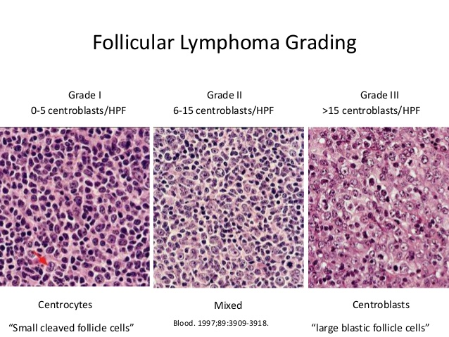
Immunophenotype – CD10, CD19, CD20, CD22, Cd79a, BCL-2.
25% - spontaneous regression.
30-50% - transform into DLBCL.
Notes:
Three grades defined based on extent of follicular or diffuse pattern

Slide 38
Mantle cell lymphoma –
From naïve B-cells, pre-germinal.
t(11:14)
Extranodal marginal zone lymphoma of MALT (MALToma)
Arises in extranodal tissues involved in chronic inflammation
Arises from marginal zone B-cells.
Indolent and remains localized for years.
Prognosis is good
May transform into DLBCL
Notes:
Eg : H.pylori infection in stomach and thyroid in Hashimoto’s thyroiditis
Small-to-medium sized lymphocytes with irregular nuclei.

Slide 39
Burkitts –
From mature B-cells.
Three variants
Associated with EBV
Also in HIV-infected patients
CNS, jaw and other facial bones commonly involved
Aggressive tumour
Responds to chemotherapy
Notes:
Three distinct clinical forms – endemic ; sporadic ; immunodeficiency associated
Endemic and sporadic – children in Africa ; sporadic in western countries ; immunodeficient in HIV patients
The apoptotic cells ingested by macrophages give it a starry sky appearance.

Slide 40
T-lineage lymphomas
Precursor T-cell lymphomas –
Highly aggressive
Patients present with a mass in anterior mediastinum along with supradiaphragmatic lymphadenopathy and pleural effusion.
Can involve CNS
Diffuse pattern
Disseminated disease and B symptoms are common

Slide 41
Mature T-cell lymphoma
Mycosis fungoides/ cutaneous T-ell lymphoma
Indolent
Presents with eczematous skin lesions
Median survival is 1 year from development of systemic disease.
Lymphopenia
Increase in suppressor:helper T-cell ratio.
Histology – pautrier’s micro-abscesses.
Circulating tumour cells – Sezary syndrome

Slide 42
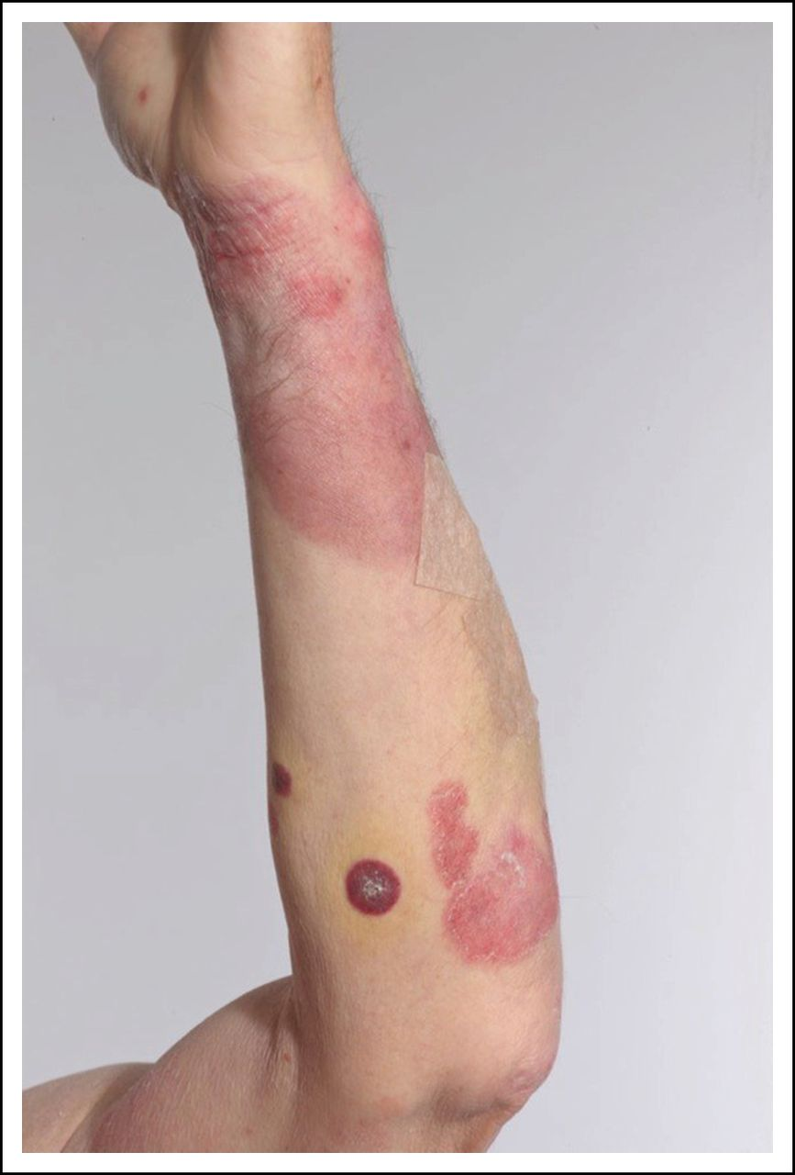
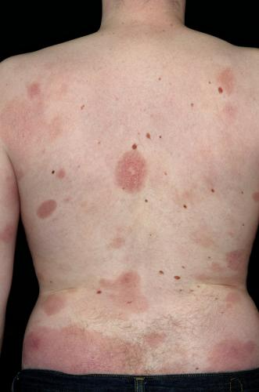
Stage 1(premycotic) – widespread patchy scaly and erythematous eruptions with severe pruritis
Stage II – tumour like lesions and infiltrated plaques in the skin. Lymphadenopathy may develop.
Stage III – skin tumours ulcerate and fungate, hepatosplenomegaly.

Slide 43
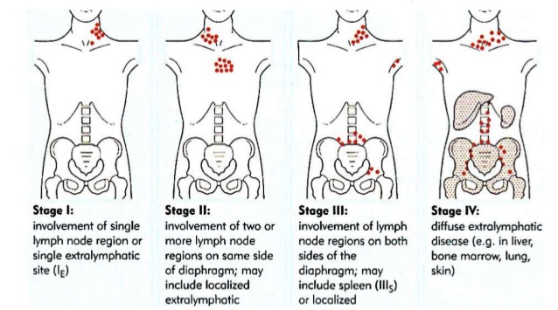
Staging
The Ann-Arbor staging is used more frequently for HL but can also be used for NHL.

Slide 44
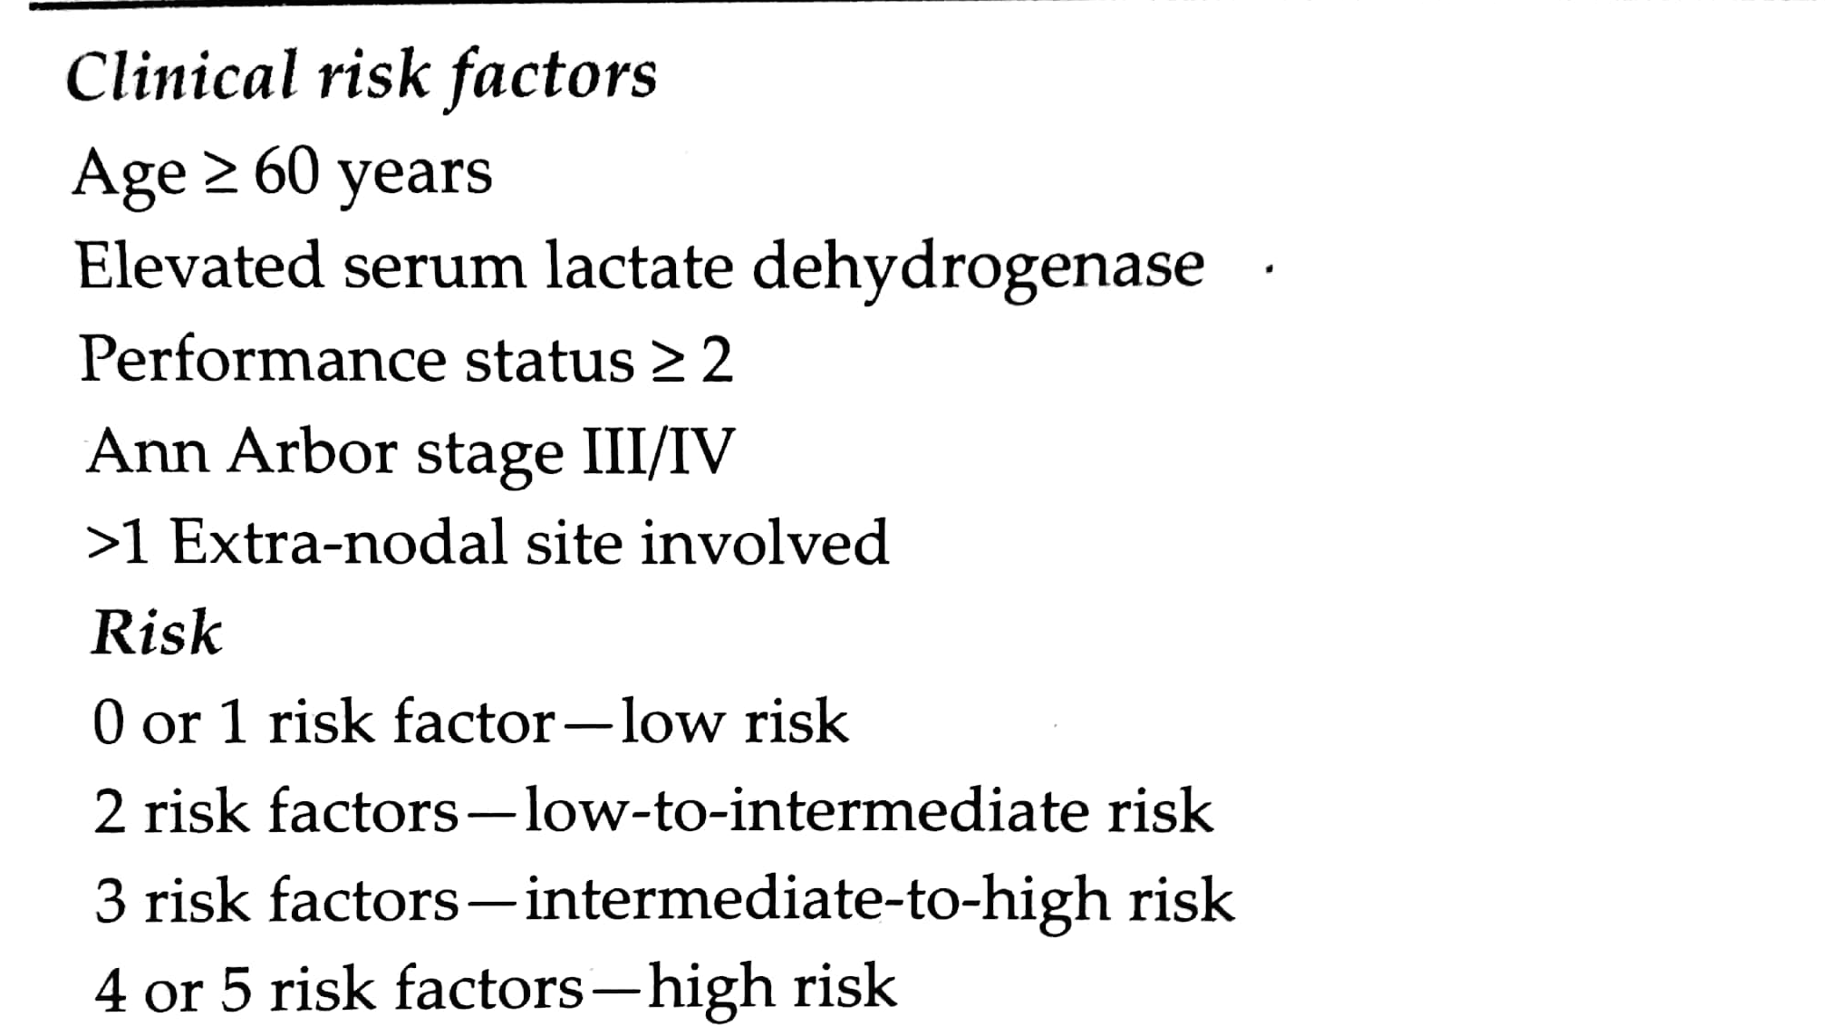
This system does not correlate with prognosis.
The international prognostic index categorizes these patients into groups with distinct prognosis.

Slide 45
Follicular lymphoma being an indolent tumour has its own staging – follicular lymphoma international prognostic index.
Parameters –
Hb <12 g/dl
LDH
No. of extra-nodal sites involved (>4)
0-1 risk factors : low risk
2 risk factors : intermediate
> 2 factors : high

Slide 46
Treatment
Indolent tumours:
follicular, small lymphocytic, marginal zone lymphomas
Stage I/II – curable
Involved field radiotherapy
Rituximab
Stage III/IV
Combination chemotherapy (CHOP) + rituximab
FND OR FAD
CVP regimen

Slide 47
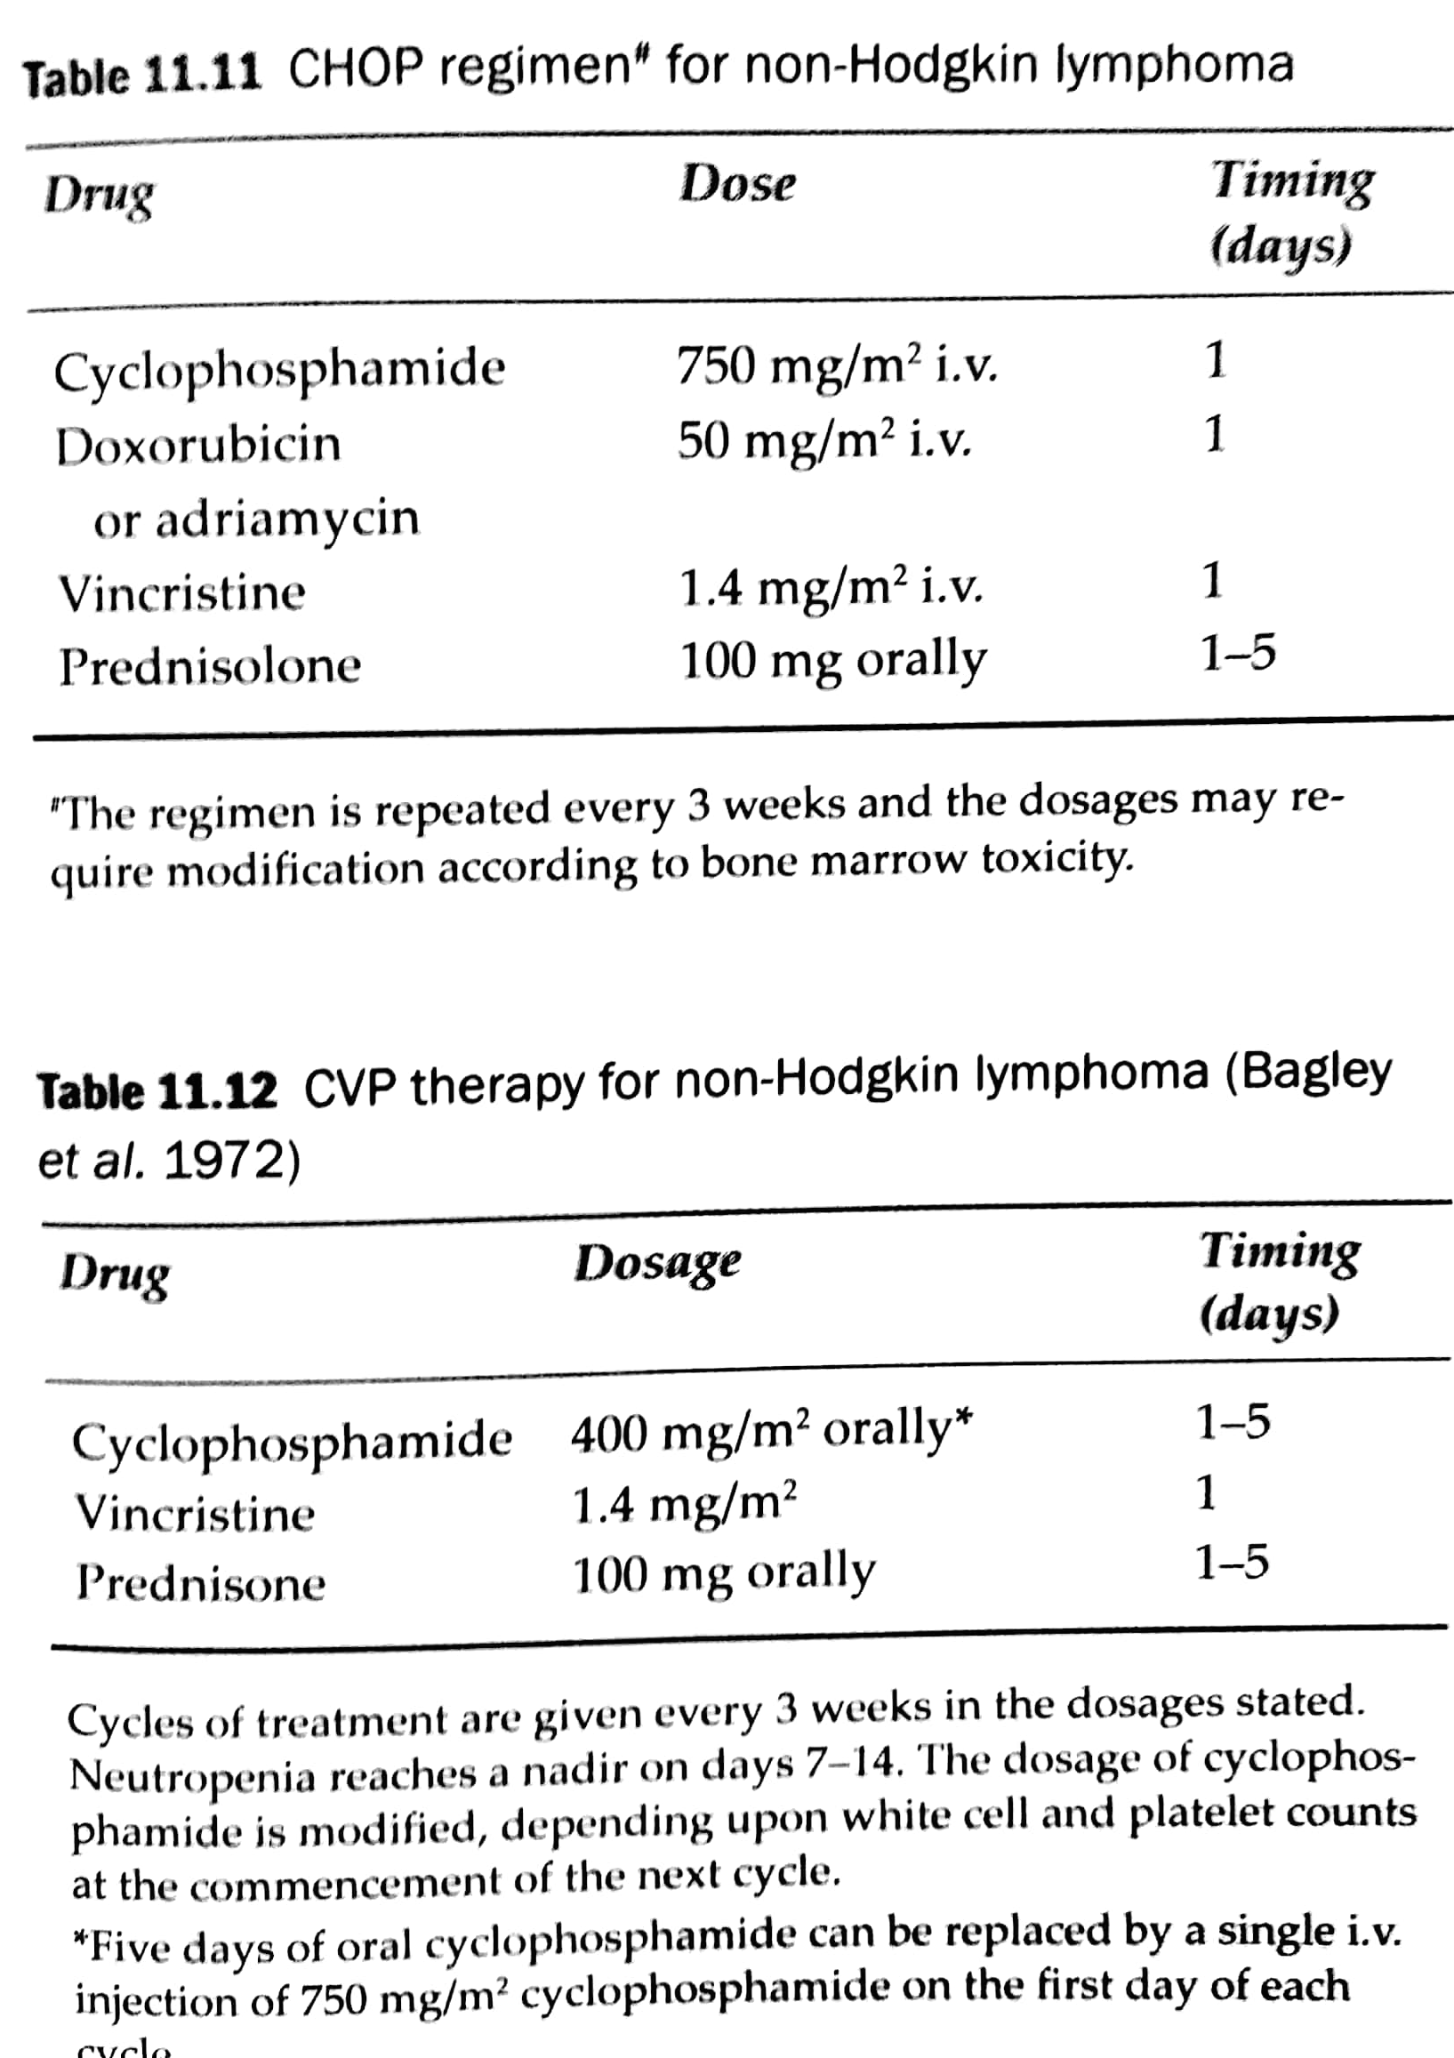
Notes:
Cyclophosphamide – alkylating agent causes cell apoptosis
Doxorubicin – antimititic and cytotoxic
Vincristine binds to the microtubular proteins – mitotic arrest

Slide 48
DLBCL-
Most popular – CHOP+ Rituximab
Stage I/II (non-bulky) – 3-4 cycles
Bulky II/III/IV – 6-8 cycles with/without subsequent field radiotherapy.
30-40% - refractory or relapse – salvage therapy
Autologous bone marrow transplant superior to salvage therapy in patients whose lymphomas are chemo-sensitive after relapse.

Slide 49
Follicular lymphoma –
Responds well to chemotherapy and radiotherapy.
Asymptomatic – wait and watch.
Single agent - Chlorambucil/cyclophosphamide if treatment is required.
Or CVP or CHOP
Localised – field radiotherapy
Remission - Addition of interferon alpha
Relapse – Rituximab
Or bedamustine with rituximab
Notes:
Interferon alpha – increases survival
Transformation to DLBCL – poorer prognosis. Initial treatment with R-CHOP – rate of histological progression seems to be decreasing.
Chlorambucil - interferes with DNA replication, apoptosis promoter.

Slide 50
Chronic lymphoid leukaemia (CLL)–
Cholarambucil alone or in combination.
Fludarabine based regimens are preferred
Anti-CD52 antibody – alemtuzimab but causes severe immunosuppression.
Young patients – bone marrow transplant considered but not very encouraging.
2 newer antibodies – Ofatumumab and Obinutuzumab
Others- Ibrutinib and idelalisib
Notes:
Ofatumumab anti CD20 – inhibits early B cell activation
Obinutuzumab anti CD20
Ibrutinib – brutons tyrosine kinase inhibitor
Idelalisib – phosphoinositide-3-kinase inhibitor
Both have anti-tumour effects.

Slide 51
Marginal zone lymphoma – is localized hence responds to local therapy- radiation or surgery.

Slide 52
Mantle cell lymphoma –
Intermediate behaviour hence does not respond to conventional chemotherapy.
Hyper C-VAD (cyclophosphamide, vincristine, adriamycin and dexamethasone) regimen in combination with rituximab.
Plus high dose methotrexate and cytarabine.
Bendamustine + rituximab

Slide 53
Thank you

