Slide 1
INTERSTITIAL LUNG DISEASE
CLASSIFICATION

Slide 2
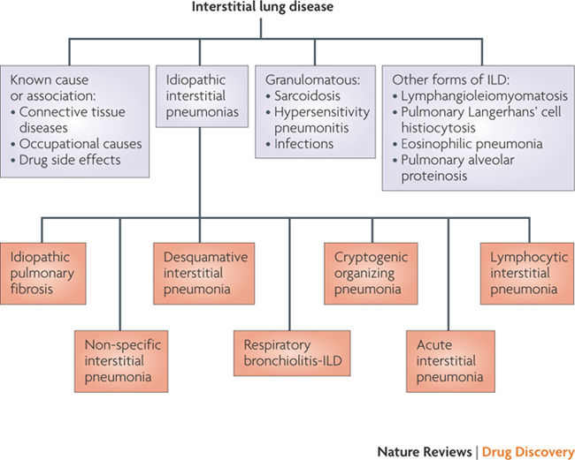

Slide 3
PIRFENIDONE

Slide 4
Pirfenidone is an orally active molecule that :
may inhibit collagen synthesis,
downregulate the production of multiple cytokines,
and block fibroblast proliferation and stimulation in response to cytokines.
Another antifibrotic molecule available is Nintedanib.

Slide 5
It has anti-inflammatory, anti-oxidant and anti fibrotic activity.
Thus may improve lung function and reduce the number of acute exacerbations in patients with idiopathic pulmonary fibrosis.

Slide 6
Indications
Mild and moderate idiopathic pulmonary fibrosis.
Use for any other conditions has not been further studied.

Slide 7
Contraindications
Hypersensitivity
History of angioedema on administration of pirfenidone.
Concomitant use of Fluvoxamine.
Severe hepatic impairment or end stage liver disease
Severe renal impairment (CrCl <30 ml/min) or end stage kidney disease on dialysis.

Slide 8
Adverse Effects
Photosensitivity reaction and rash
Angioedema
Dizziness
Nausea
Fatigue
Weight loss
Renal impairment
Hepatic impairment

Slide 9
Pregnancy and Lactation
Not enough data is available for effects on foetus and infant when administered to the mother.
Currently it is recommended only if benefits outweigh the risk in specific cases.

Slide 10
Dose
It is available in India as 200 mg oral tablet.
Recommended dose is 200mg thrice a day (600 mg)
After 2 weeks the dose is gradually increased to 600 mg (1800 mg/day).
Cost is around Rs. 18 per tablet.

