Slide 1
Pulmonary Hypertension
Dr. Sanjana Bhagwat
Moderator : Dr. S. Sharma

Slide 2
DEFINITION
Elevation in pulmonary arterial pressure 25 mm Hg or greater in a resting individual and 30 mm hg or more during exercise.
The population resting mPAP is approx 14 mmHg.

Slide 3
CLASSIFICATION

Slide 4
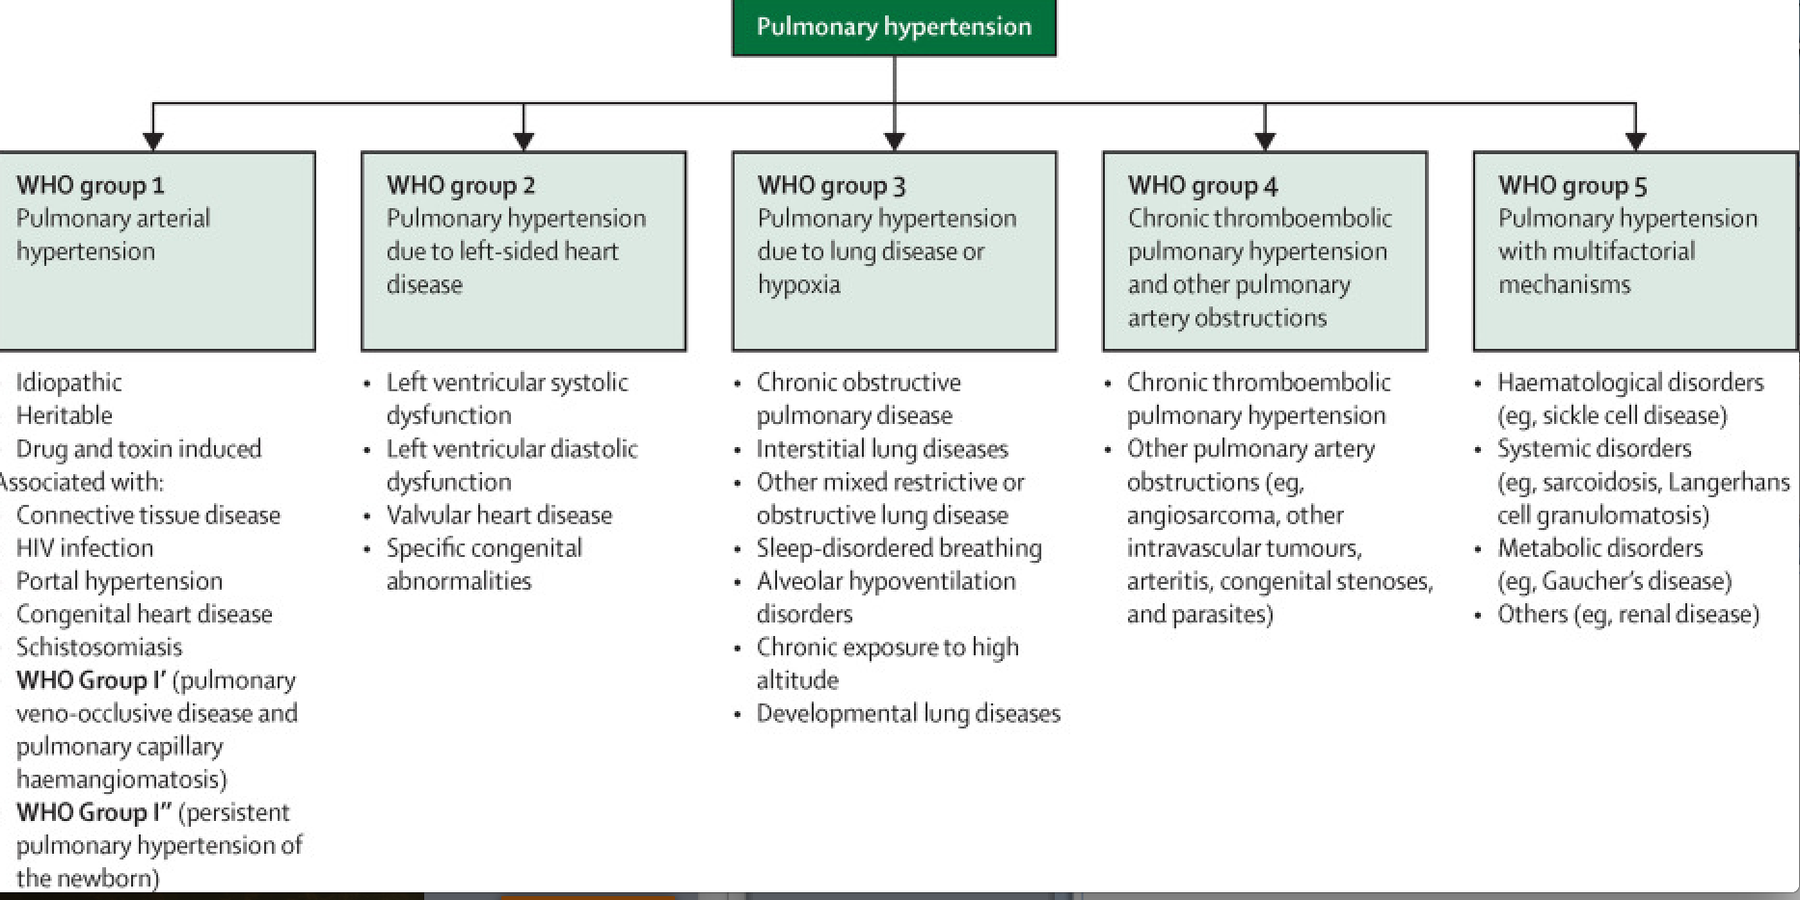

Slide 6
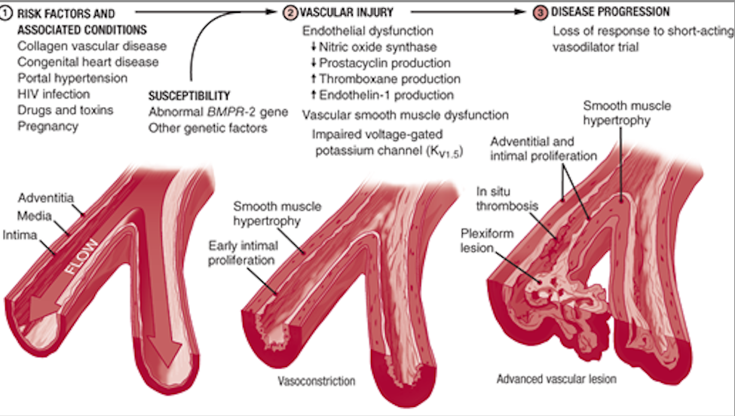
PATHOGENESIS

Slide 7
GENETICS
BMPR2 – 1st PAH-predisposing gene
Germline mutation seen in 70-80% cases
15-20% of sporadic cases.
Others : ALK1, ENG, Smad proteins
Familial IPAH – F>M, more severe disease

Slide 8
CLINICAL FEATURES
SYMPTOMS :
Dyspnoea is the most common presenting feature
Fatigue
Oedema, syncope, chest pain less frequently seen

Slide 9
SIGNS :
Loud P2
Left parasternal lift
Right ventricular S4
Increased jugular ‘a’ wave
Holosystolic murmur of tricuspid regurgitation
Pulsatile liver, hepatomegaly
Peripheral oedema
Central cyanosis
clubbing
Signs of underlying congenital heart disease, like, murmurs, opening snap etc
Obesity, kyphoscoliosis
Aclerodactyly, arthritis, raynaud’s phenomenon
Venous stasis ulcers (sickle cell disease)
Pulmonary vascular bruits ( chronic thromboembolism PH)
Splenomegaly, caput medusae, spider naevi, palmar erythema ( portal hypertension)

Slide 10
MANAGEMENT

Slide 11
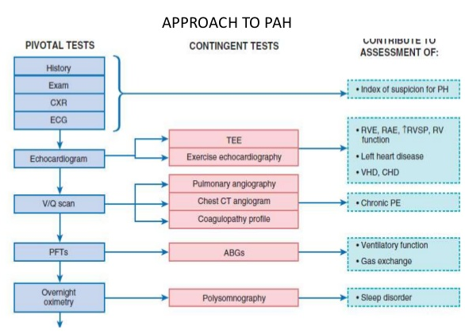

Slide 12
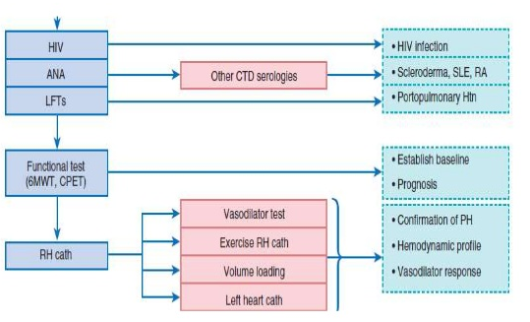

Slide 13
INVESTIGATIONS
ECG :
Not very sensitive or specific. Can show right atrial enlargement, right axis deviation and right ventricular enlargement with strain pattern.
CHEST XRAY :
Enlarged main and hilar pulmonary artery shadows with ‘pruning’ or attenuation of peripheral vasculature

Slide 14
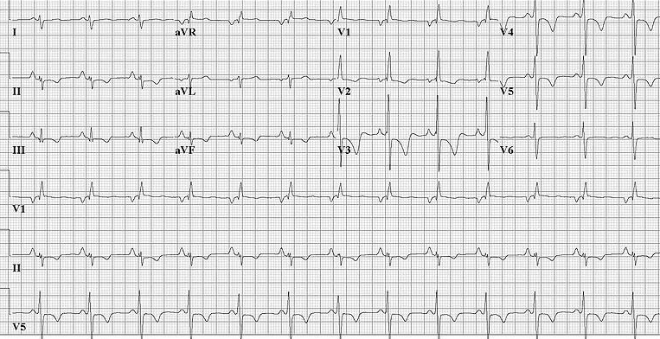
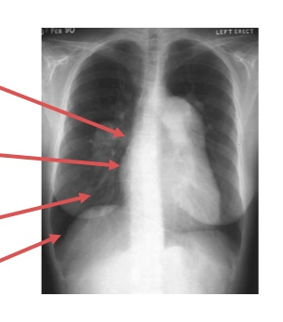
P pulmonale in II, III,
aVF
T wave inversions –
Strain pattern
Enlarged central pulmonary artery
Right ventricular
hypertrophy
Pruning of peripheral
vasculature
Clear lung fields

Slide 15
ECHOCARDIOGRAPHY:
Dilated right ventricle
Elevated estimated pulmonary artery systolic pressure
Specific etiologies live valvular heart disease, systolic and diastolic function can also be assessed.
VENTILATION – PERFUSION SCAN :
Most sensitive for chronic thromboembolism PH
PULMONARY ANGIOGRAPHY :
To be done when suspicion of PH persists even after non-invasive imaging.

Slide 16
PULMONARY FUNCTION TESTS : To assess for obstructive or restrictive disease
CARDIAC MAGNETIC RESONANCE IMAGING :
For right ventricular function
A RV EF <35% is also a predictor of mortality
OVERNIGHT OXIMETRY : Help to identify those with obstructive sleep apnoea
LAB STUDIES : For connective tissue dispoders, HIV, Liver disease
FUNCTIONAL ASSESSMENT :
Done by the 6-minute walk test to quantify exercise ability.
Useful prognostic predictor and is included in the the clinical assessment of disease progression and treatment effect.

Slide 17
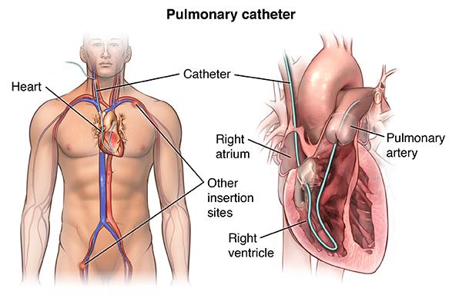
RIGHT HEART CATHETERIZATION :

