Slide 1
Statins Reduce the Risk of Cirrhosis and its Decompensation in Chronic Hepatitis B Patients: A Nationwide Cohort Study
Dr. Priti Shahapure
Moderator: Dr. Rajendra Mane
Published on 10th may 2016 in AJG

Slide 2
INTRODUCTION
Hepatitis B is one of the major global health issues.
Almost 2 billion people are infected with HBV worldwide, including 350 million people who have chronic HBV infection.
HBV infection can cause acute and chronic hepatitis, cirrhosis and hepatocellular carcinoma.
The use of statins has been shown to reduce the fibrosis progression and cirrhosis in patients with chronic hepatitis C however the protective effect of statins in development of cirrhosis in pts with CHB is not known.

Slide 3
Hepatic sinusoidal endothelial dysfunction with decreased nitric oxide production contributes to increased hepatic vascular tone in cirrhosis.
Simvastatin improves the sinusoidal endothelial dysfunction thus decreases the hepatic vascular resistance in cirrhotic patients.
This study hypothesized that statins have pleiotropic effects in advanced liver disease.
The aim was to evaluate the effect of statins on the development of cirrhosis, its complications and and its decompensation in CHB patients.

Slide 4
METHODOLOGY
Prevalence of HBV in Taiwan is15-20%,which is one of the highest in the world.
This study utilized the National Health Insurance Research Database (NHIRD) which was launced in T Taiwan on 1st March 1995 and more than 99% of the taiwanese population was enrolled in it.
INCLUSION CRITERIA :
Chronic Hepatitis B ( defined by positivity of HbsAg for more than 6 months)
Age of onset of the disease > 20 years.

Slide 5
EXCLUSION CRITERIA:
Hepatitis C infection, Biliary cirrhosis, Alcoholic liver disease or Alcoholic Cirrhosis.
Patients already on statins.
Pts already been diagnosed with Cirrhosis or esophageal varices before the inception point.
Study Design:
Study period- 1997-2009
Statins cohort- Pts taking > 28cDDD of statins
Non statin cohort- Pts taking < 28cDDD of statins.

Slide 6
For the accuracy of the diagnosis of cirrhosis pts were enrolled with two physician visits under the assigned diagnosis of cirrhosis plus,
USG at least 6 months before the diagnosis or
Blood test for Albumin, Bilirubin, PT, aPTT , CBC atleast 12 months before the diagnosis.
Decompensated cirrhosis refers to the pts who were included in the Registry for Catastropic Ilness Patient Database(RCIPD) a subpart of NHIRD.
One of the following criteria is required for cirrhotic pts to be registered in RCIPD: 1) intractable ascites 2) variceal bleeding 3) hepatic coma or liver decompensation.

Slide 7
The effects of comorbidities were adjusted with the help of Deyo comorbidity index which includes 12 diagnostic categories:
MI, CHF, PVD, CVD, dementia, Chr pulmonary disease, Rheumatic disease, peptic ulcer disease, renal disease, hemiplegia or paraplegia, any malignancy including lymphoma and leukemia, & HIV.
DOSE-RESPONSE relationship:
Potential confounders: CHB treatment, and nonstatin lipid lowering agent such as cholestyramine, colestipol and ezetimibe and clofibrate, fenofibrate, gemfibrosil.
Also to show the dose response relationship the study population was stratified by drug use levels into four groups(non-users, 28-90, 91-365 and >365cDDD)

Slide 8
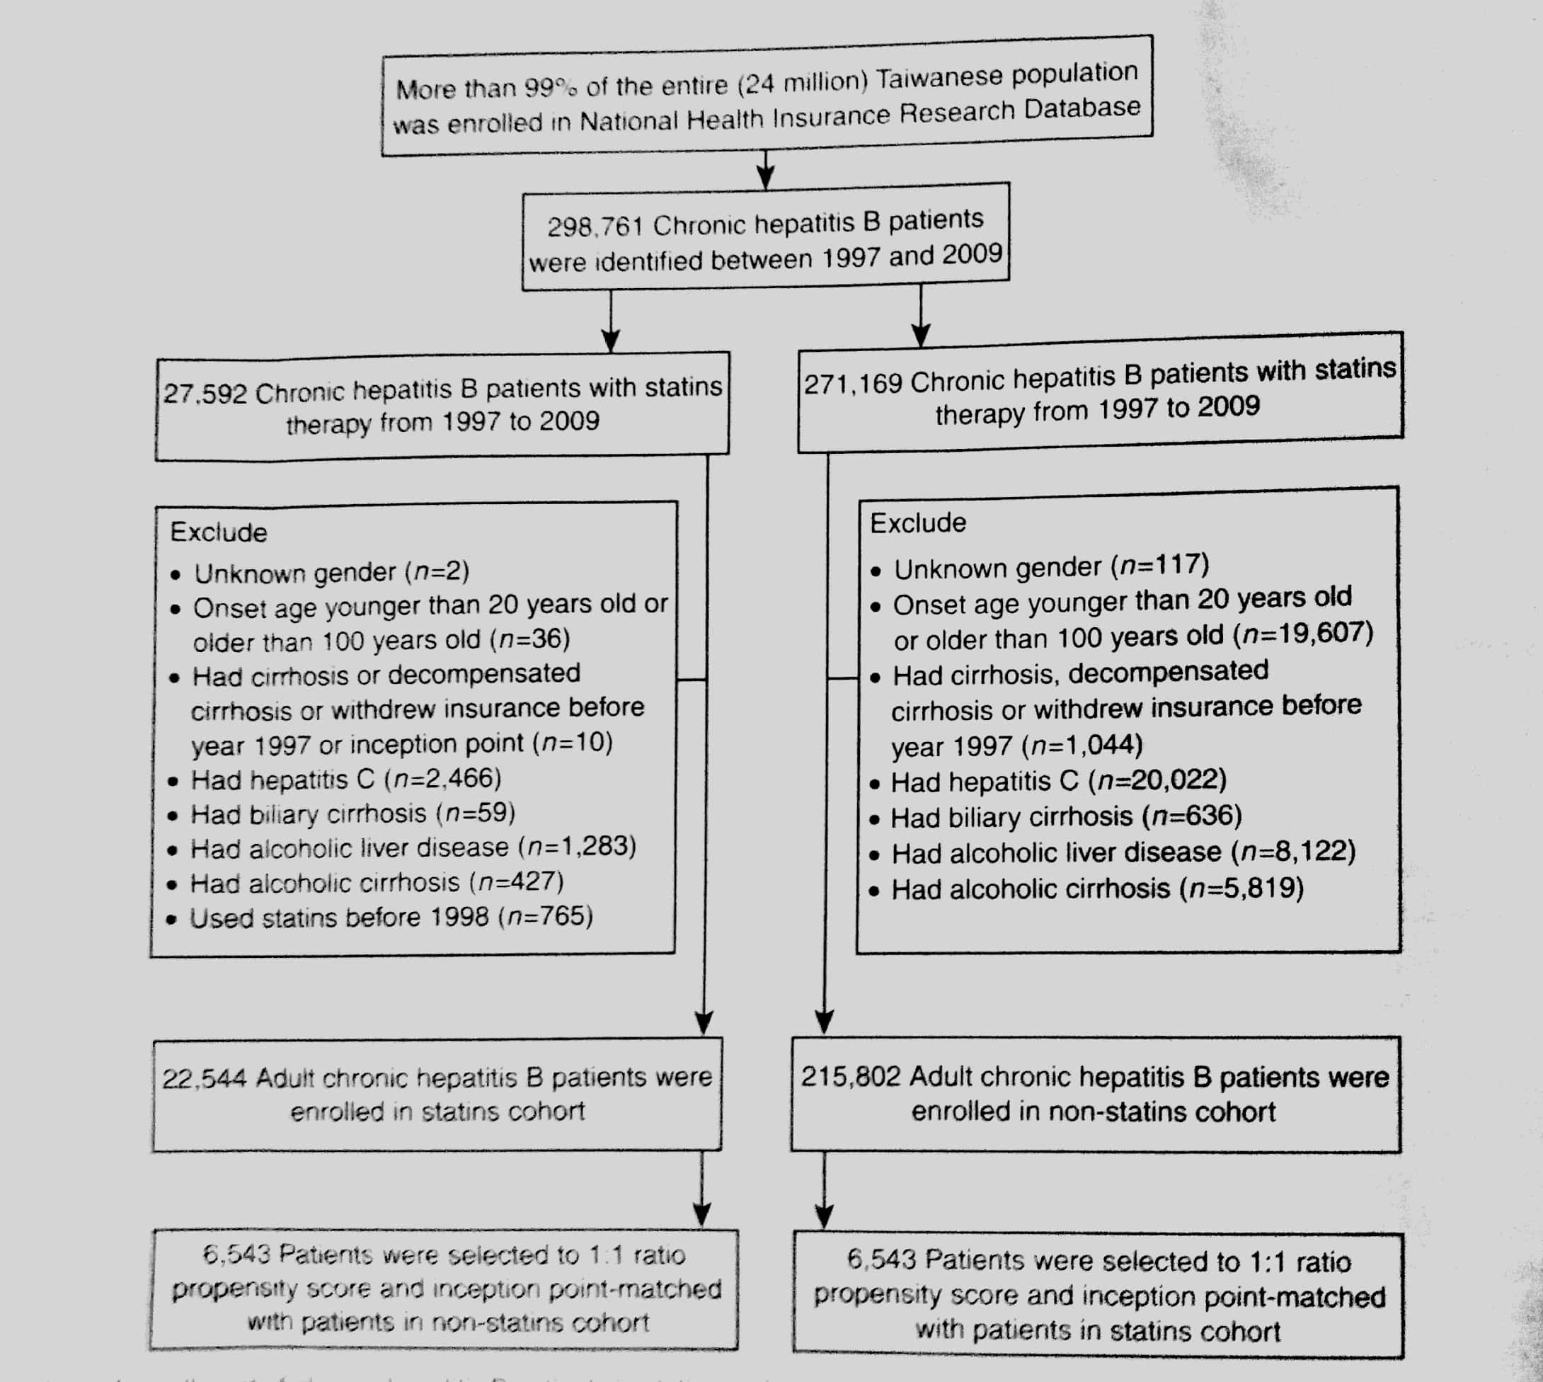

Slide 9
RESULTS
After the matching of the baseline characteristics between the two groups the cumulative incidence of cirrhosis and decompensated were calculated.
Some patients with cirrhosis and decompensated cirrhosis had concomitant HCC.
These Pts were also included in the analysis to show that the effects of statins in reducing the risks of cirrhosis and decompensated cirrhosis were independent of HCC.

Slide 10
CHB patients using statins had a significantly lower cumulative incidence of cirrhosis( relative risk = 0.433) and decompensated cirrhosis( relative risk=0.468) compared to the patients not using statins.
After the adjustment for age, gender, comorbidity index, hypertension, diabetes, hyperlipidemia, HCC, NAFLD, aspirin use,diabetes medication, CHB treatment, non statin lipid lowering drugs using the cox proportional hazard model, statins were still found to be an independent protector against cirrhosis (AHR=0.512) and its decompensation(AHR=0.534).

Slide 11
 | STATIN COHORT ( 30,818 PERSON YEARS OF FOLLOW UP) | NON STATIN COHORT (29,902 PERSON YEARS OF FOLLOW UP)
LIVER CIRRHOSIS | 173 patients (IR= 0.561 per 100 person years) | 400 patients ( IR= 1.138 per 100 person years)
DECOMPENSATED CIRRHOSIS | 59 patients (IR= 0.190 per 100 person years ) | 126 patients ( IR= 0.411per 100 years follow up)

Slide 12
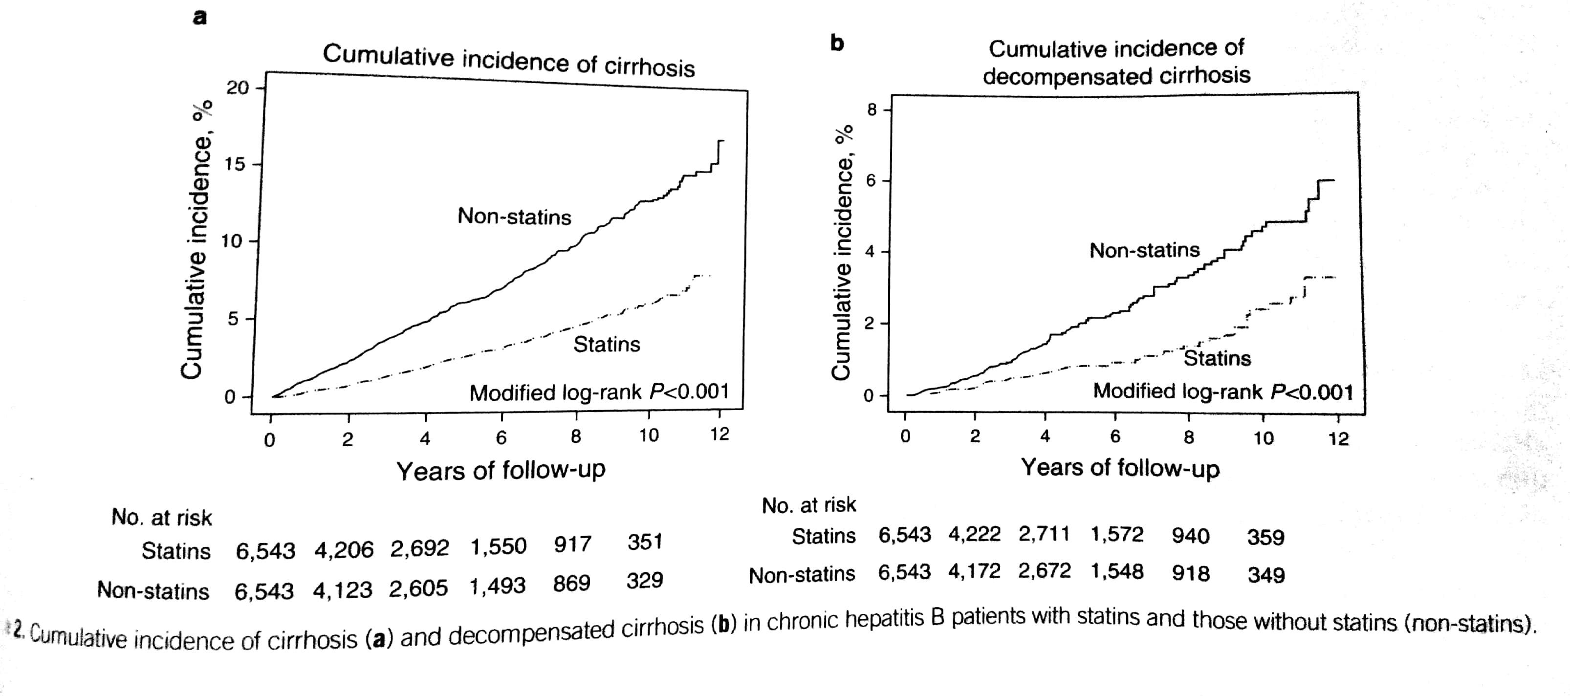

Slide 13
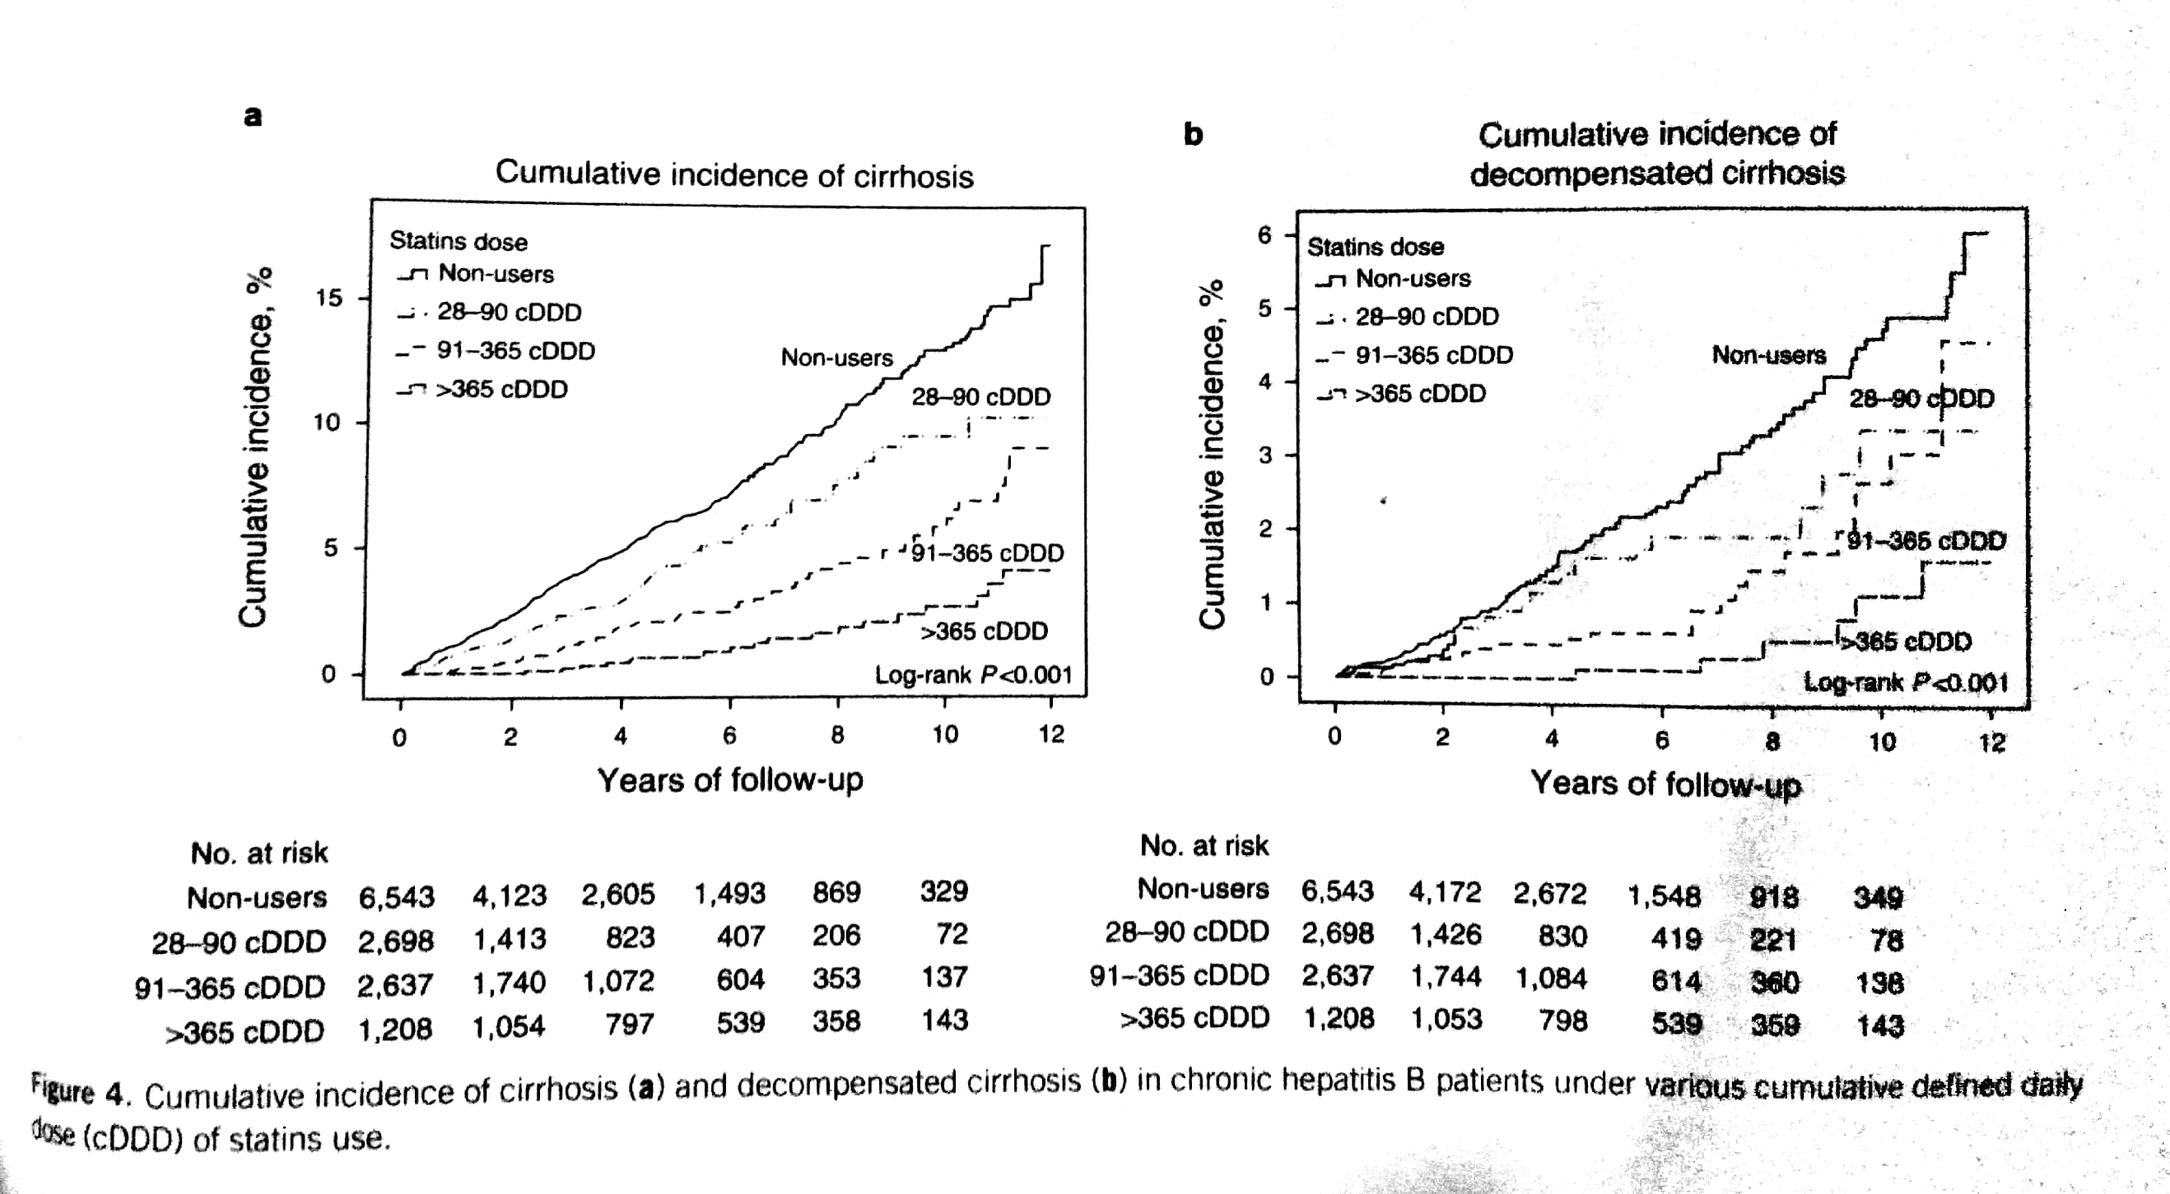

Slide 14
DISCUSSION
This large population based study in a hepatitis B virus endemic country suggested that statins independently protect CHB pts from development of cirrhosis and itsdecompensation.
The mechanism by which statins reduce the risk ofcirrhosis is not clearly understood.
They were thought to possess anti-HBV activity by blocking cholesterol synthesis and HBV replication.
Also Simvastatin decreased procollagen 1 and alpha smooth muscle actin which are involved in liver fibrosis.

Slide 15
Statins also inhibit the induction of connective tissue growth factor, which may stimulate the activation of hepatic stellate cells and fibrogenesis.
As the database included comprehensive data of all the patients with CHB in Taiwan with the inclusion of 13,086 CHB patients and upto 12 years of follow up, this study was able to illustrate the decreased risk of cirrhosis and its decompensation in pts using statins.
Additionally, inception point matching design with extensive adjustment of the confounders supported by the discovery of dose-response relationship strongly suggest the protective effect of statins.

Slide 16
Limitations:
All the patients identities were encrypted for privacy and data scrutiny,therefore they could not be contacted to discuss their use of statins.
Hence poor compliance may have occurred, and the study may have overestimated the actual dosage taken.
Several variables were not included in the database such as cholesterol level, TG levels, BMI, and the use of over the counter drugs.

Slide 17
THANK YOU.

