Slide 1
THROMBOLYTIC THERAPY

Slide 2
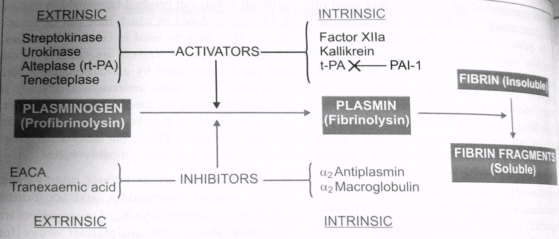

Slide 3
APPROACH TO STEMI

Slide 4
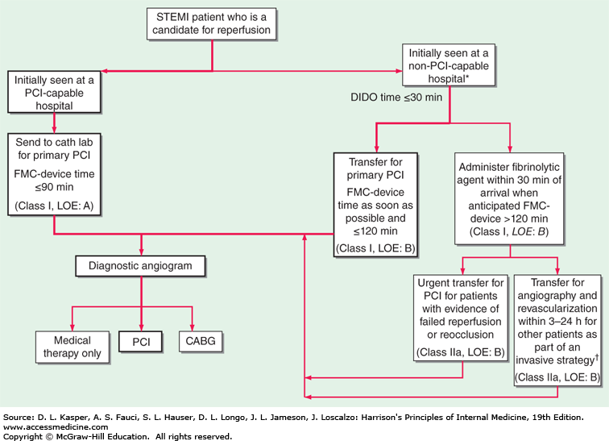

Slide 5
THROMBOLYTIC AGENTS (FIBRINOLYTICS)
Fibrinolytics are the drugs that activate plasminogen to form plasmin and thus help in the lysis of the thrombus.

Slide 6
NON-FIBRIN SPECIFIC
FIBRIN SPECIFIC
Streptokinase
Anistreplase
Urokinase
Tissue plasminogen activators (t-PA)
Alteplase
Reteplase
Tenecteplase

Slide 7
Streptokinase:
is obtained from beta-hemolytic streptococcus
It forms a complex with plasminogen and exposes its active site
It is antigenic (can cause anaphylaxis)
Least expensive
Anistreplase:
Combining streptokinase with Lys-plasminogen.
Single bolus infusion.
Antigenic
Urokinase:
Not antigenic.
Directly converts plasminogen to plasmin.
Can be used for catheter-directed lysis of thrombi
Availability is limited.
Recombinant tPA
Alteplase
Reteplase
Tenecteplase
Not antigenic
More efficacious
Costly
Tenecteplase is the longest acting
Tenecteplase and reteplase are bolus fibrinolytics as no iv infusion is required.

Slide 8
Indications
Acute myocardial infarction
Life-threatening pulmonary embolism
Deep venous thrombosis
Blocked catheters
Acute ischaemic stroke
Peripheral artery disease

Slide 9
Contraindications
ABSOLUTE | RELATIVE
Hitory of haemorrhagic stroke at any time | Current use of anticoagulants (INR > 2)
Non-haemorrhagic stroke within the past year | Recent ( > 2 weeks) invasive or surgical procedure)
Marked hypertension (systolic > 180 and/or diastolic > 110 mmHg) | Prolonged ( >10 min ) CPR
Suspicion of aortic disssection | Known bleeding diasthesis
Active intenal bleeding | pregnancy
 | Haemorrhagic ophthalmic condition
 | Active peptic ulcer disease
 | History of severe hypertension that is currently adequately controlled

Slide 10
Dosing
Streptokinase : 1.5 million IU in 100 ml NS
Tenecteplase : 0.5 mg/kg bolus
Reteplase : 10 U over 10 min and same dose repeated 30 min later

Slide 11
Thank you

